Slide 1


CHS - Summer Reading Challenge
Year 8
Your theme is ‘Change’
Log into Sora using the instructions provided.
Choose books that relate to your theme.
Complete the activities whilst reading selected books.
Prizes will be awarded for the best completed challenges and number of books read on Sora.
Enjoy!! Happy holidays!

Slide 2
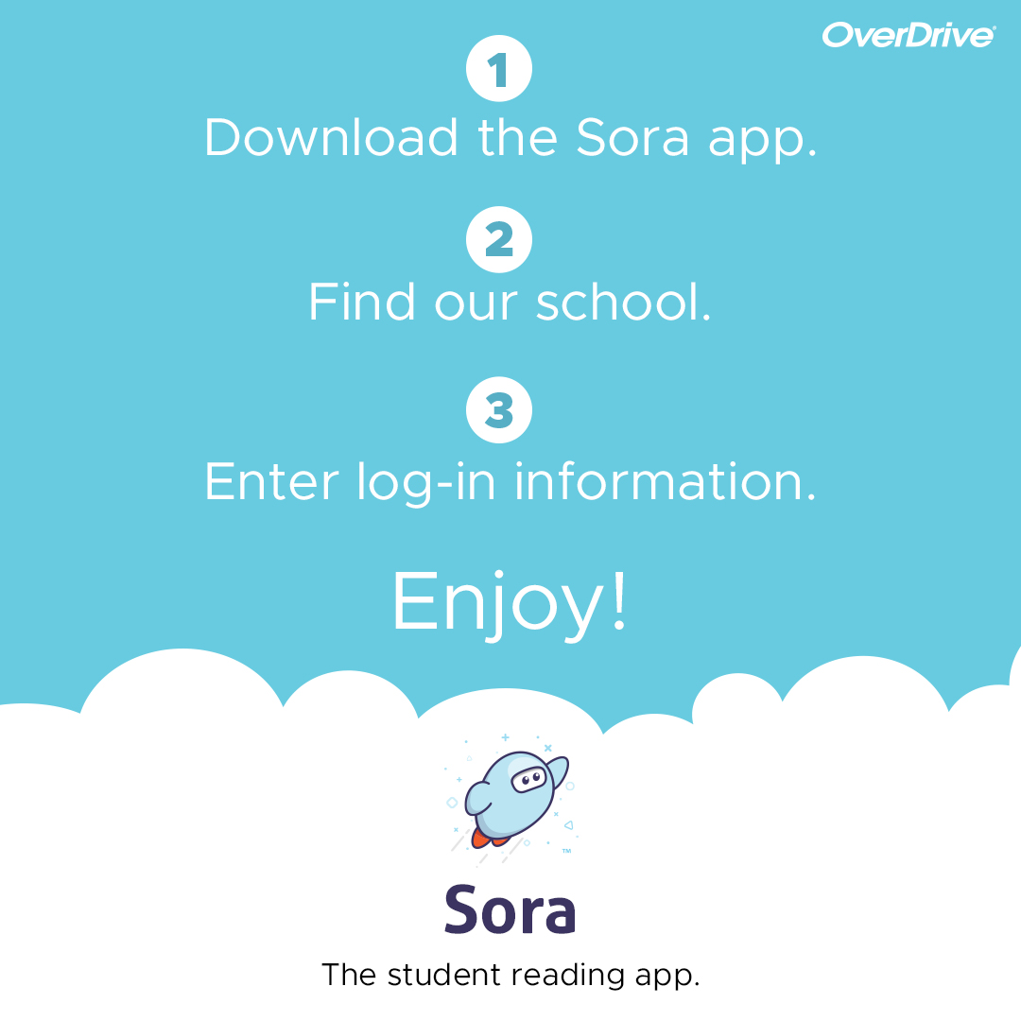
Log onto Sora
Download the app or Click on https://soraapp.com/welcome
Click on My School is Secondary eBooks Now
Select Crompton House Church of England School from the scroll down menu
User name – johnsmith18 (firstnamesurname + year started at CHS)
Password – ddmmyy students DOB in 6 digit format.
For a Sora user overview click here!
For any system related queries email learning-zone@cromptonhouse.org

Slide 3

Week 1
Core Task
Familiarize yourself with Sora and find any books related to your given theme of ‘Change’.
Make your own book collection including an audio book and save the titles on your book shelf within the Sora app.
Start to read!
Extension Task
Create a journal account about what you have found.

Slide 4

Week 2
Core Task
Continue to read books from your book shelf collection created in week 1.
Select one book and research the author.
Research the social and historical context of your chosen book too.
Extension
Create a biography about your author and the context in which the book was set. Your audience should be students in your year group.

Slide 5
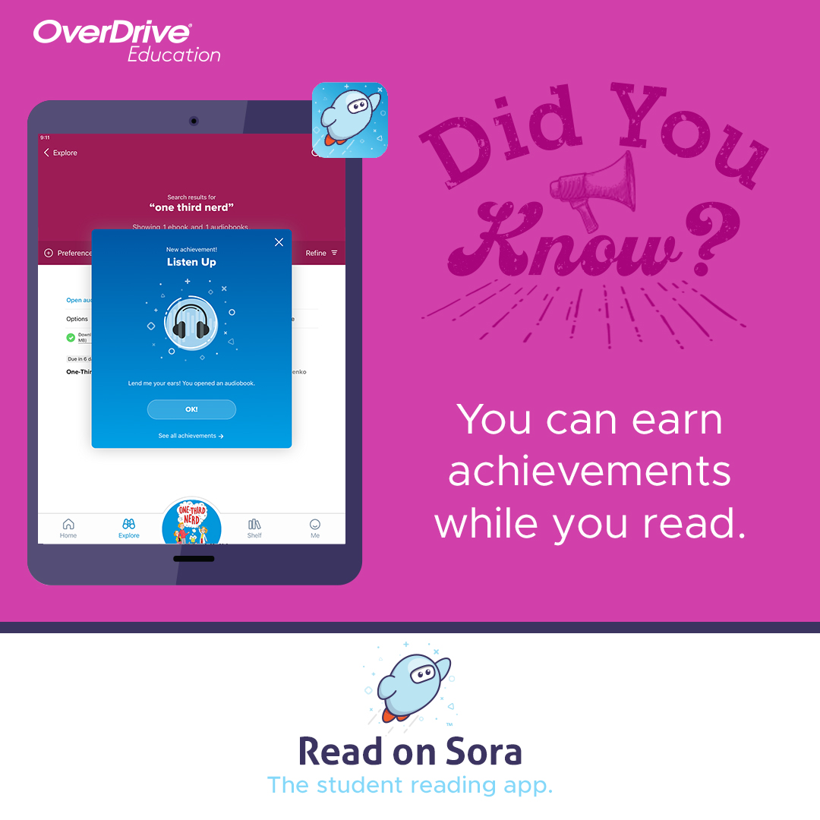
Week 3
Core Task
Keep reading!
Collect as many Sora achievement badges as you can! Such as ‘Reading Rockstar’ ‘Early Bird’ and ‘Captivated’!
Extension
Create a diary entry from the perspective of one of the characters from a chosen book. You must write in their style, using their own language.

Slide 6
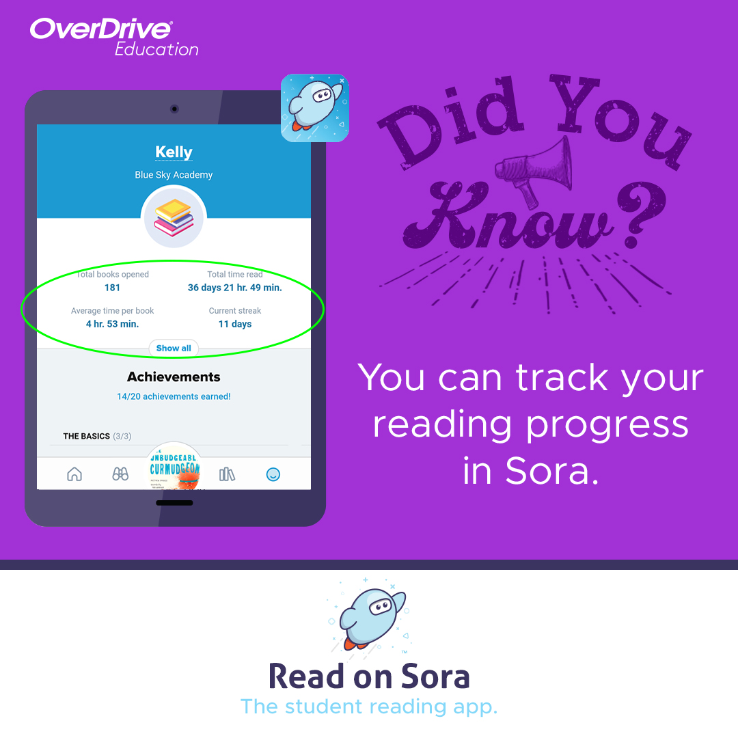
Week 4
Core Task
Keep Reading and finish your book!
Keep track of your reading progress in Sora, it’s great to see how much time you have spent reading.
Extension
Select another book from your bookshelf and read it!

Slide 7
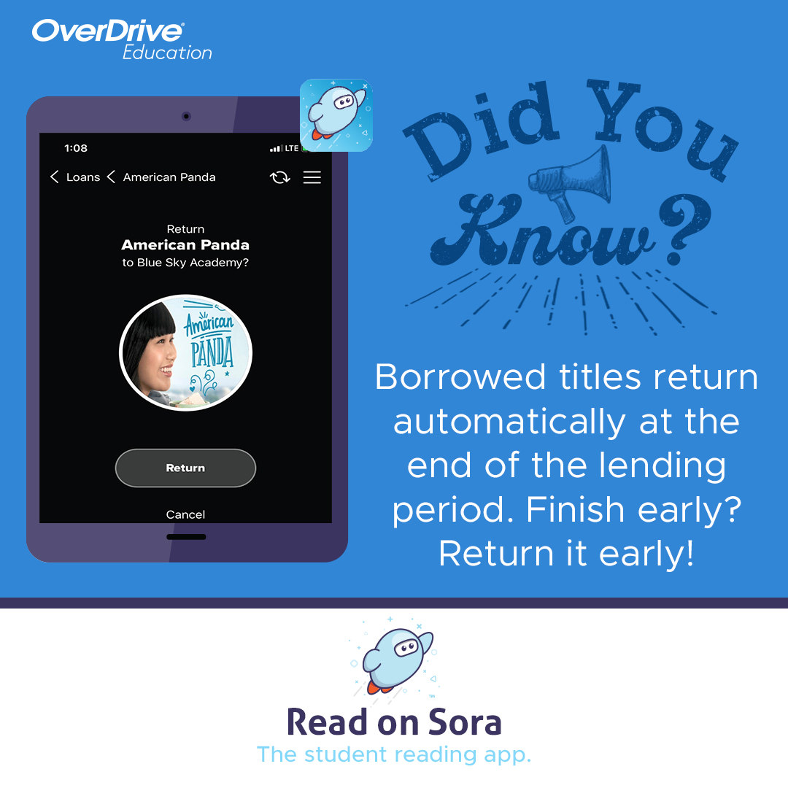
Week 5
Core Task
Create a review of one of your chosen books for students in your year group.
Extension
Re- read the ending of your book. Can you create an alternative ending?

Slide 8

Week 6
Core Task
Listen to the first few chapters of an audio book from your collection
Carry on reading as many books as you can and simply enjoy!!
Extension
Challenge yourself and finish your audio book before you start the new school year! See you soon!!

