Slide 1

Year 11 Parents Information Evening
Sept 2022

Slide 2
Grade 4+ English & Maths
81%
2022

Slide 3


Slide 4


Slide 5
How aware are you?
How many weeks are left before external exams start?
Have revision notes been started for all subjects?
Is there a revision file for each subject for revision notes and past questions?
What exam board and specification are your sons and daughters following for different subjects?
What is their target/MEG grade and what did they achieve in their last assessment?
What needs to be done in particular subjects in order to close the gap between their working at grade and target grade?
Are weekends and evenings balanced between school work and other activities?

Slide 6

GCSE exams start in Mid May. This means from next Monday there are 25 school weeks until the start of the summer exam season.

Slide 7



Mr Raynerd
Assistant Head
KS4
Sept 2022

Slide 8
Year 11 Upcoming Events
Year 11 Working Together Evening | 29th September 2022
Mock Exams – Set 1 | Week 1 17/10/22 - Week 2 31/10/22
Mock Results Day | TBC - November 2022
Parents Evening | 7th & 13th December 2022
Work Experience | w.c 12th December 2022
Revision Day at Norton Grange | 27th Jan 2023 – Provisional
Period 6 Revision | w.c 27th February 2023
Mock Set 2 | 2 weeks - w.c. 20th February 2023
Super Learning Schedule | 15th May 2023 - During GCSE Exams 2023
GCSE Exams | 15th May 2023
Valedictory | TBC
Prom | Wednesday 28th June 2023

Slide 9
Work Experience
Starts Week commencing 12th December.
Extended deadline for forms – October 14th

Slide 10
Revision Day – Norton Grange hotel.
Provided key revision techniques.
Provided equipment and resources to use for revision
GCSE timetable provided
Mindmaps
Post-it Notes
Flash Cards

Slide 11
Period 6 – February
Monday 2:40 – 3:40pm
Additional Hour for all Year 11
Targeted intervention
Compulsory for Y11

Slide 12
Super Learning Sessions
Support Sessions During the exam period – Super Learning Sessions
Students will officially leave school after their final exam. This is to ensure they are best prepared! There will be some study days as well as the super learning sessions.

Slide 13




Revision Resources
Doddle
GCSEpod
SENECA
Kaboodle

Slide 14
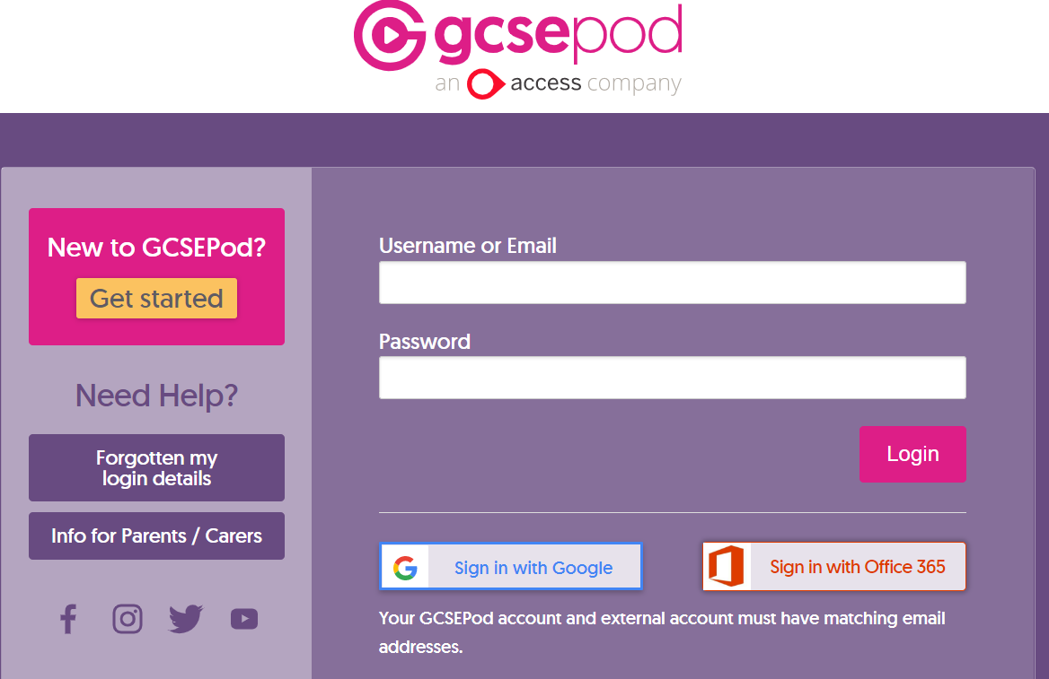

Slide 15

Prom & Valedictory
Prom is on Wednesday 28th June 2023
Saddleworth Hotel
Attendance at the prom and valedictory will be dependant on the positive report from all teachers based on behaviour and attitude to learning.

Slide 16

Post 16 Choices:
Scenario 1. You enjoy school, like learning, would like to go to University or get a Higher/Degree Apprenticeship = CHS Sixth Form to do 3 Academic Qualifications.
Scenario 2. You like learning, but perhaps in a more practical style = College – Hopwood Hall, Oldham College etc
Scenario 3. Would prefer to get started in the world of work = Level 3 apprenticeship.

Slide 17


Slide 18

Revision in English

Slide 19

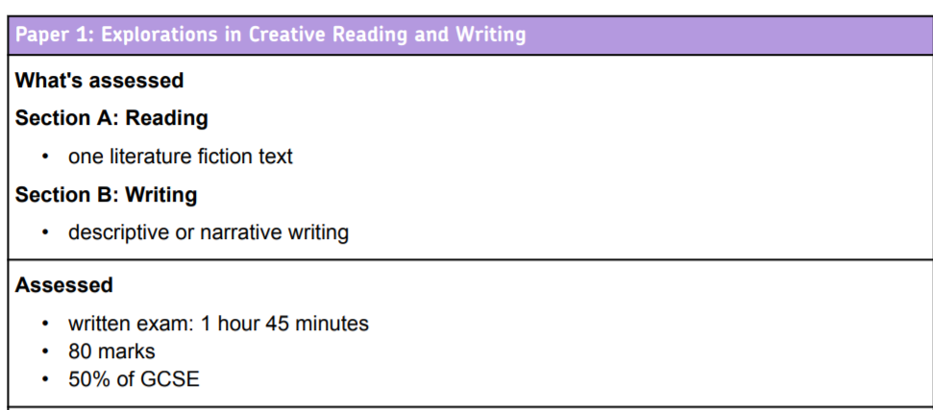

English Language
Read and understand a text.
Analyse a writer’s use of language.
Analyse a writer’s use of structure.
Explore a writer’s intentions and analyse their methods.
Use content and organisation in writing.
Use technical accuracy in writing.

Slide 20
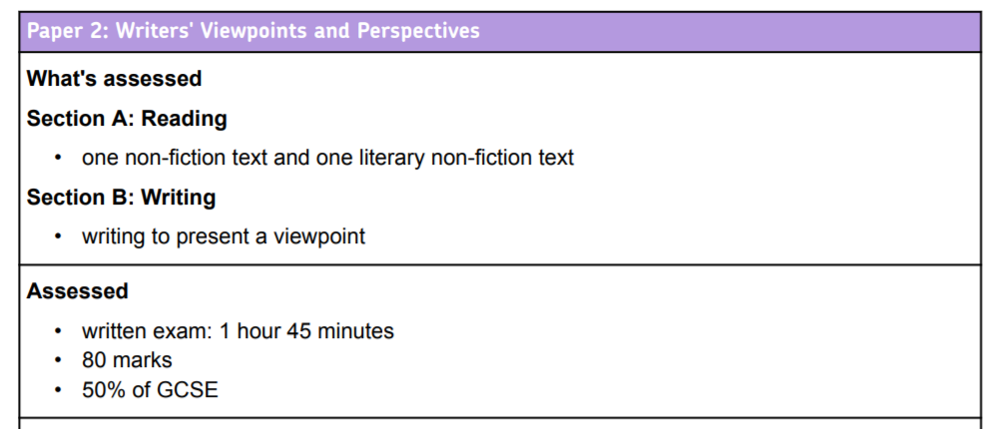
English Language
Read and understand a text.
Summarise and compare two texts.
Analyse a writer’s use of language.
Compare writers’ viewpoints and analyse their methods.
Use content and organisation in writing.
Use technical accuracy in writing.

Slide 21
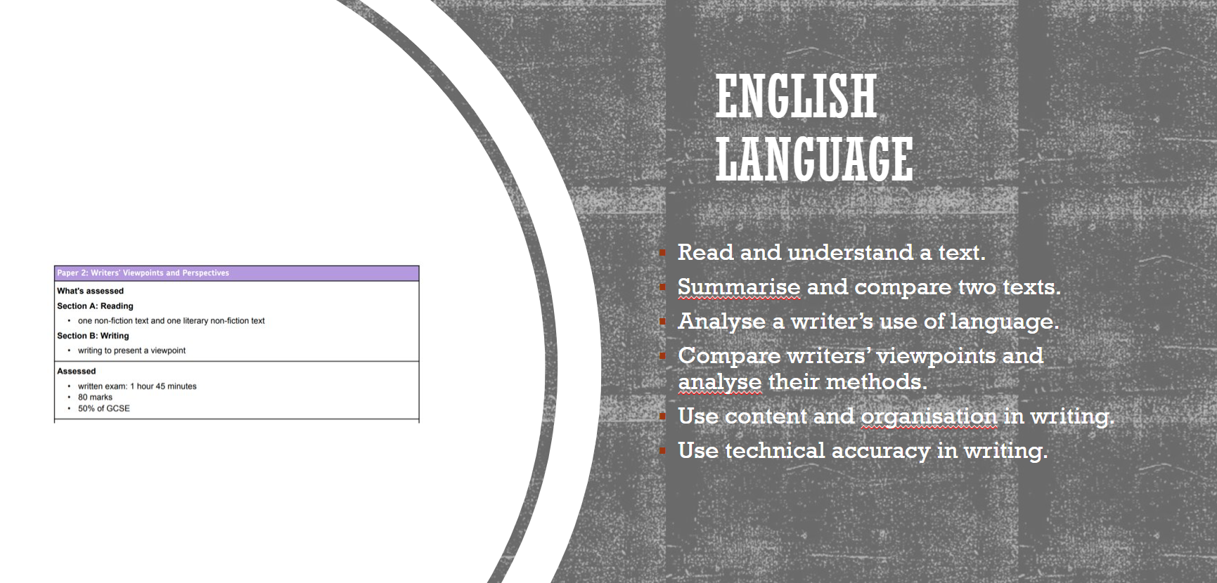
Autumn exam

Slide 22
Revising for English Language
The best revision for English Language is to practice past papers. All past papers have been allocated to all students on Doddle.
Read high quality fiction and non-fiction.
Pupils should use their PLCs to identify questions to work on.

Slide 23
English Literature
Paper 1 | Paper 2
Macbeth | An Inspector Calls
A Christmas Carol | Power and Conflict poetry
 | Unseen poetry

Slide 24

Texts studied
Shakespeare’s ‘Macbeth’
J.B. Priestley’s ‘An Inspector Calls’
Charles Dicken's 'A Christmas Carol.'
The AQA poetry anthology ‘Power and Conflict’ cluster of poems.
______________________________________________
Pupils need:
A strong knowledge of the whole text.
An awareness of the contexts in which the texts were created.

Slide 25
Revising for English Literature
The best revision for English Literature is to complete practice past papers. All past papers have been allocated to all students on Doddle.
Individual quizzes are also available on Doddle.
GCSE Pod has videos focusing on individual texts and skills.
Pupils have been given an in-house produced revision booklet for each text studied.
There is a wide variety of revision books available online. We recommend the ones produced by the publisher CGP
Students should use their PLCs to identify areas to work on.

Slide 26
Autumn exam
Macbeth
An Inspector Calls

Slide 27

Support
After school and Saturday sessions for invited students.
Holiday sessions for invited students.
Teams twilight sessions before mock and final exams.

Slide 28


Claire Borthwick
              c.borthwick@cromptonhouse.org
              ext 284

Slide 29
Success in Maths
Maths is a skills based subject
Reading through notes is ineffective
Practise, practise, practise

Slide 30
What does the maths exam look like?
Increased content
Less scaffolding in questions requiring more resilience and independence.
More problem solving and questions in context.

Slide 31
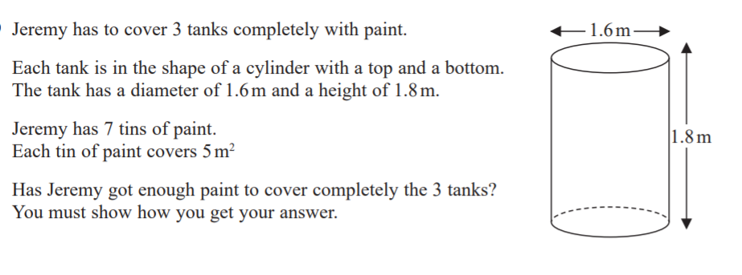
What do the questions look like?
Foundation June 2019, Paper 3

Slide 32
How are students examined?
Exam Board Pearson Edexcel
Two tiers of entry
Foundation 5-1 Higher 9-4
Three exam papers (1 hour 30 mins each):
Paper 1 Non Calculator
Paper 2 Calculator
Paper 3 Calculator

Slide 33
GCSE Mathematics:
Edexcel Average Grade Percentages
These boundaries are our best estimates based upon the previous results.
These are different every year.
 | 1 | 2 | 3 | 4 | 5 | 6 | 7 | 8 | 9
F % | 13 | 27 | 42 | 57 | 71
H % |  |  | 14 | 20 | 32 | 43 | 56 | 69 | 82

Slide 34
Resources to help you practise
Maths Genie: Free online support with all past papers, mark schemes, solutions and videos to help
https://www.mathsgenie.co.uk/
Corbettmaths
https://corbettmaths.com/
Pixi Maths
https://www.piximaths.co.uk/the-revision-zone
DrFrost
https://www.drfrostmaths.com/index.php
SPARX Homework platform

Slide 35
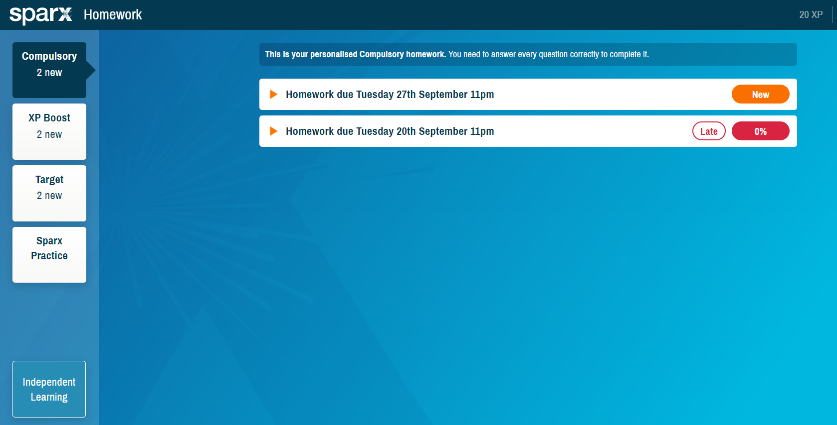
SPARX

Slide 36
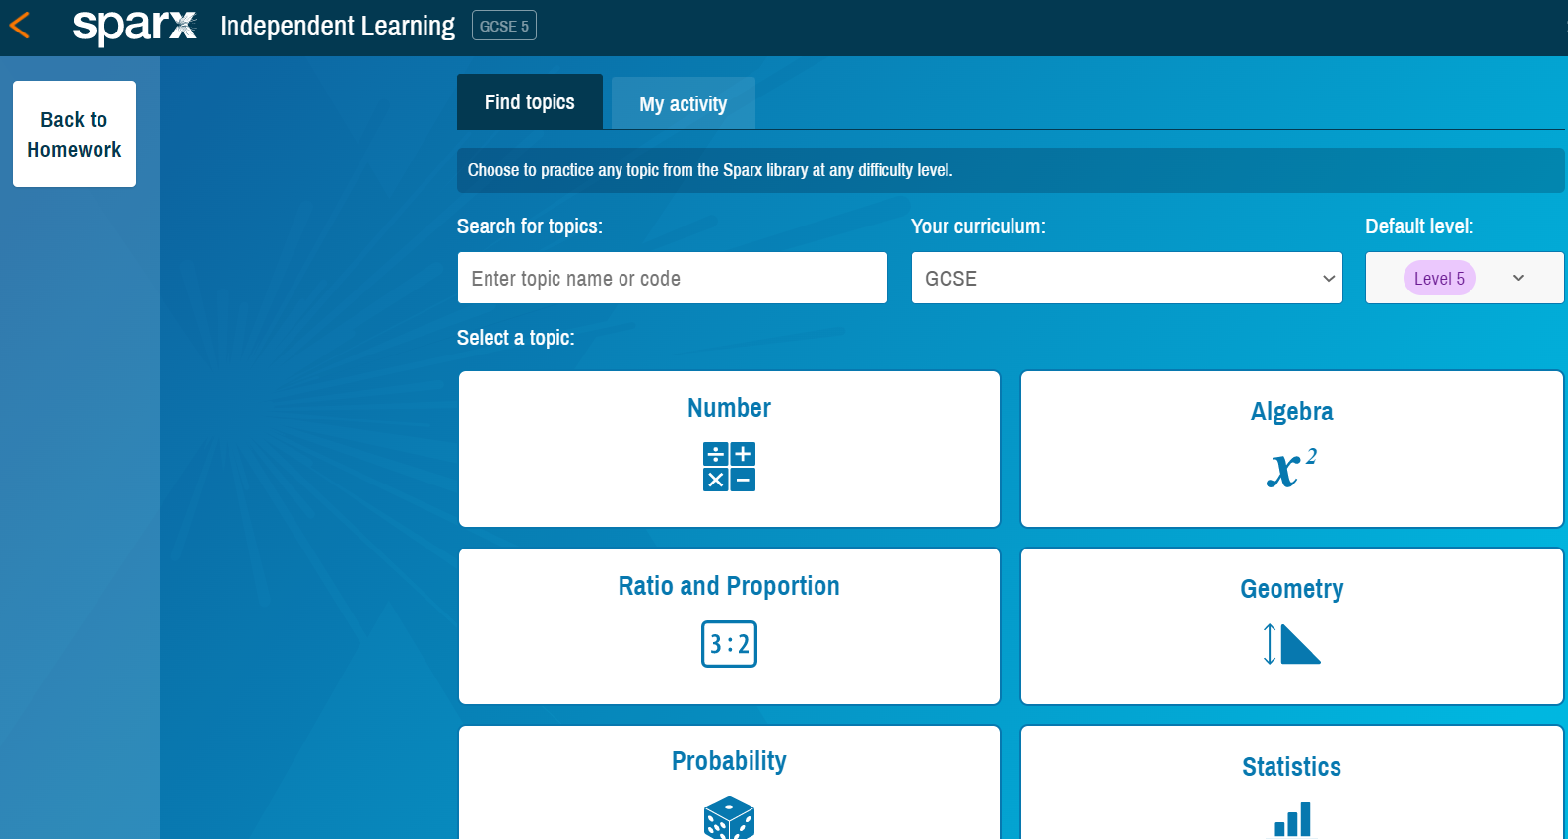

Slide 37

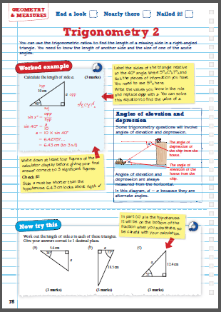
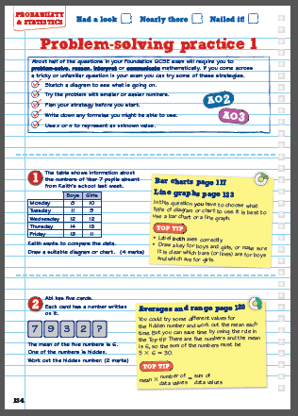
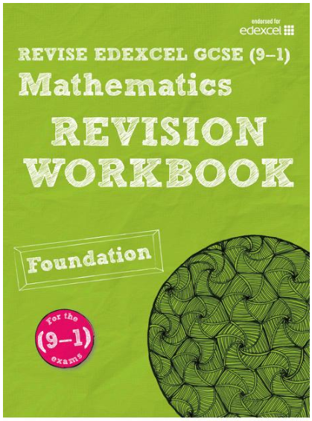

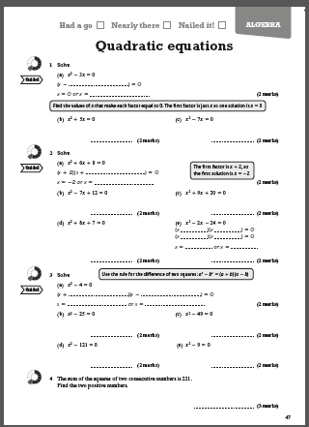
Revision Guides and Workbooks
Order online:
Pearson publications are recommended.

Slide 38

Science
GCSE

Slide 39
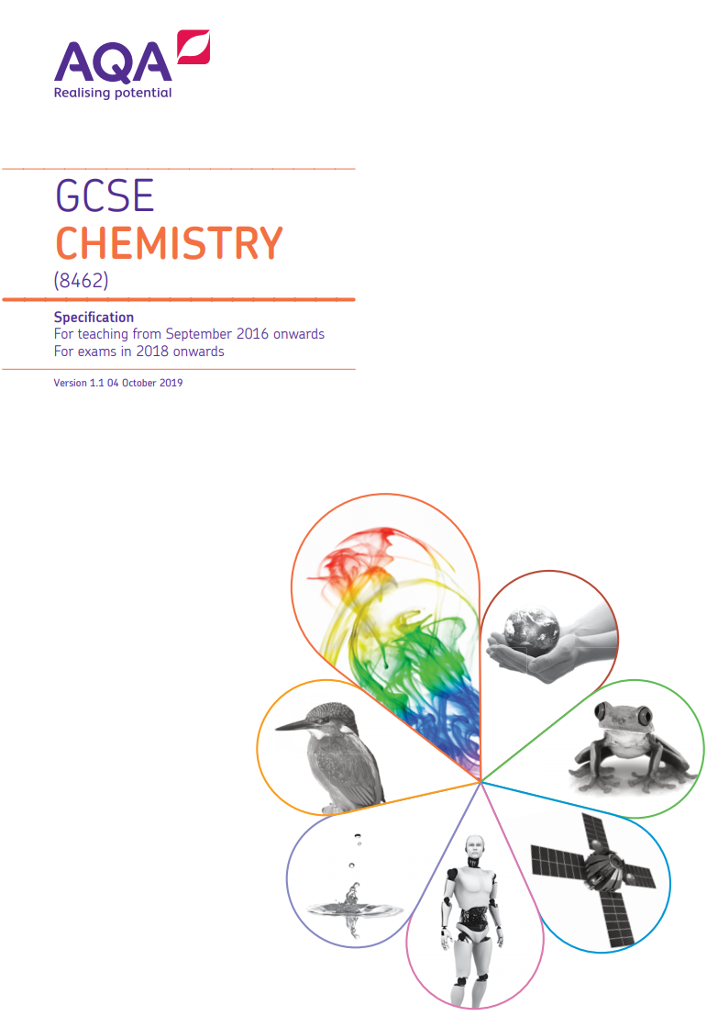


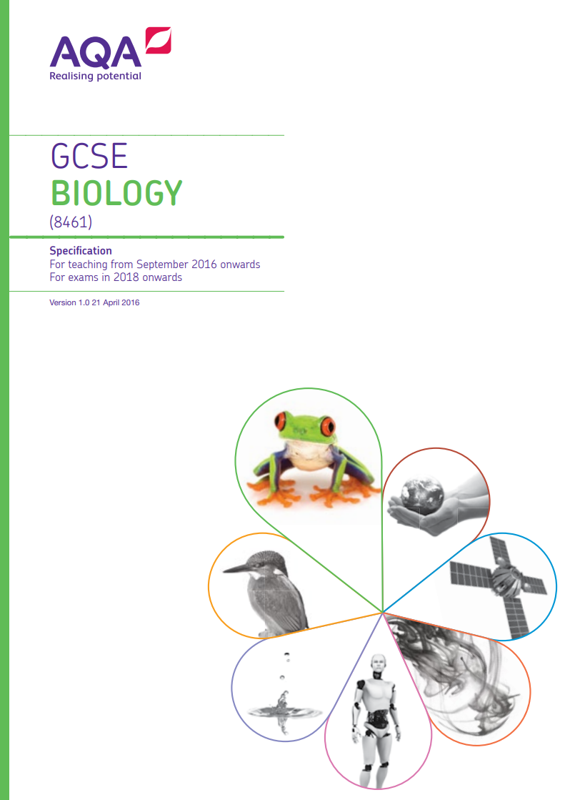

Slide 40
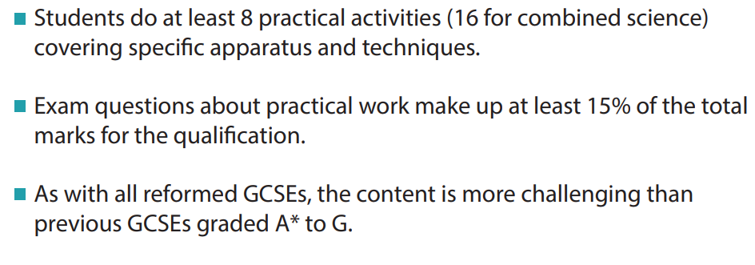

Slide 41
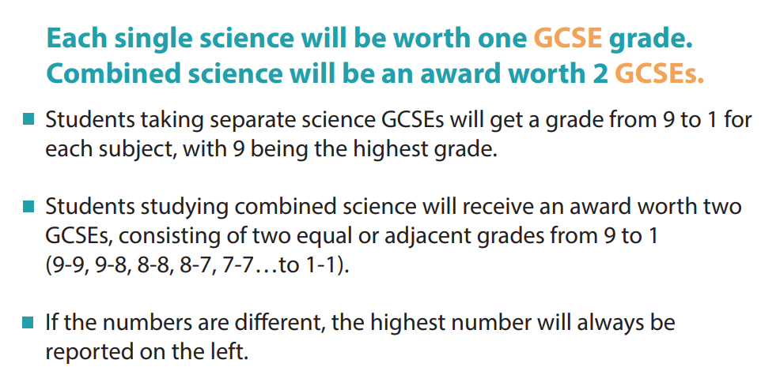

Slide 42
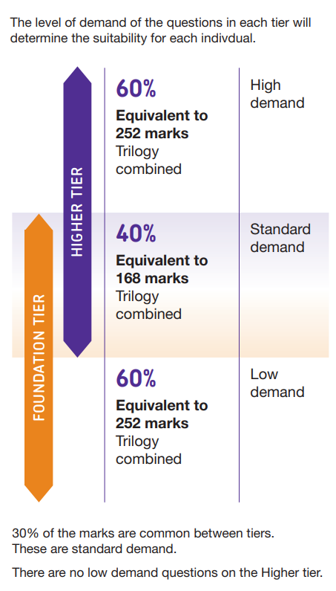


Slide 43
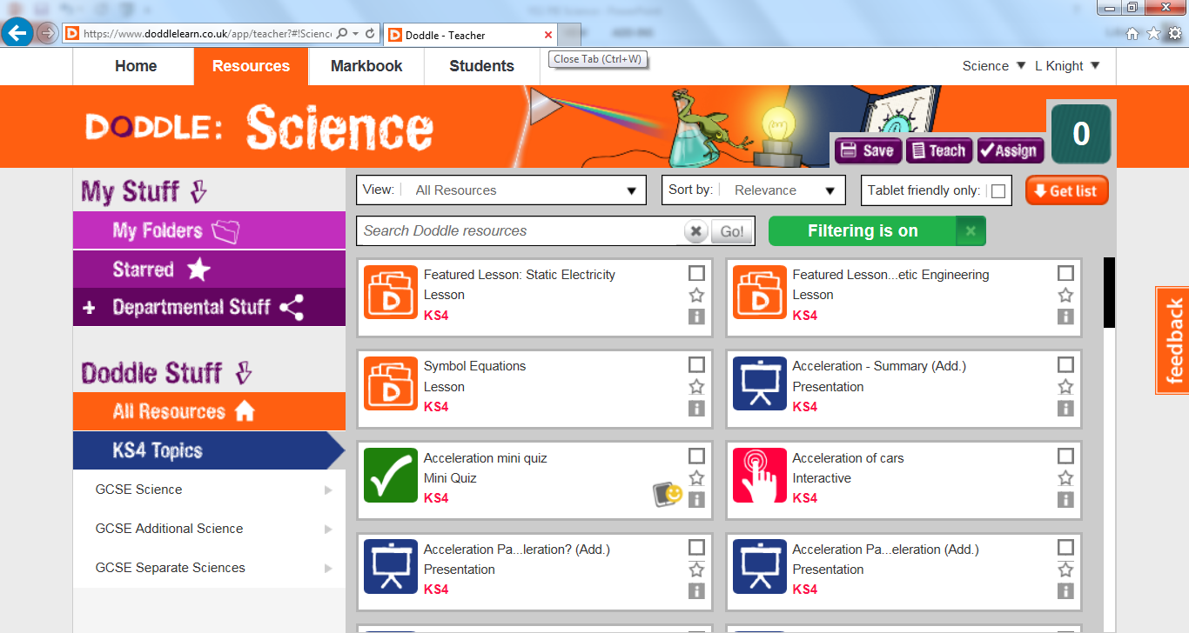

Slide 44
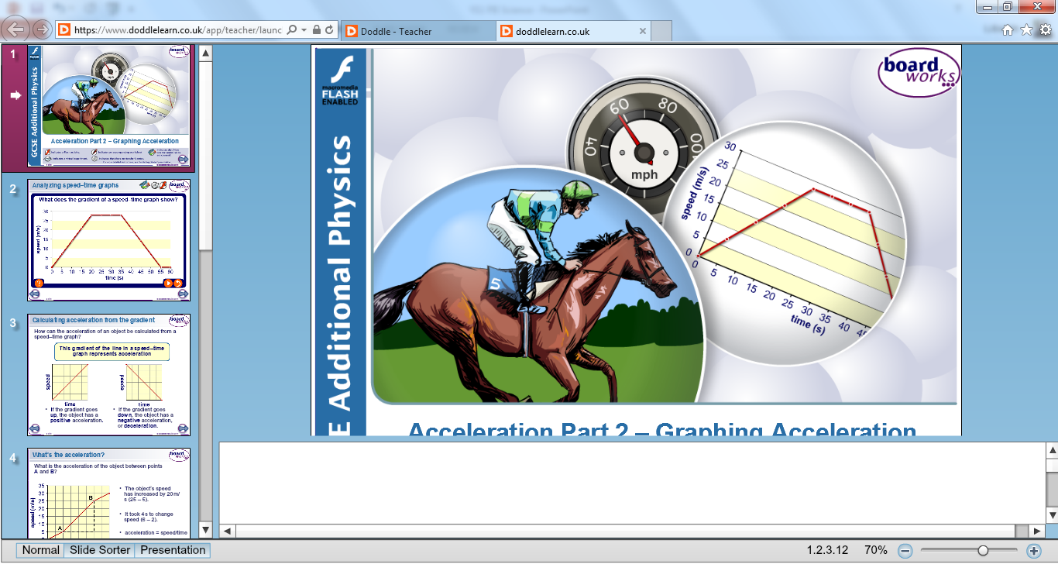

Slide 45
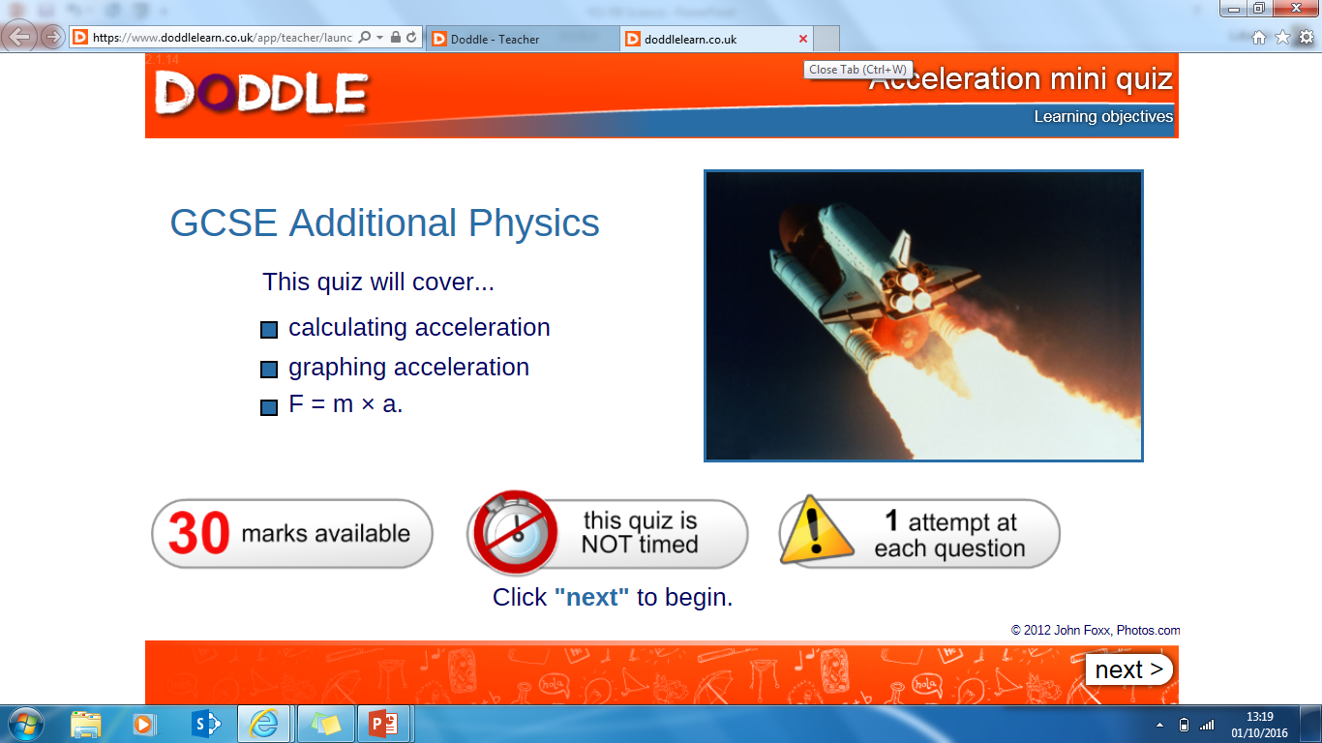

Slide 46
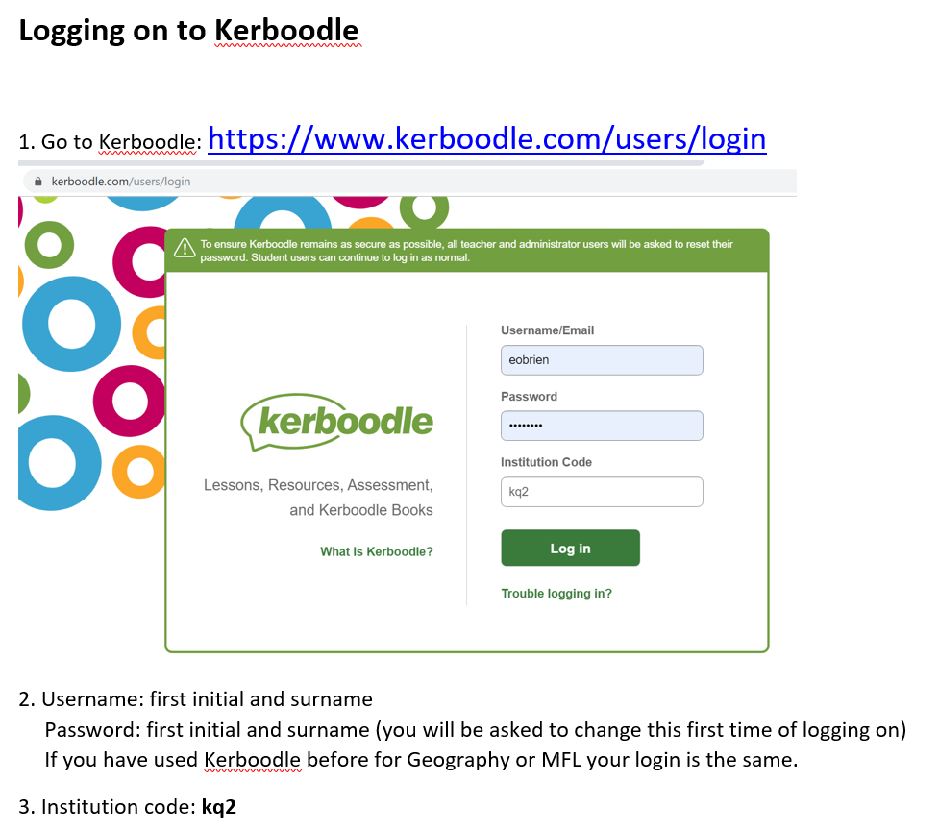

Slide 47
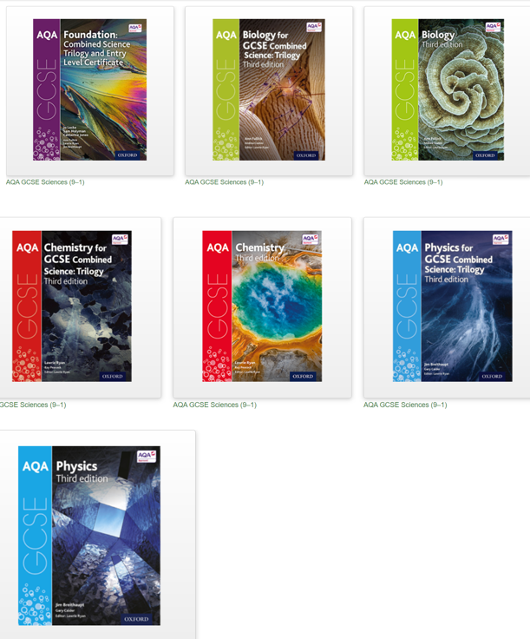
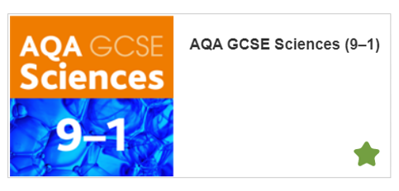
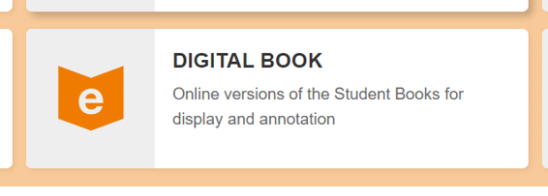

Slide 48
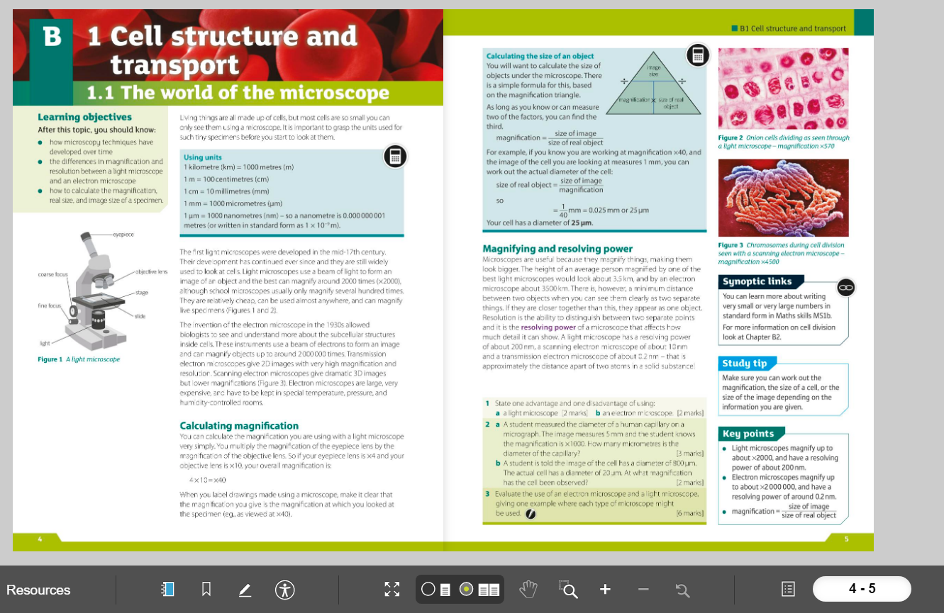

Slide 49
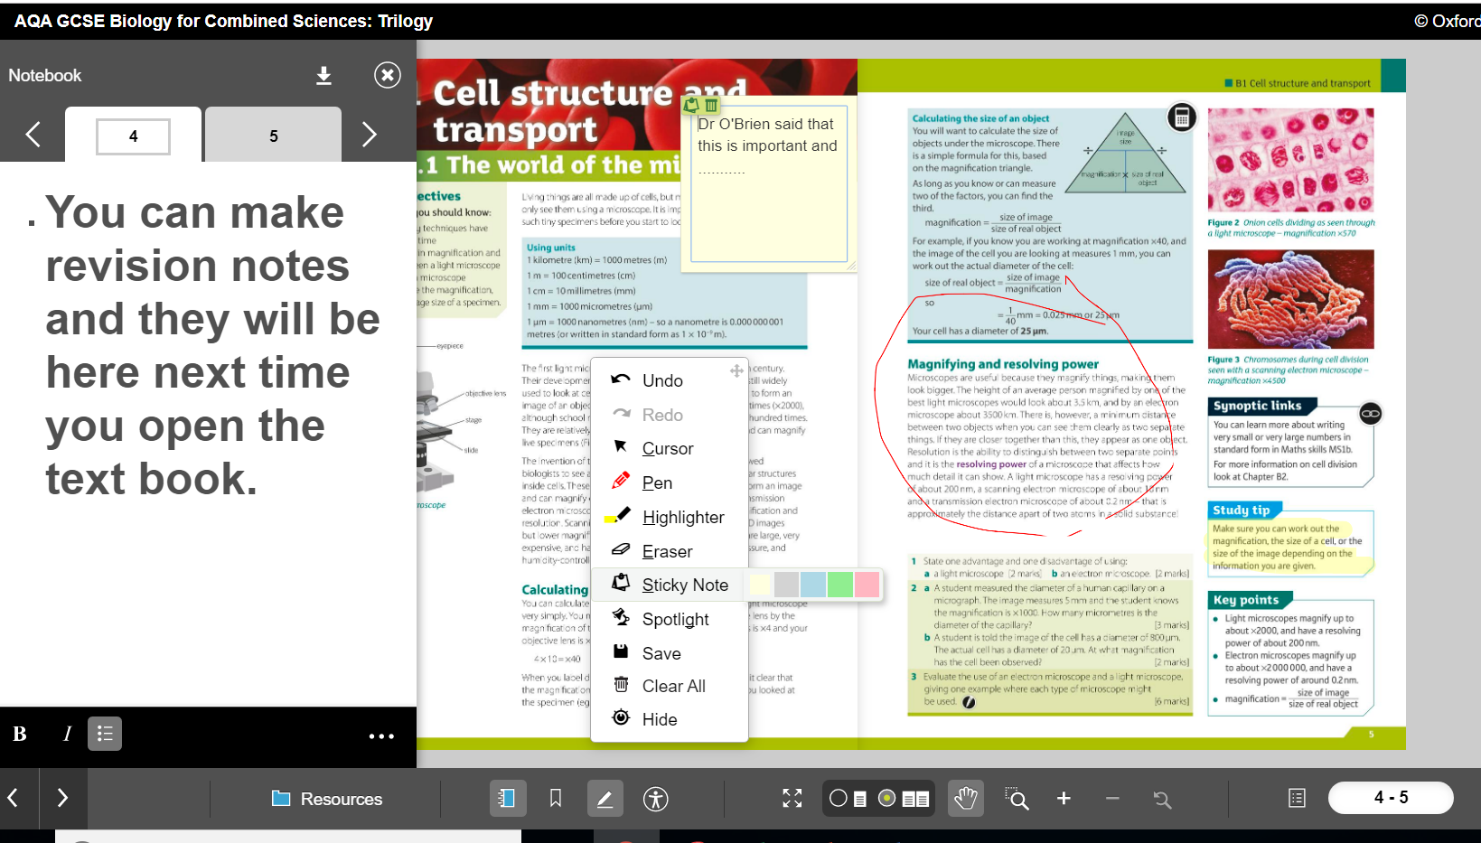

Slide 50
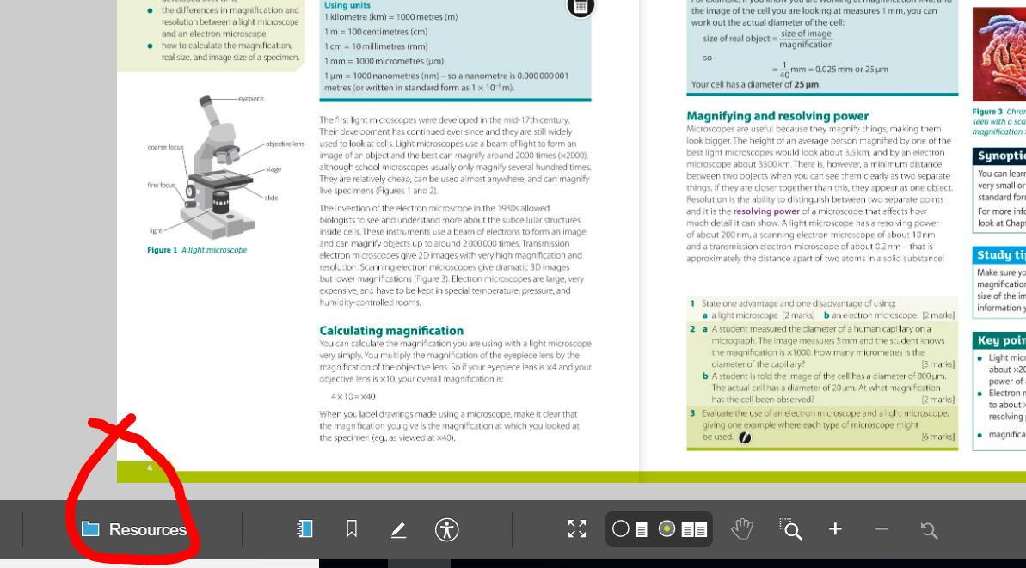

Slide 51
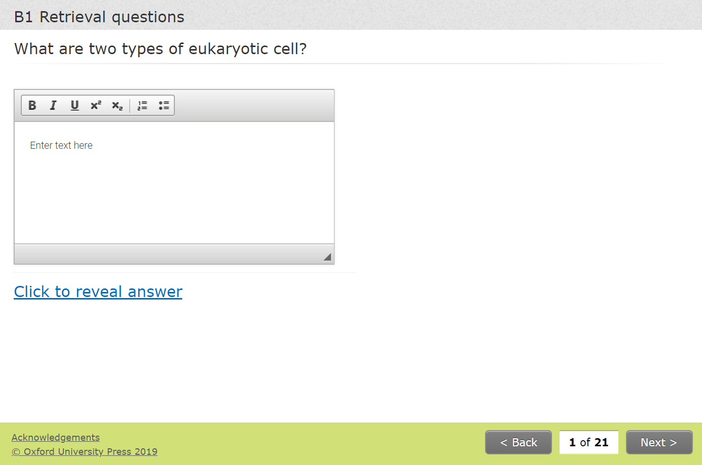

Slide 52
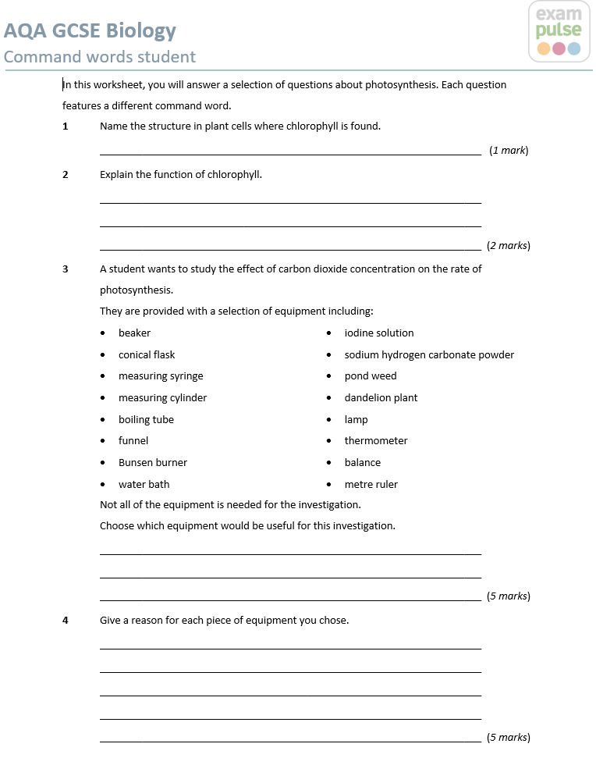
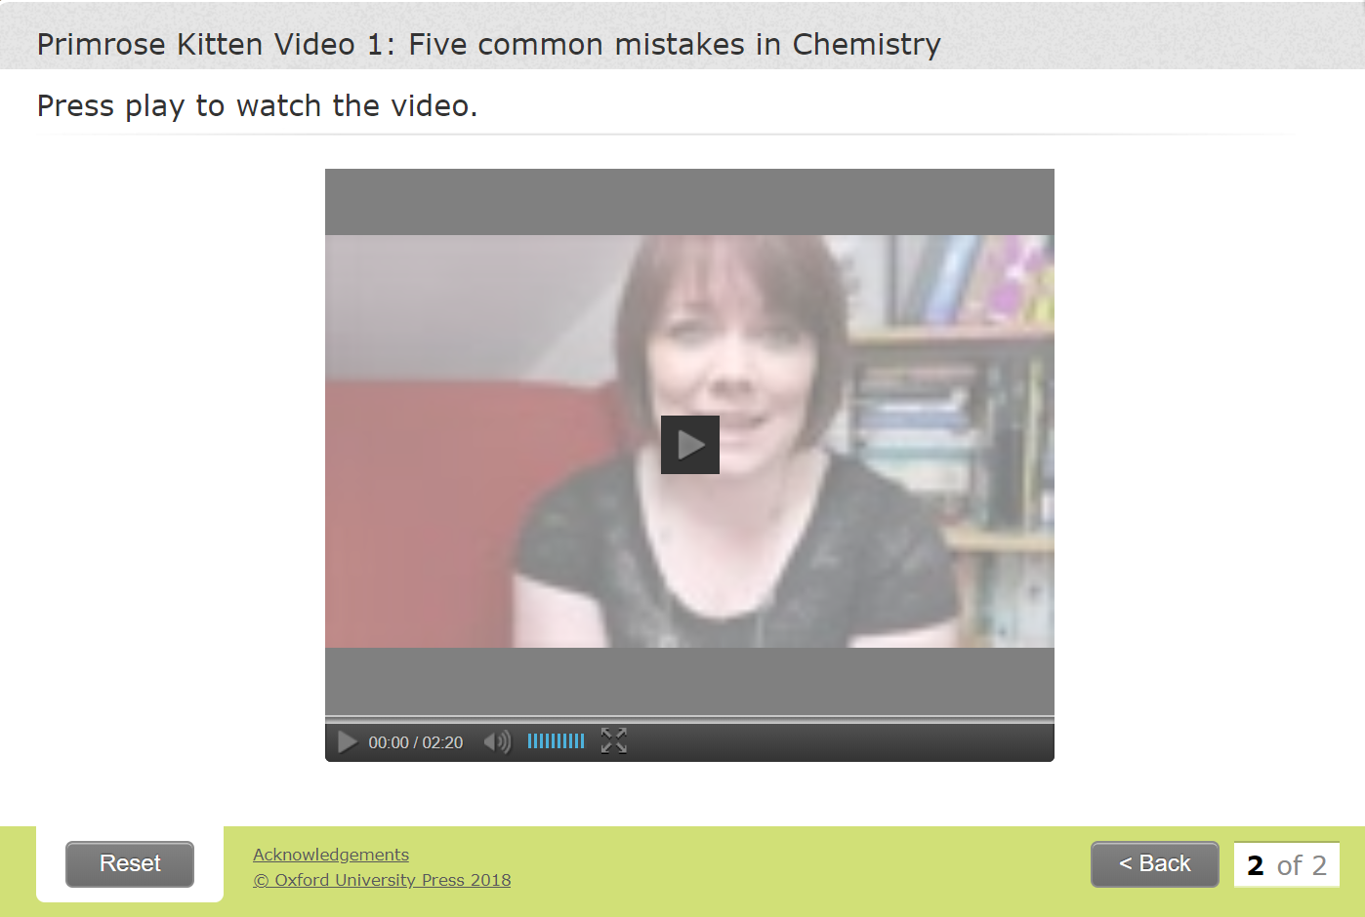

Slide 53

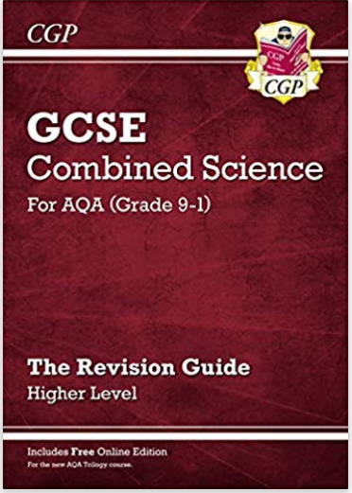
Use your revision guide too

Slide 54
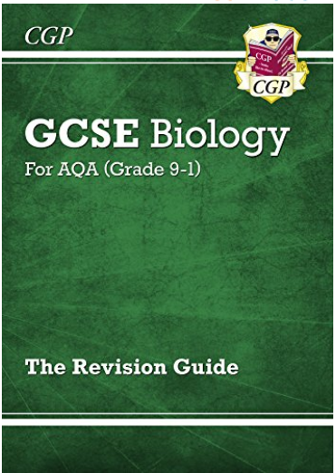
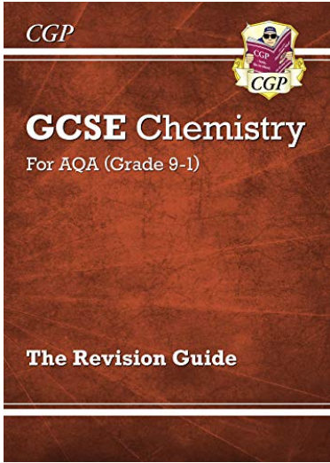


Slide 55


Slide 56
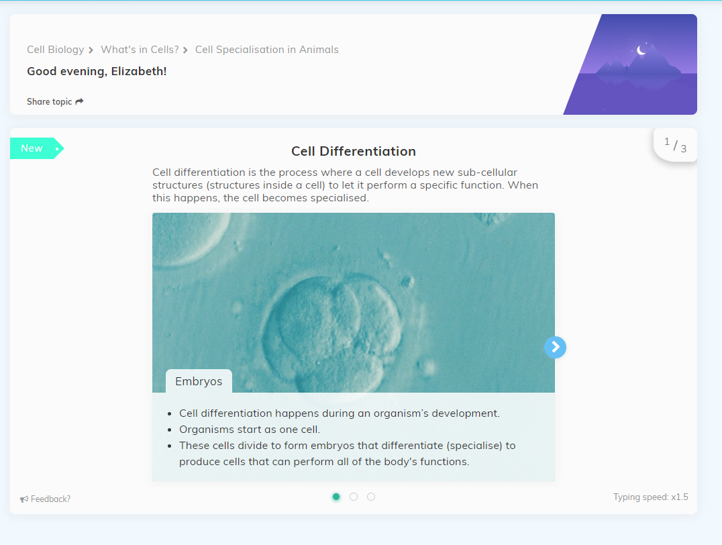

Slide 57
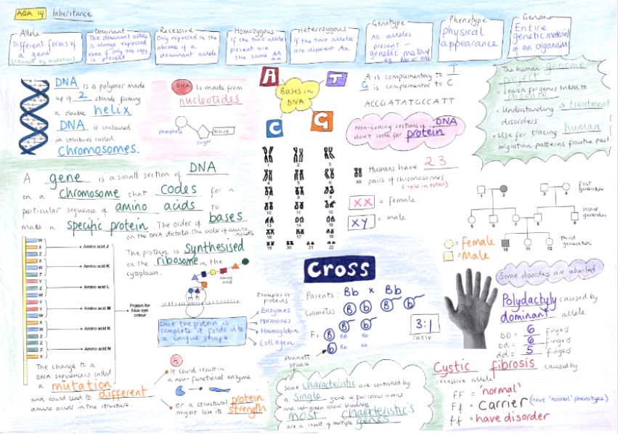

Slide 58
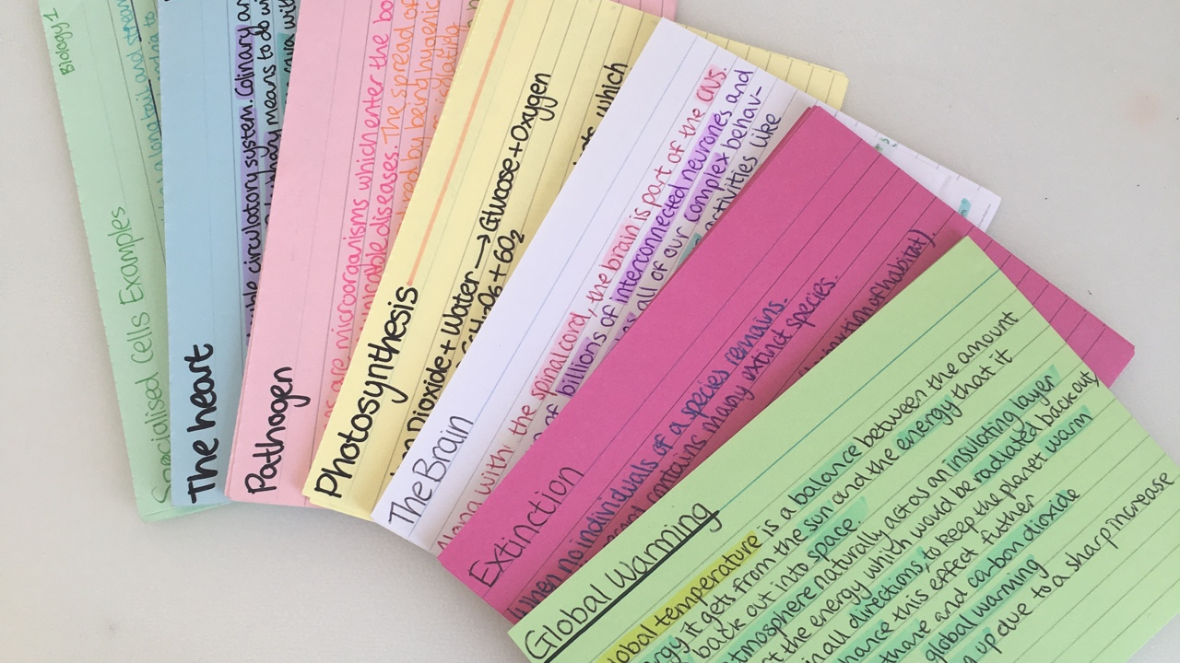

Slide 59
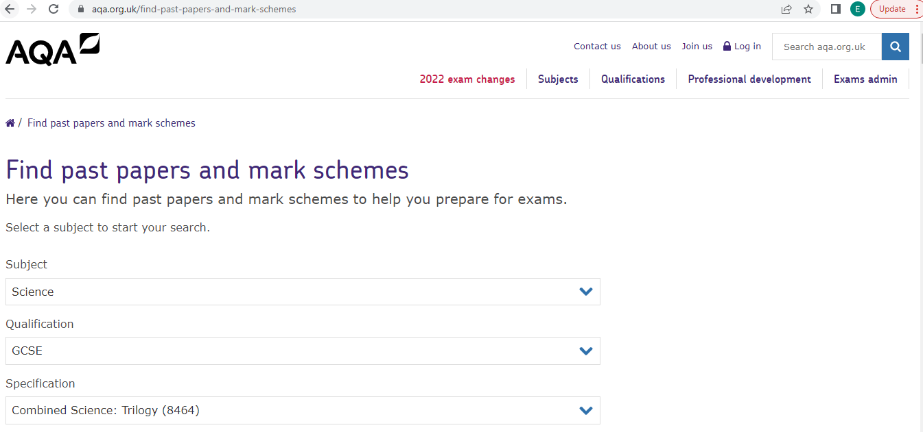

Slide 60
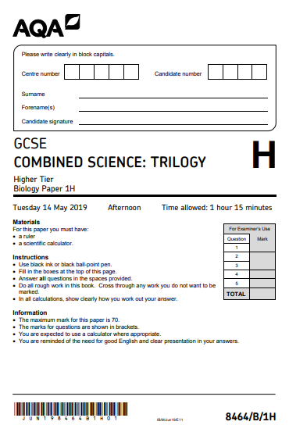
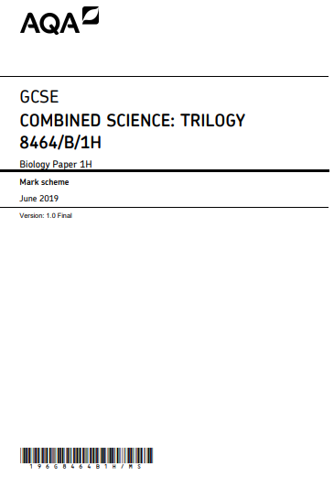

Slide 61

Successful learning

Slide 62
IT IS ALL ABOUT OUR LEARNING PARTNERSHIP!!!!...
STUDENT
MENTORING
TALKING / DODDLE
HIGH QUALITY COMMUNICATION
FAMILY
(PARENTS/ CARERS)
TEACHERS
EMAILS / PHONE /REPORTS/ PARENTS EVENINGS

Slide 63

“The world is THEIR oyster”
College
Sixth form
Apprenticeship
UNIVERSITY
WORK

Slide 64
Organisation e.g. having a file for each subject ready for revision notes and past questions?
What exam boards and specifications your daughter / son is following for different subjects?
What is their minimum expected target grade and what is their working at grade?
What needs to be done in particular subjects in order to close the gap between their working at grade and target grade?
Are weekends and evenings balanced between school work and other activities?
Are you (both you & your child) aware of?

Slide 65
support / Intervention
Mentoring by form tutors.
Personal Learning Checklists
- to identify areas for improvement leading to small group
or even 1 to 1 support from staff (where necessary).
After school / lunch time revision.
Catch up clubs.
Easter Revision
Small Group Mentoring
Maths and English extra support
Study Skills assemblies
Home Learning Area (Study zone)
Study skills day
Careers advice
Grade Boosters
How we support your child

Slide 66
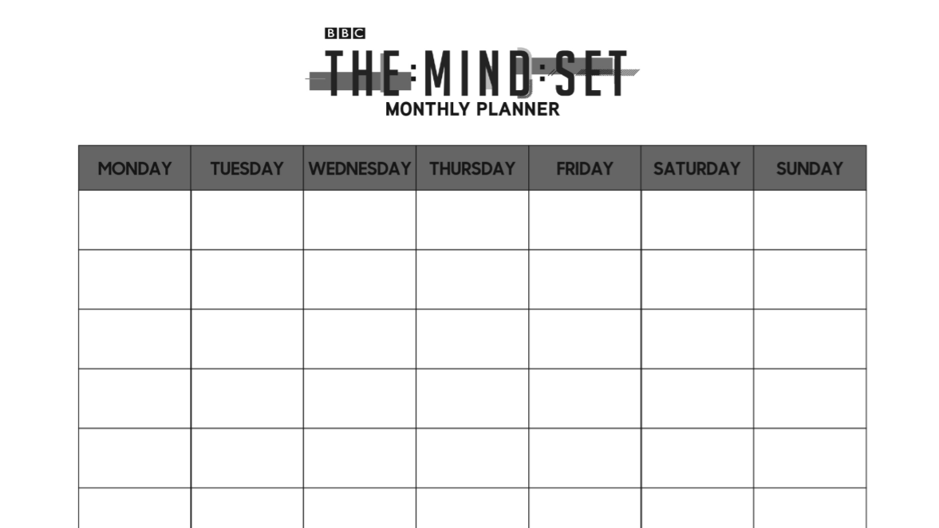
Revision timetable
All students will be completing a revision schedule during their study skills day in January 2022.

Slide 67


How to revise effectively

Slide 68
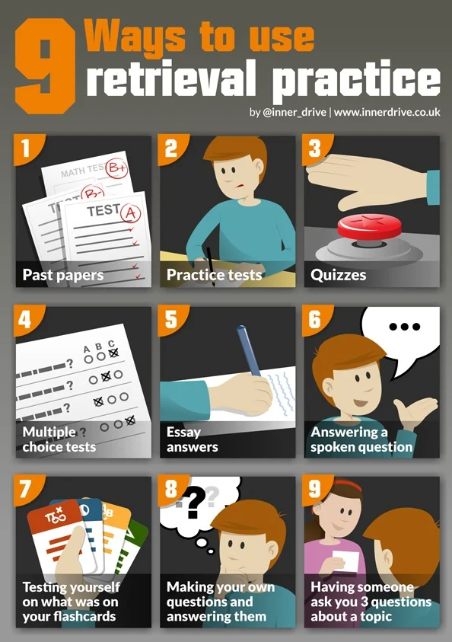
Retrieval Practice
Also known as the testing effect
Strategy which requires students to generate an answer to a question.
Most effective revision strategies

Slide 69
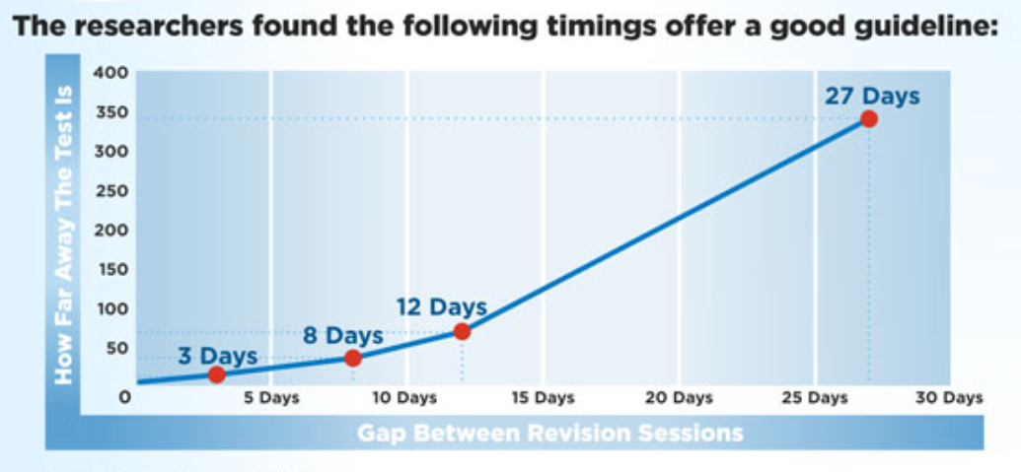
spacing
Learning a little information regularly
10% to 30% difference in final test results
Forget previously learnt information
More likely to be transferred to their long-term memory.

Slide 70

A good learning partner
Choose a study partner for the right reasons
If the person next to you is working hard, it is likely that you will follow and increase your work ethic
If students are able to work together they are more likely to experiment with different techniques and learn faster from positive and negative feedback.

Slide 71

revision ideas

Slide 72
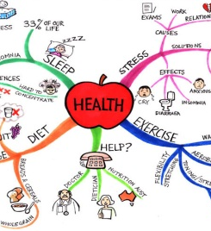
mind maps
Start with a central theme and organise the information from it, grouped into subtopics. Label the branches with the relationships.
To summarise a whole topic after revising it in detail. Only put in the key words, everything else should come to mind when you read it.

Slide 73

Read-cover-Recall-Check
Read the information you want to remember. Cover it up, write out what you remember. Check to see how much you forgot.
Use it to test yourself on; Spellings, Lists, A sequence of simple events

Slide 74

Past Exam questions and analysis
Complete some past exam questions. Mark your answers. Fill in the answers you missed. Go through the paper and colour code each topic (Red-need to revise, Amber-Need to go over a few bits again, Green-I’ve got it)
Use it to test your ability to; recall the information you have revised, to answer the question asked, not just write down everything you know, to follow the command words in an exam.

Slide 75
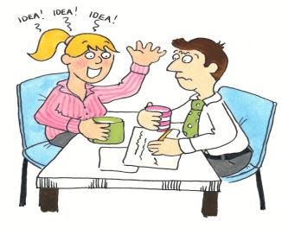
Describe or explain a process/scenario to someone else.
Describe or explain a process/scenario to someone who does not know it or a classmate.
They can ask questions to fill in any gaps you missed and if they are also revising it may help them understand the work better.
Use it when; Explaining a series of events or a process that has some detail

Slide 76
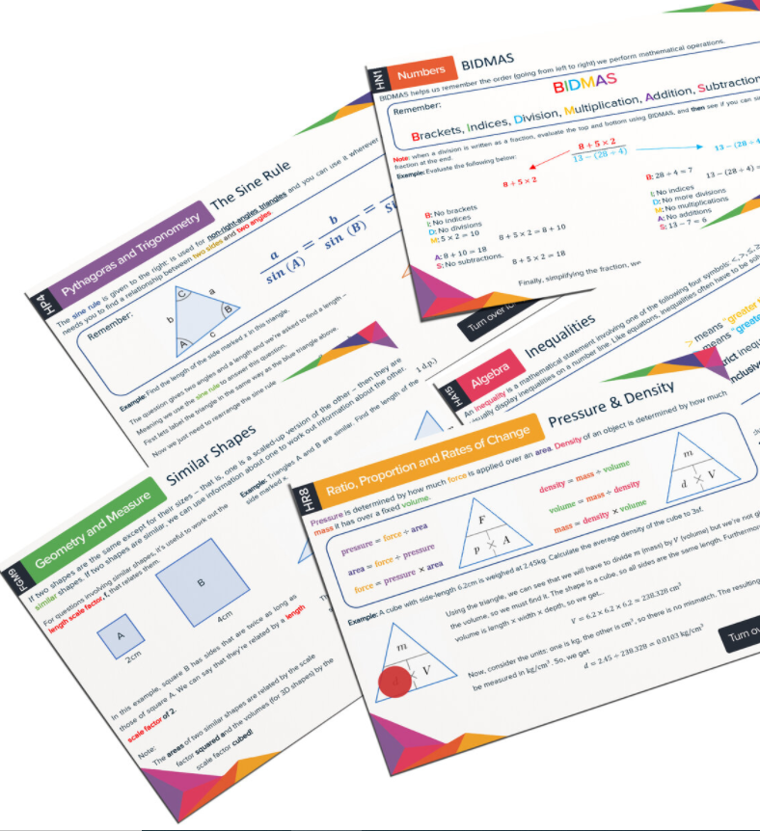
Flash cards
For key information and facts. You can carry them around with you and test yourself anywhere.
Use it to remind and test yourself on; Spellings Lists, A sequence of simple events, maths formulae
You can also create excellent flash cards on – line and on your phone using Quizlet. This also has an app.

Slide 77

How not to revise

Slide 78

cramming
Should not be relied upon
Cramming can make students feel stressed

Slide 79
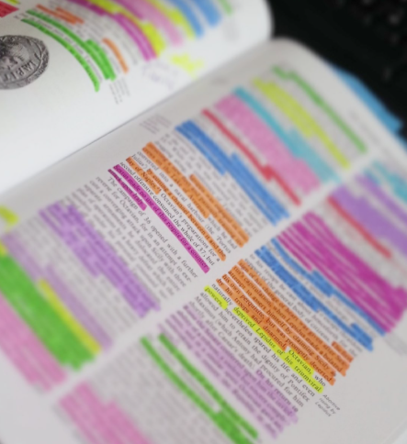
Re-reading
84% of students re-read their notes when revising, whilst 55% claimed this was their number one strategy.
When students employ this strategy they simply skim read the text.
Information is neither considered nor processed, and does not become embedded in the long term memory.

Slide 80



distractions
Multi-tasking is a myth.
Having a mobile phone out whilst revising causes a decrease in concentration and a reduction of 20% in performance.
A quiet environment is preferable and leads to an exam performance that is 60% better than those who revise whilst listening to music with lyrics.

Slide 81
How can parents help their child prepare for exams?

Slide 82

How can parents help?
Ensure they are using Doddle to access and record home learning.
Support them with their home learning.
Check their planner.
Encourage them to attend revision sessions.
Look out for parent mail messages telling you about forthcoming tests – encourage them to revise
Check their book/folder for teacher feedback, sign the feedback, and talk to your child about the work they are doing
Contact class teacher with any concerns (e-mail is best)
Have a revision timetable.
Organise a storage area / draw /shelf for books & files –

Slide 83

Minimise Distractions
Ensure that they are revising without any distractions present.
Keep mobile phones further than arms length
Worth the long term gain.

Slide 84

Help with revision
Using retrieval practice
Test your child on flashcards
Create multiple choice or essay questions based on the subject material.
Print off and collate relevant past paper questions for your child to attempt.

Slide 85

Support your child to achieve
High parental expectations lead to higher academic achievement.
Realistic
Accompanied with social support

Slide 86

Help them cope with setbacks
Highly stressful time
Some exams may not go as well as the student would have hoped.
Parent’s reaction can be key
An opportunity for learning rather than a judgment on their ability
Growth mindset

Slide 87

how many hours a day should a student be revising?

Slide 88

“How many hours of revision is enough?”
No set number of hours
Both quality and quantity.
The Student Room recommends 15-20 hours per week (which equates to only 2-3 hours per day)
A former Headmaster of Harrow recommends 7 hours of revision per day during the holidays!
Impossible question to answer
Students need to experiment to see what works for them.
Taking short breaks
Exercise
Taking a short walk for just 12 minutes can improve happiness, attentiveness and confidence

Slide 89

‘TwILIGHT’ TEAMS SUPPORT

Slide 90
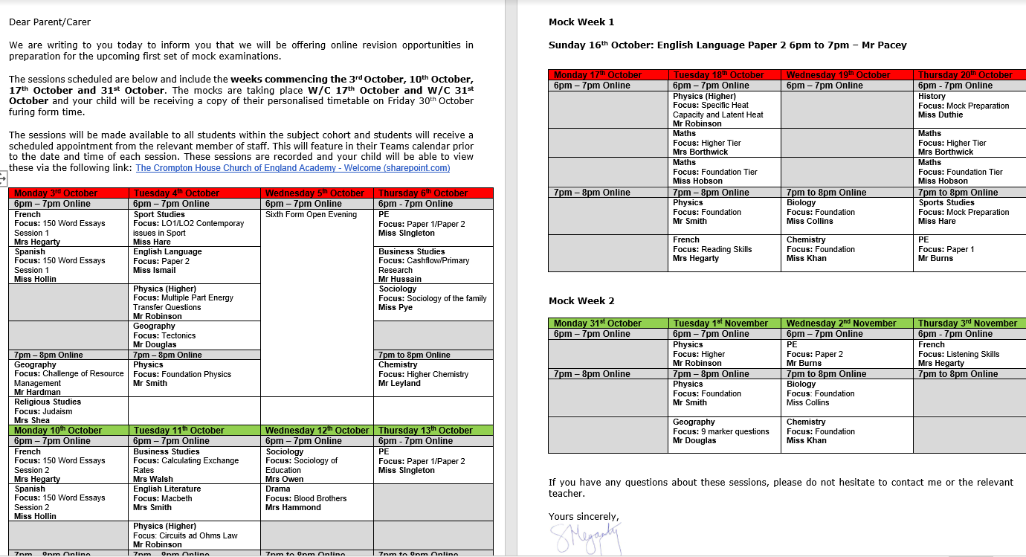

Slide 91
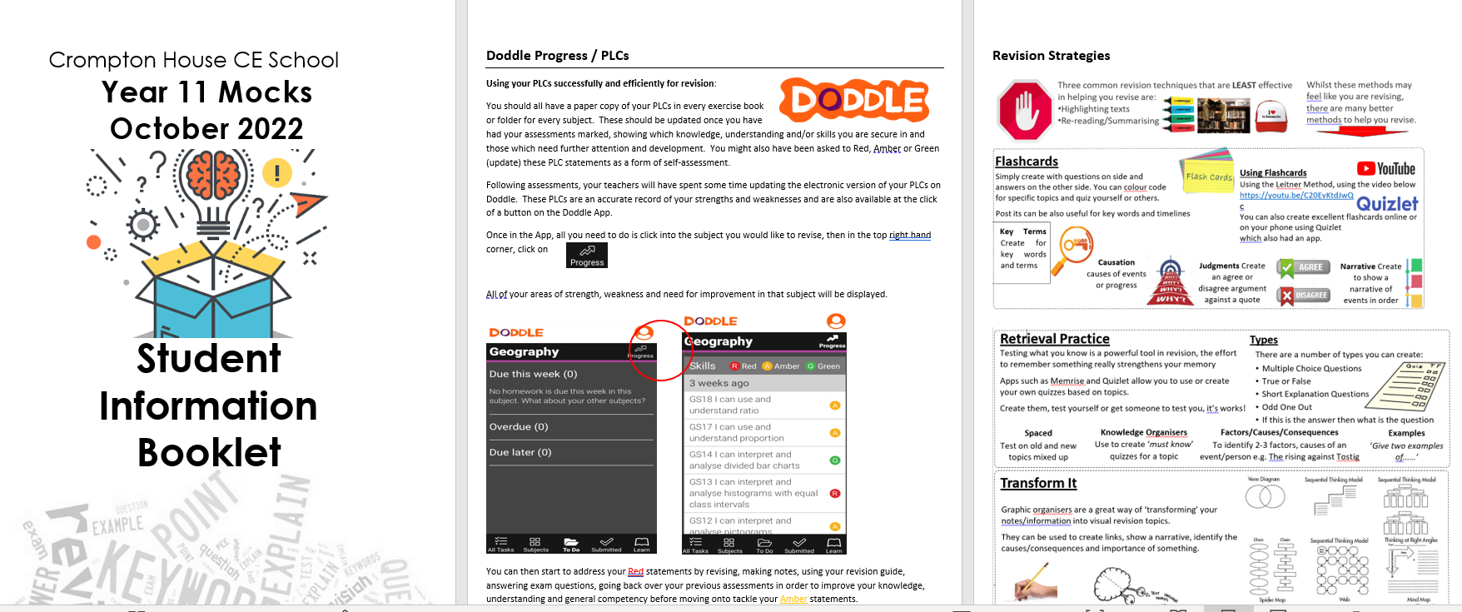

Slide 92
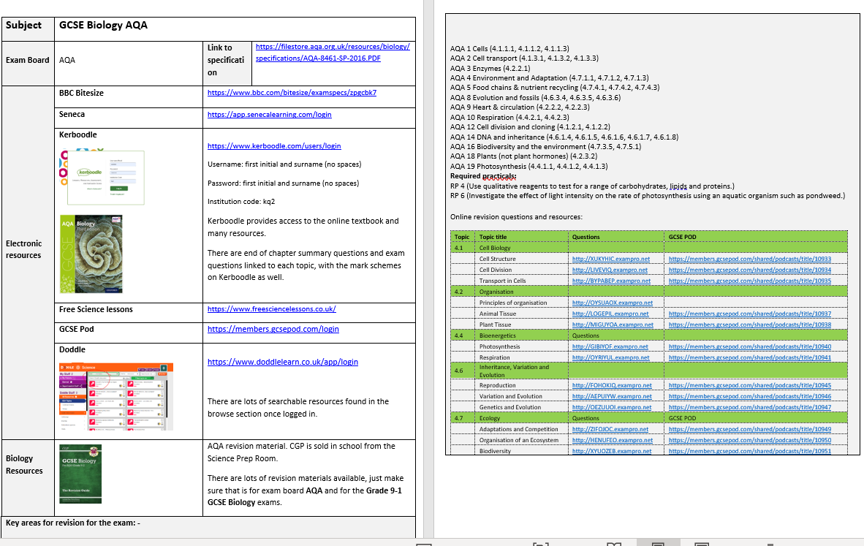

Slide 93


Notes:
There is lots of information and support for any student or parents who may need some help with their emotional well being and tonight you can take this handout which signposts helpful contacts, websites and apps that with support your emotional wellbeing

Slide 94


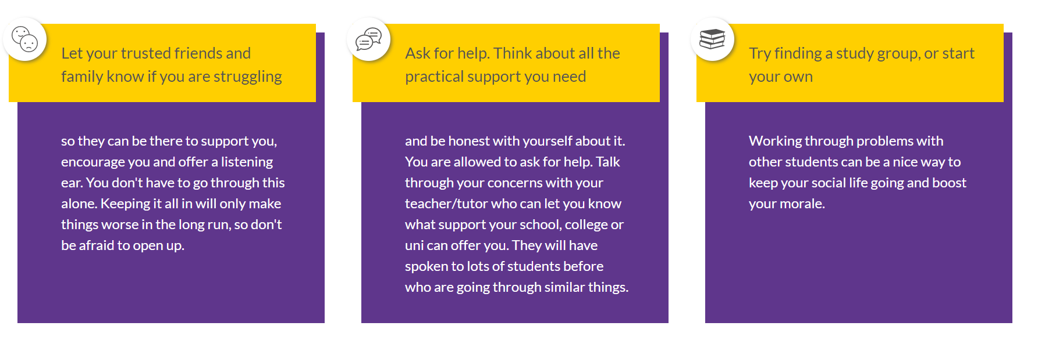

Slide 95
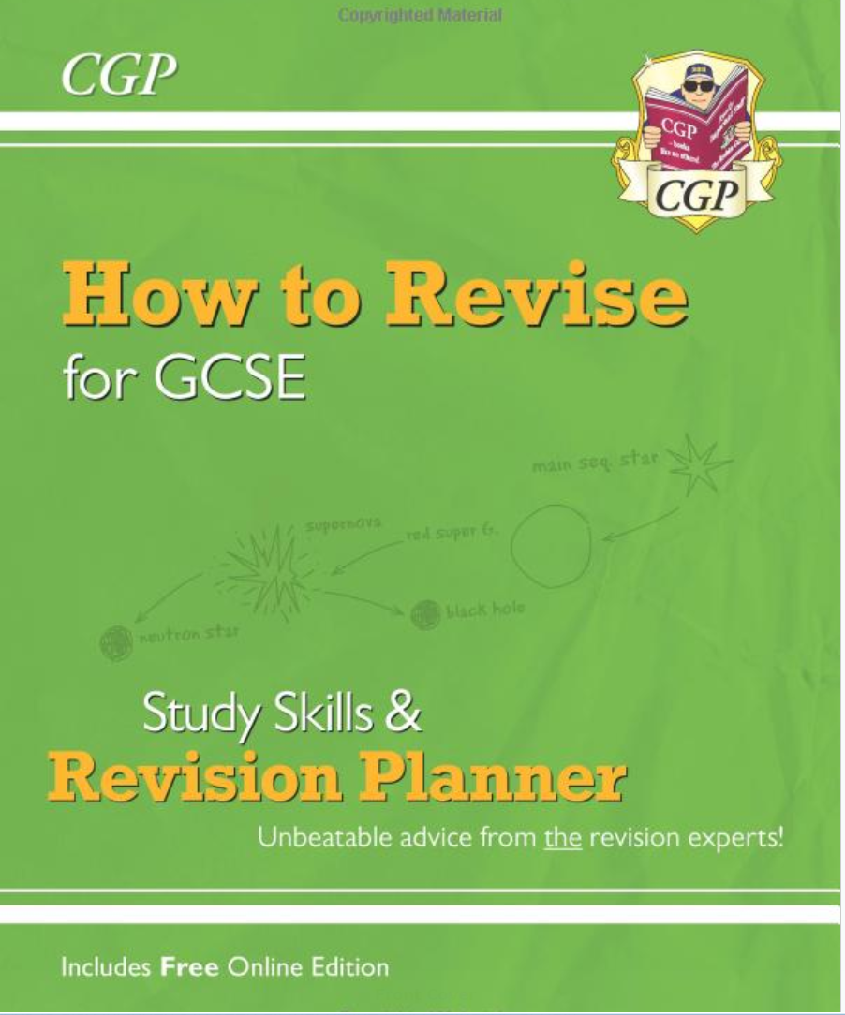
This book is available tonight for all parents for £2.

Slide 96

Any Questions?

