Slide 1




Literacy at Crompton House
Parent Information Evening
Reading 18.10.22
“Literacy is one of the greatest gifts a person could receive.”
J. Selinsky
Reading
Writing
Oracy

Slide 2
Key Members of Staff
D. Pacey – Assistant Headteacher / Head of English
Gemma Holt – Literacy Lead / Lead Practitioner of English
K. Heywood/ M. Newell – SENCO
R. Rushworth – SEND Intervention Lead
C. Cullen – School Librarian

Slide 3

Literacy is one of our main school priorities here at Crompton House.
We believe that every child has the right to a high-quality education and that literacy skills are a crucial tool enabling students to access this.
In our school, all teachers are a teacher of literacy.

Slide 4


Slide 5
Why Reading?
British Cohort Study:
“Of the 17,000 members, 6,000 took a range of cognitive tests at age 16. We compared children from the same social backgrounds who achieved similar tested abilities at ages five and 10 and discovered that those who frequently read books at age 10 and more than once a week when they were 16 had higher test results than those who read less. In other words, reading for pleasure was linked to greater intellectual progress, both in vocabulary, spelling and mathematics.”
Personal Development
Mental Health
Attainment
Fun

Slide 6
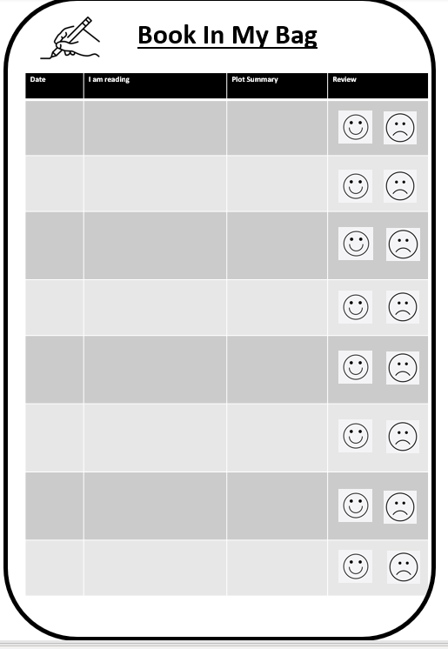
Expectations for Reading
Your child is expected to carry a reading book (fiction or non-fiction) on them at all times as part of their daily equipment check list.
We expect this to be changed at regular intervals and this will be monitored half-termly by form tutors.
Library books are on loan for two-weekly periods but can be extended.

Slide 7

Reading and the Curriculum
Reading for pleasure opportunities are built into our form time curriculum for all students.
All KS3 students have a library lesson once a fortnight with a focus on grammar skills and then reading for pleasure.
The explicit teaching of reading skills has formed an integral part of our wider staff training programme. Our training has been closely guided by the Education Endowment Policy research and the National Literacy Trust. This is now being integrated into all curriculum areas.

Slide 8
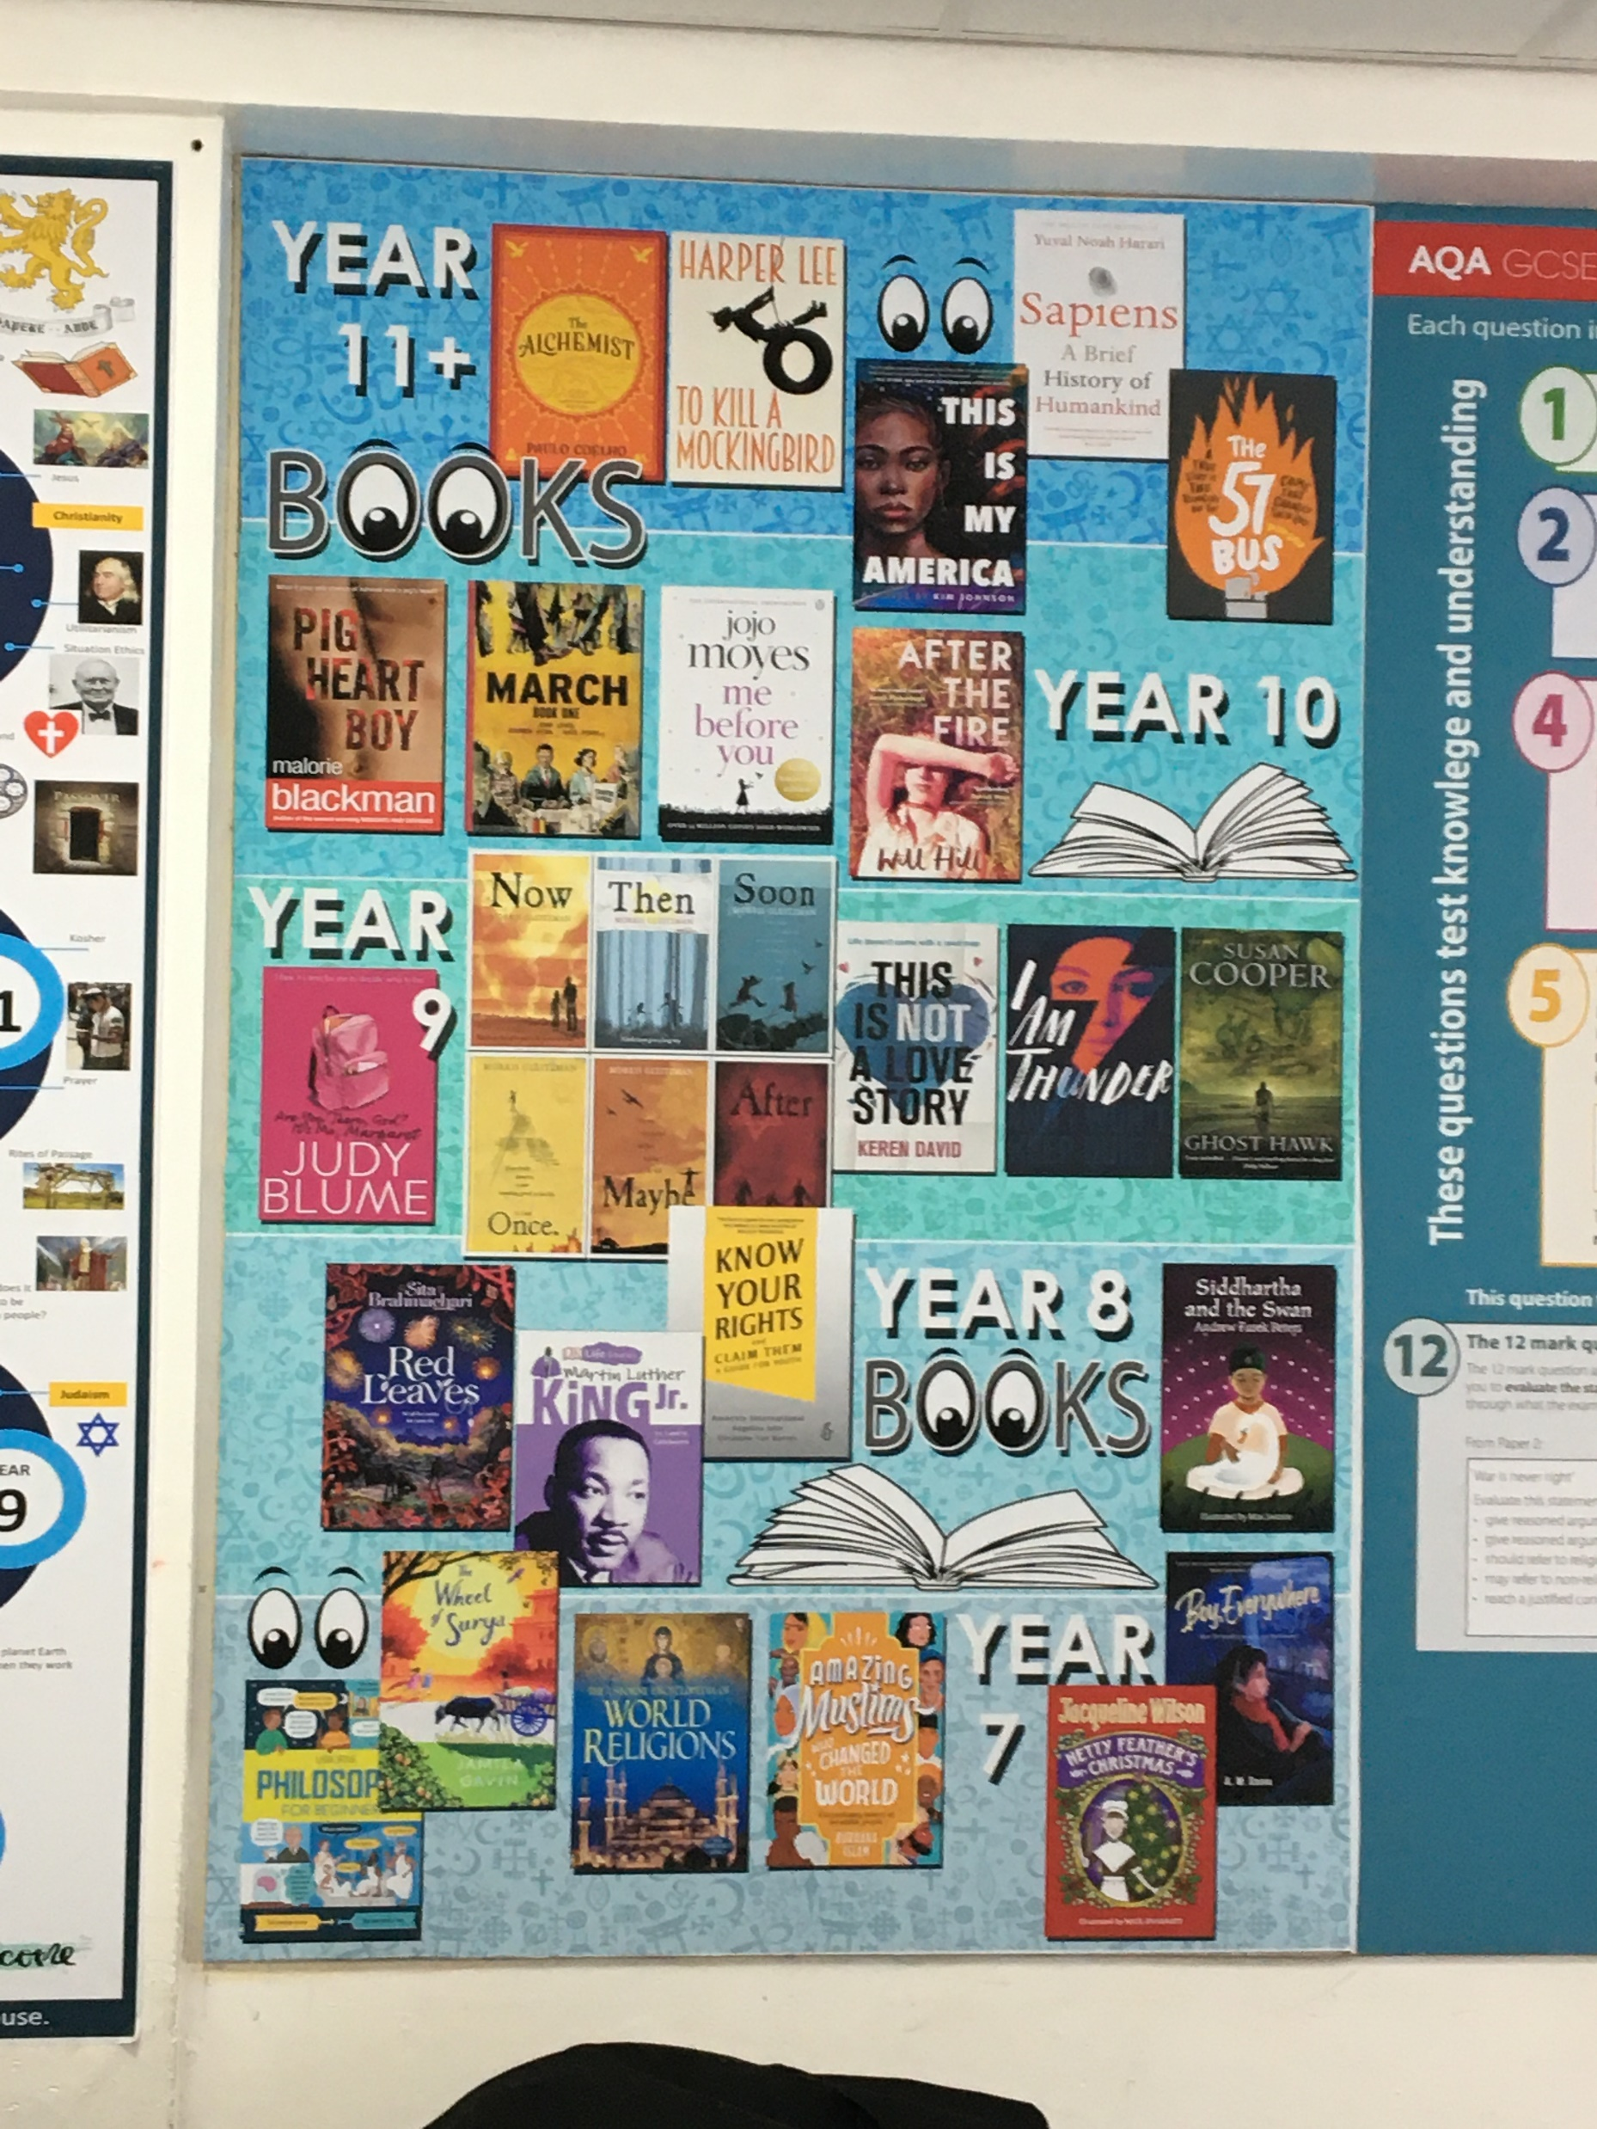
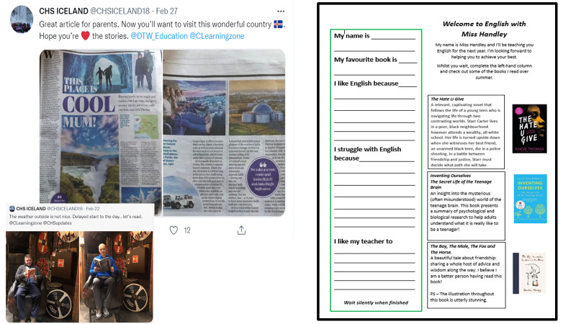


The promotion of reading across the curriculum:

Slide 9

Reading and Extra-Curricular Activities
All students have access to our well-stocked library which is open before school (8am-8:35am), scheduled break and lunchtimes and after school until 4pm.
All students have access to SORA which is our online library of e-books and audio books.
Book Council – The Novellas
Drop Everything and Read
Readathon Charity Event
Author visits
Book Clubs – Gothic, Science, Manga
Carnegie Book Shadowing – Gifted and Talented Readers
Scholastic Book Fair

Slide 10
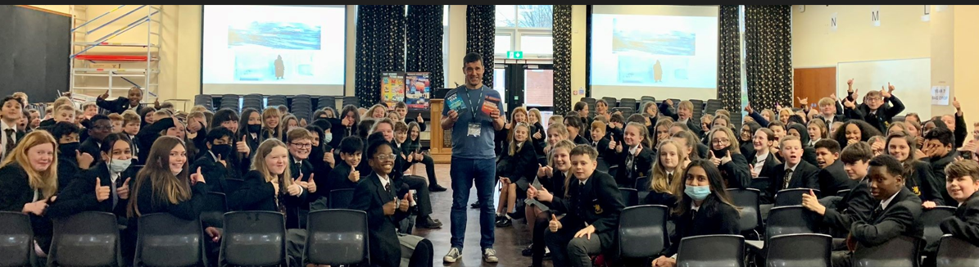
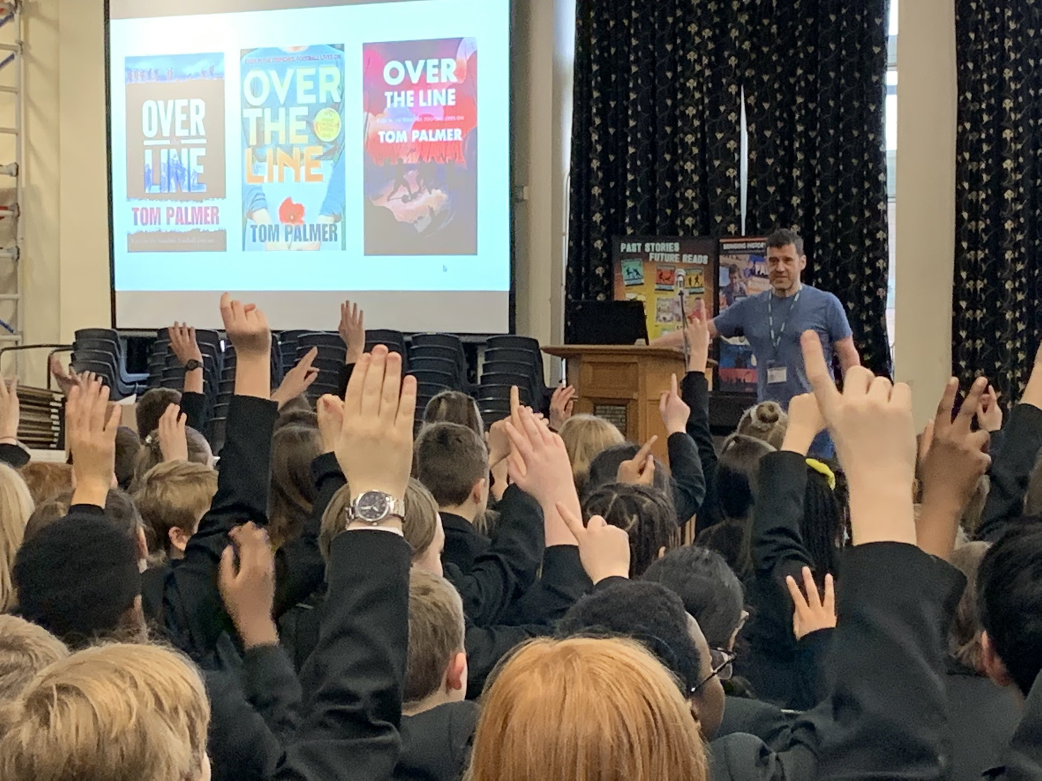
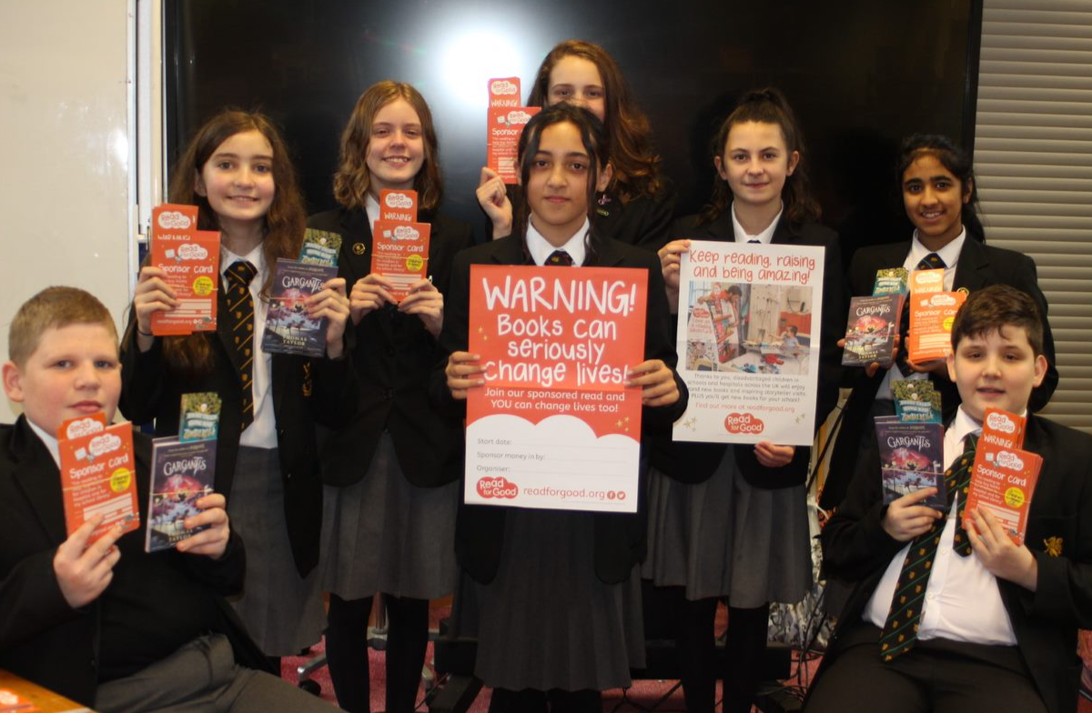

Slide 11
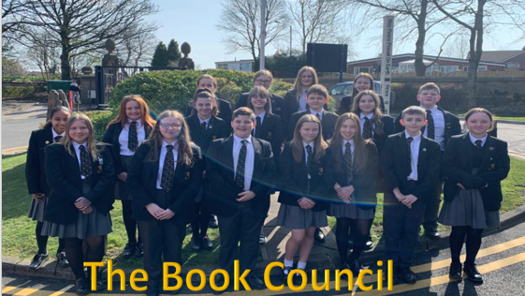
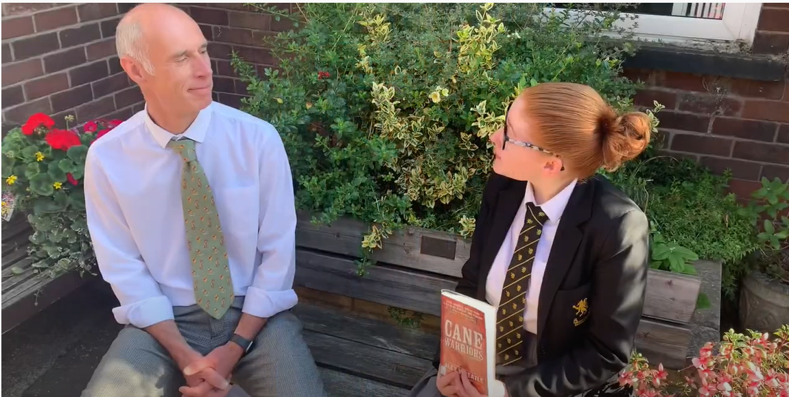
The Novellas
What is the Novellas?
What do we do?
Why are we so passionate about reading?

Slide 12

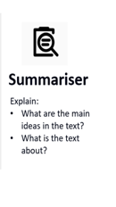
Crompton House Book Reviews
Our school book council, The Novellas, have been working hard on bringing you recommendations from some of our staff’s favourite reads.
Watch the video by following the link:
https://www.youtube.com/watch?v=AQYJf8T7qxE
Think. Pair. Share
What is the book about?

Slide 13
Reading Progress

Slide 14

How do we monitor reading progress?
We run the New Group Reading Test (NGRT)
This produces a reading age for each student. This is reported in years or months.
We test students twice yearly so that we can monitor progress and enable us to place students on early intervention for the next academic year.
The data is reported home to parents/carers through students’ data reports.
If a students chronological age is 11years 3 months, we would want to see their reading age as 11:3 or higher.

Slide 15
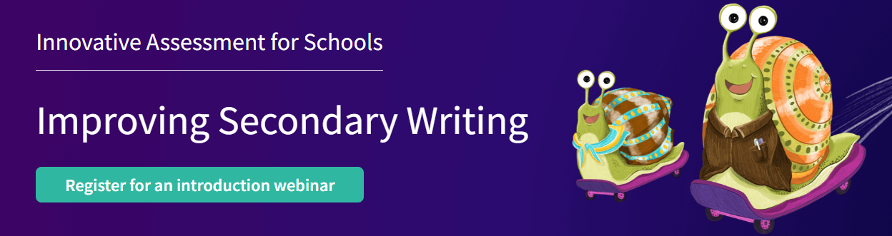
How do we monitor progress?
Year 7 are also the first year to take part in the National Improving Secondary Writing project.
They have completed a writing baseline in their English lessons and this will be marked by a process of comparative judgement.
By the end of the marking process, we will have a writing age for each student who took part.

Slide 16





What if my child isn’t making the expected progress?
We run a number of interventions to help students who have been identified as needing support.
Reading Buddies
Guided Reading
Handwriting

Slide 17
Who am I for?
Students whose reading age is below 9 years of age.
We use the Fresh Start programme to teach every student to read – no matter how old they are - so that we can set them up for the best possible future.
It is a fast-paced, systematic programme targeting students who need to catch up quickly with their reading.
English is one of the most complex languages to learn. We have more than 150 ways to represent the 44 sounds of the English language with only 26 letters!

Slide 18
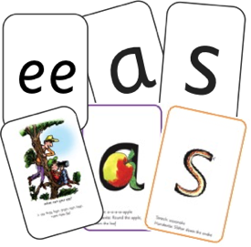
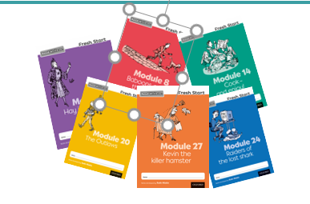



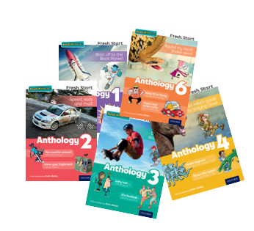


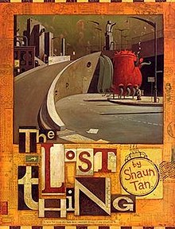


Read Write Inc. Fresh Start daily lessons
We teach sounds first (graphemes)
– in a specific order.
We then teach your children to blend those sounds together in order to read words
The students read words in the matched Modules. Each Module is carefully matched to the sounds and words they can already read - setting them up for success.
After the modules, they will be able to independently read ‘real’ books
Notes:
Click – We teach the sounds first – in a specific order.
Click – We then teach your children to blend those sounds together in order to read words
Click – The students read words in the matched Modules. Each Module is carefully matched to the sounds and words they can already read - setting them up for success.
Click - After the modules, they will be able to independently read ‘real’ books
What Fresh Start does is simple - we teach sounds (click), students practise reading and spelling words containing these sounds (click), then we give students decodable modules (click) containing sounds and words they can read.
They read each module three times at school and again with you at home.
On each reading, pupil’s fluency increases and the more they can focus on what the story is about.
Students also learn to spell the words they have been reading and develop their ideas into sentences so that they can write about the modules they read.
Our aim is for students to finish the Fresh Start programme quickly so they can start reading these books for themselves.

Slide 19
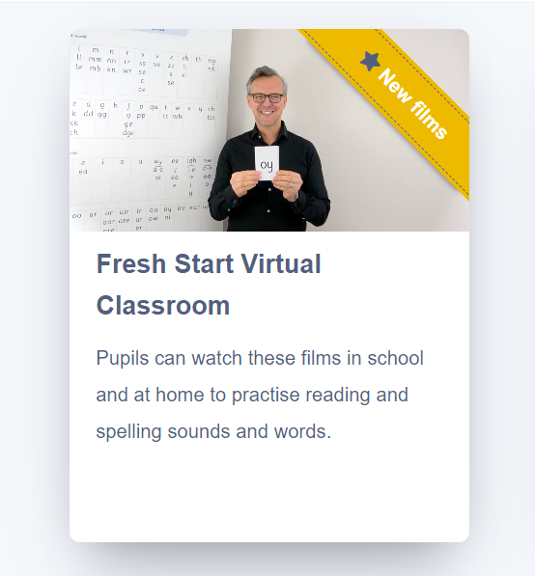
Fresh Start Virtual Classrooms
Students on this programme can support their learning during school by accessing the virtual classrooms programme online.
Each student will have an individual log in to this portal which they can access from home.

Slide 20

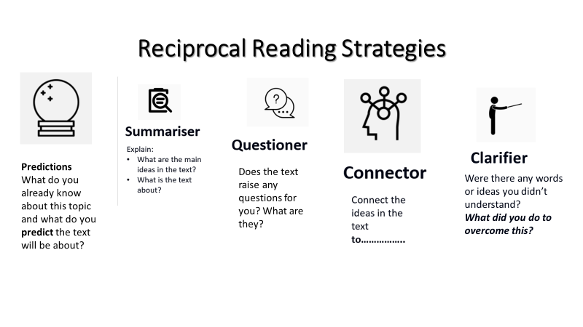
Who am I for?
Students whose reading age is more than two years below their chronological age but does not have a phonics need.
Shared reading experience to encourage:
Comprehension
Inference
Fluency
Reading for pleasure

Slide 21
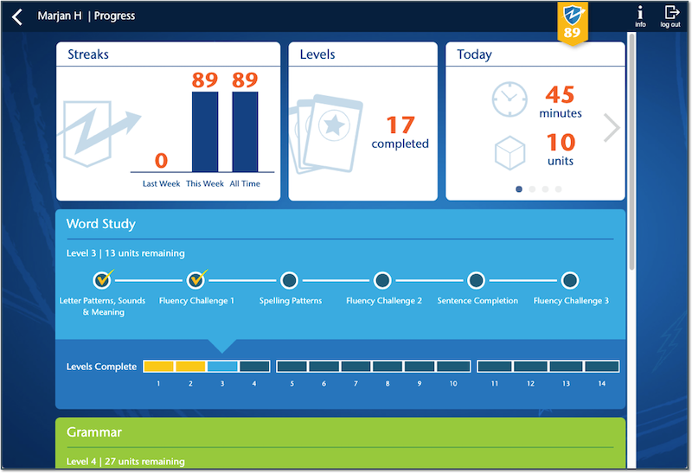
Who am I for?
Students whose reading age is more than two years below their chronological age.

Slide 22
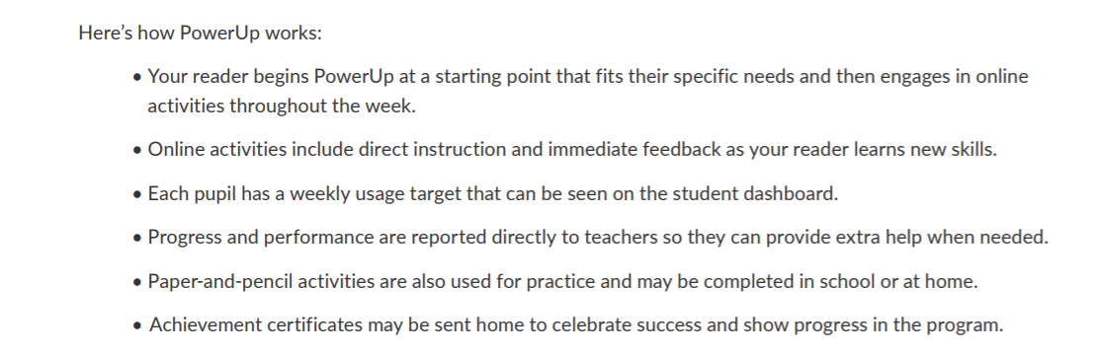
Word Study Grammar Comprehension

Slide 23

https://www.lexiapowerup.com/
Teacher email: G.holt@cromptonhouse.org
FirstnameSurname
Crompton1
We recommend 30 minutes 3x a week.

Slide 24

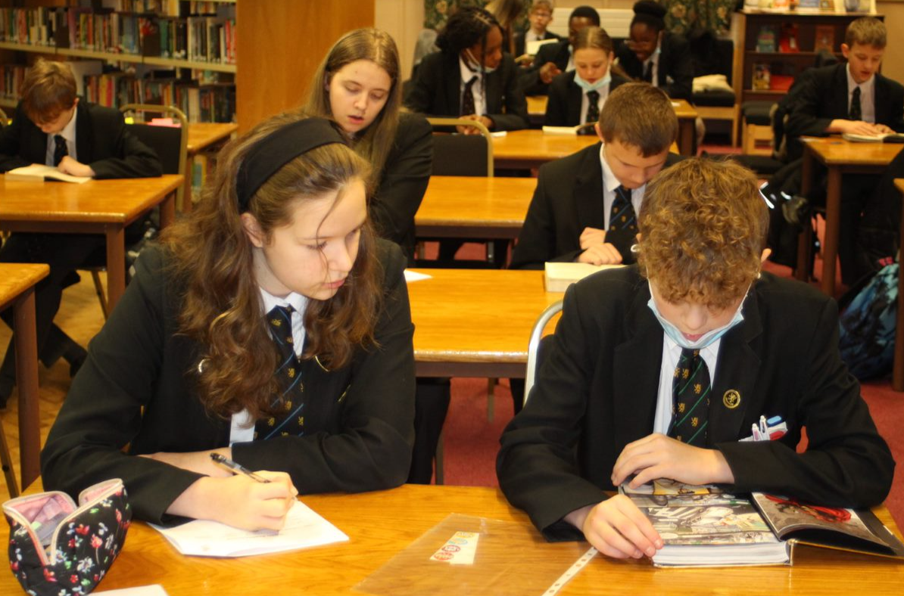
For the Reader:
Provides a reading role model
Buddies them with an older student
Fluency
Comprehension
Inference
Reading for pleasure
For the mentor:
Receive training
Excellent for the C.V
Can be used for Duke of Edinburgh
Get to pass on their love of reading

Slide 25
Reading and SEN
If you suspect that your child may have a Special Educational Need in relation to reading then please contact our school inclusion team:
Inclusionteam@cromptonhouse.org
Please note that we don’t do testing for dyslexia within school.
This would need to be done privately with an outside agency.
However, please get in touch if you have any concerns or would like some advice on this process.

Slide 26
Reading At Home

Slide 27

How can I support my child at home?

Slide 28
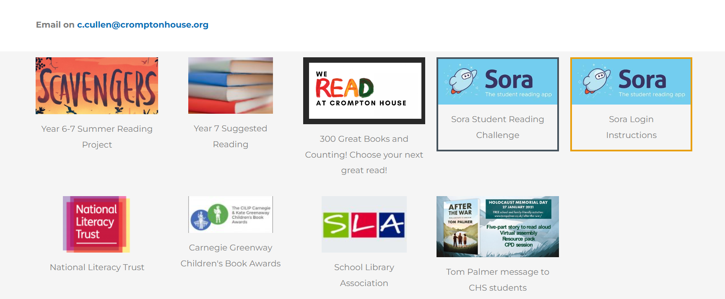

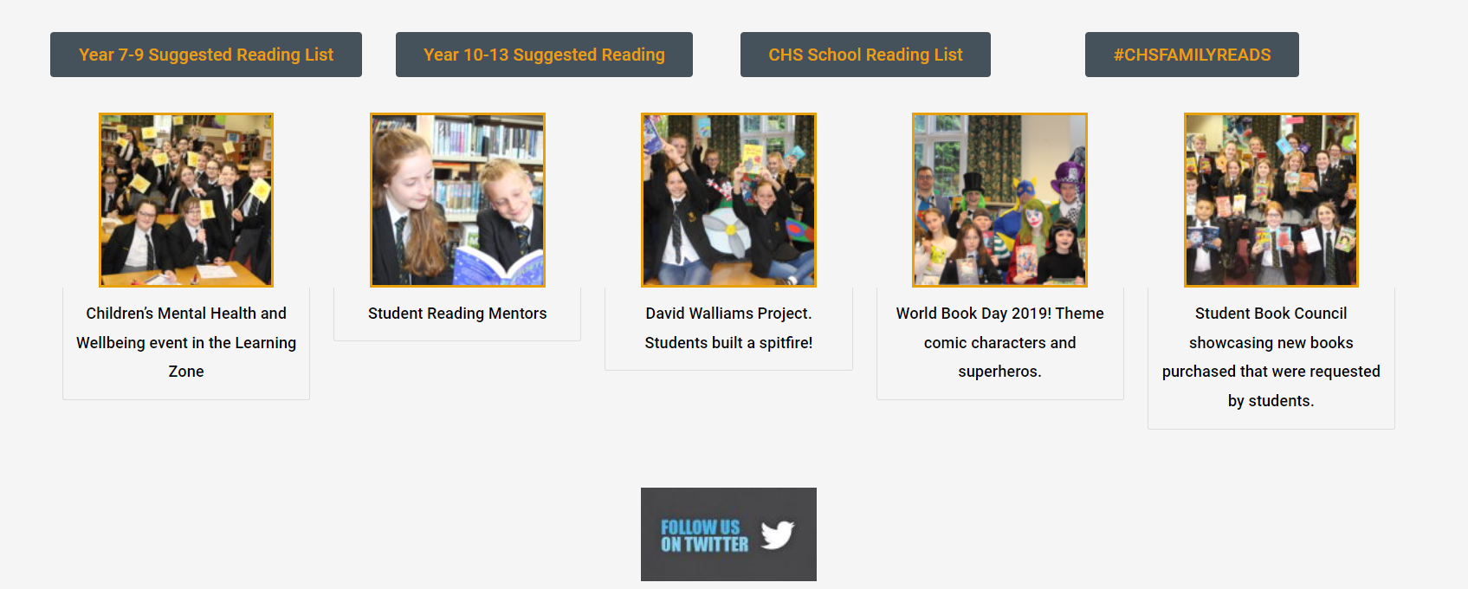

How can I support my child at home?

Slide 29
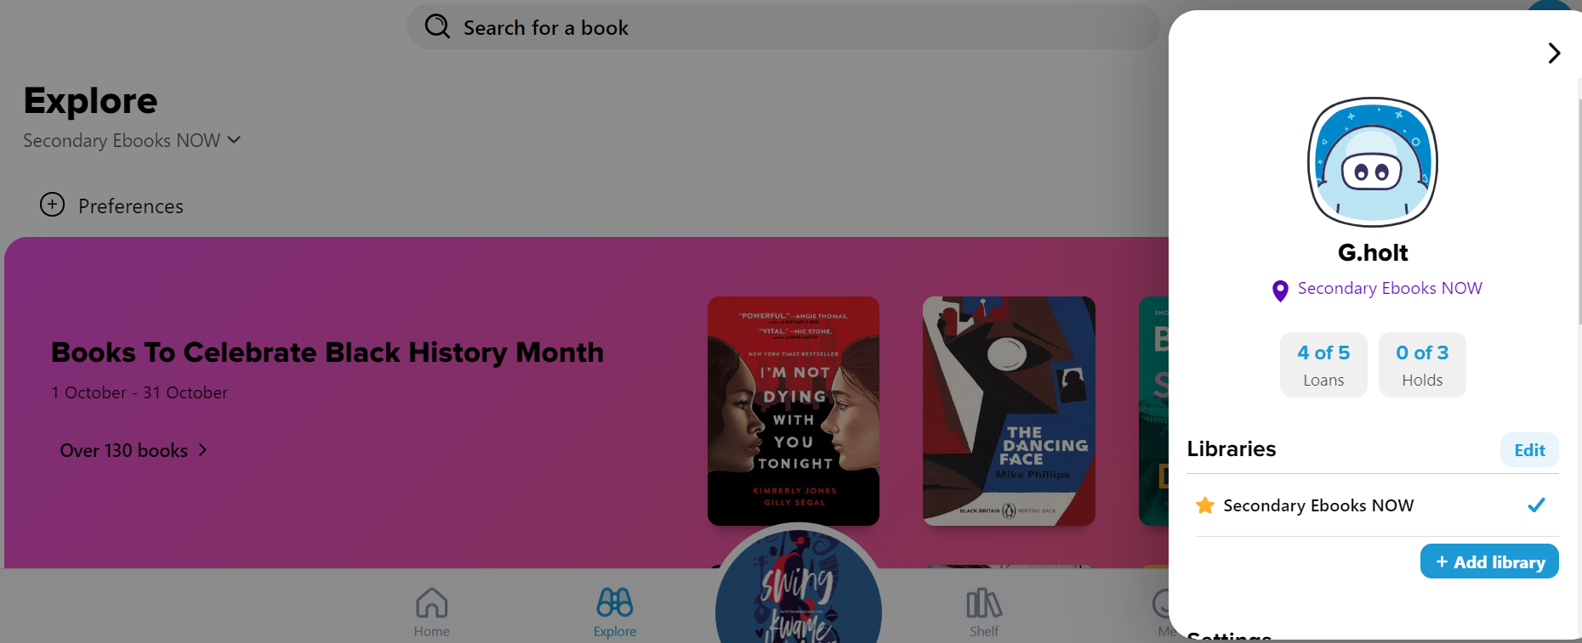
WWW.SORAAPP.COM

Slide 30

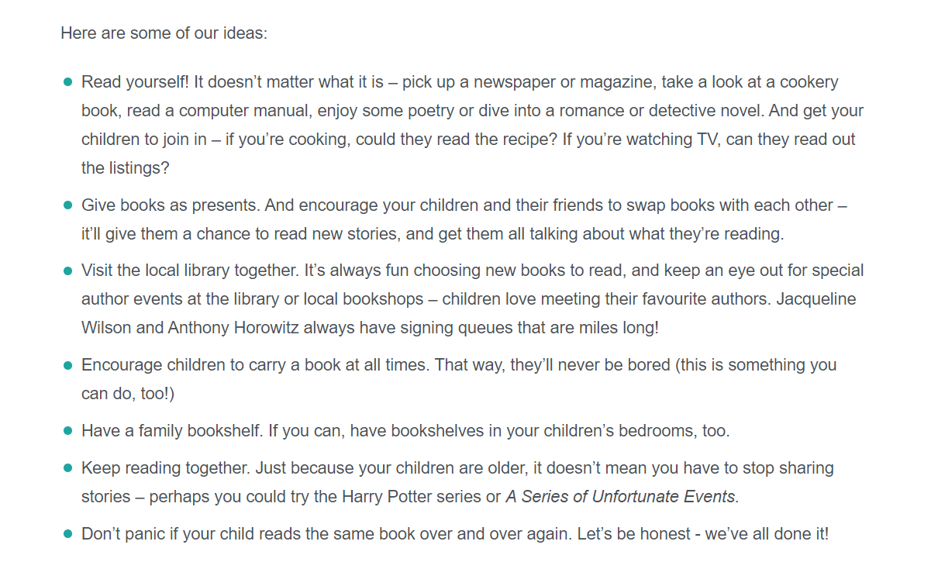

Slide 31
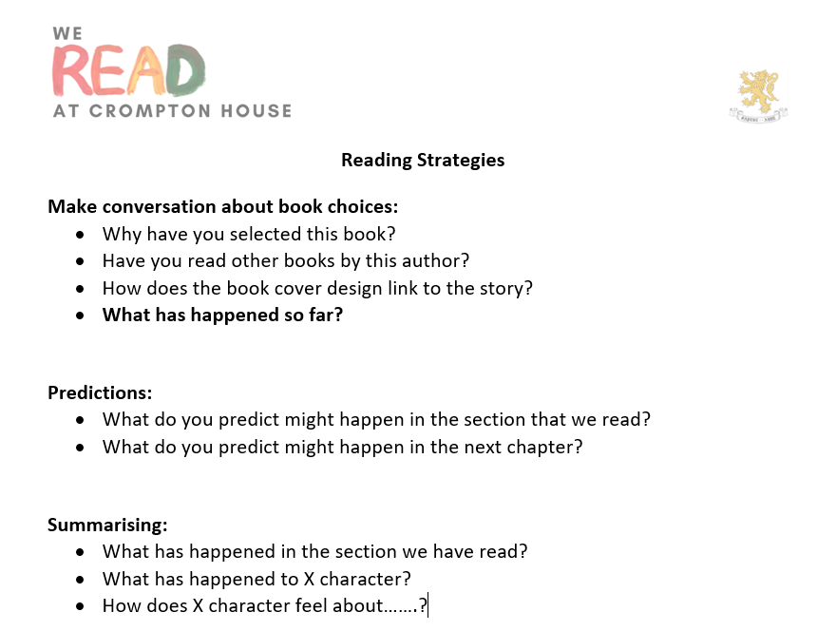

Slide 32

#WriteASmile for #MentalHealthAwarenessWeek 2022 – YouTube
Any Questions?

Slide 33
Reading is the one ability that, once set in motion, has the capacity to feed itself, to grow exponentially, providing a base from which the possibilities are infinite.
Michael Morpurgo
Notes:
Remember that all parents have the power to change outcomes for their children.

