Slide 1
Y10 Working Together Evening
Welcome to KS4

Slide 2
Aims
Mr Raynerd
Welcome and introductions
Parent Portal
GCSEPod & Online Resources
Mrs Hegarty
Assessment& Exams
Mr Smith
Homework & PLCs
Miss Clough
Revision Strategies
Good Mental Health

Slide 3
The Importance of you….
Parental engagement has a large and positive impact on children’s learning.
This was the single most important finding from a recent and a
authoritative review of the evidence
Review of best practice in parental engagement - GOV.UK (www.gov.uk)

Slide 5
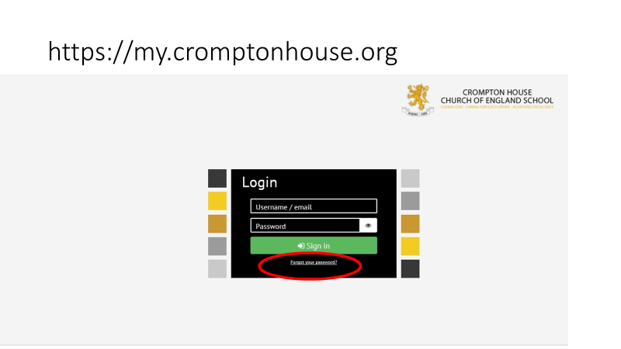
Parental Portal

Slide 6
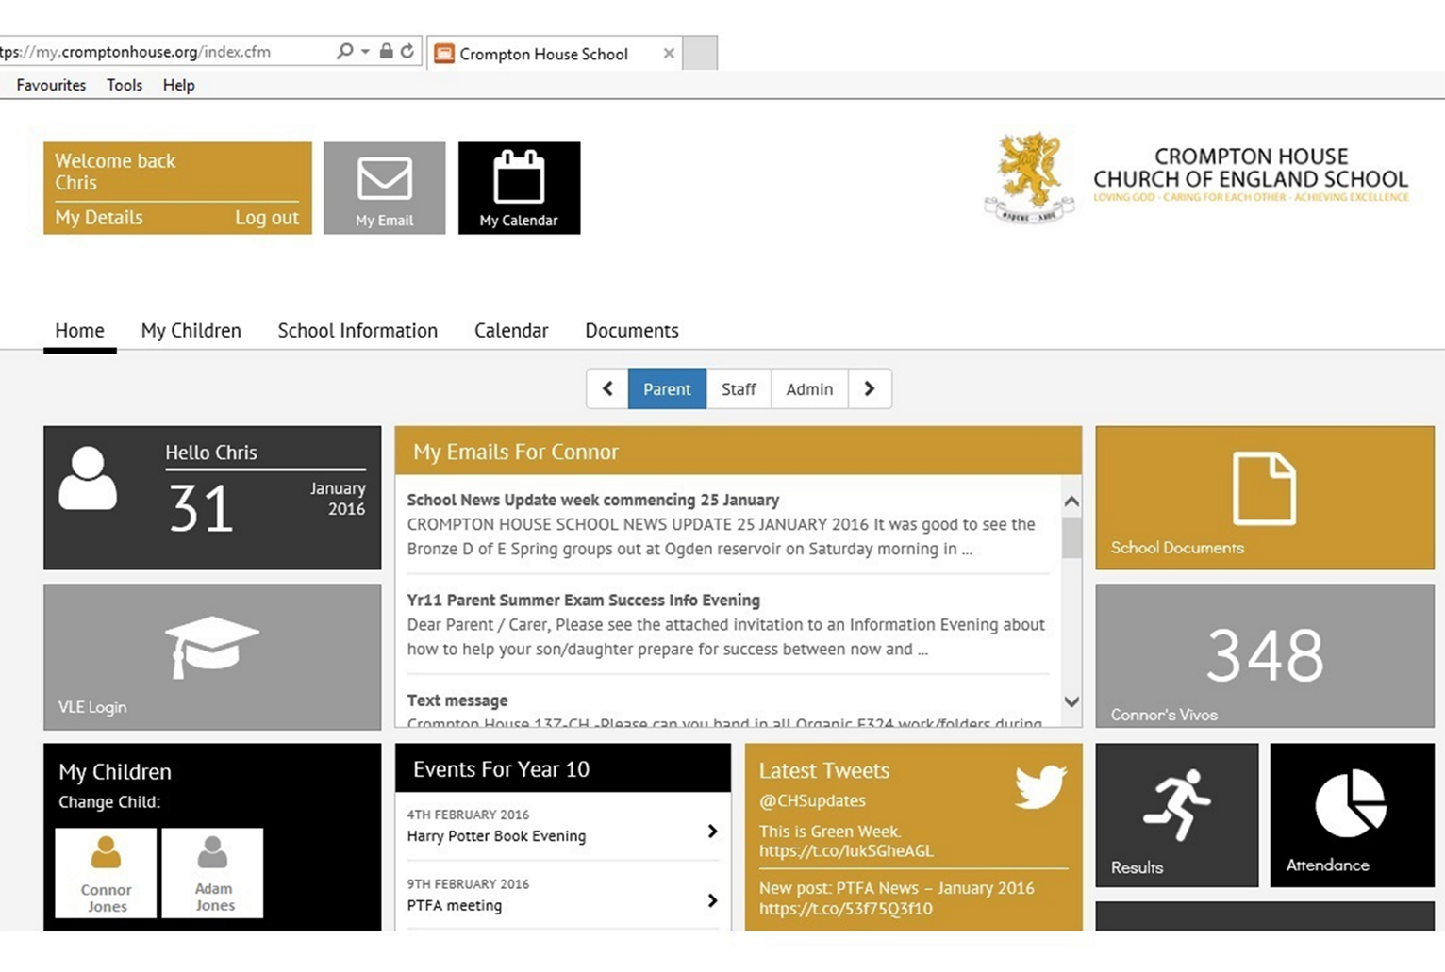

Slide 7
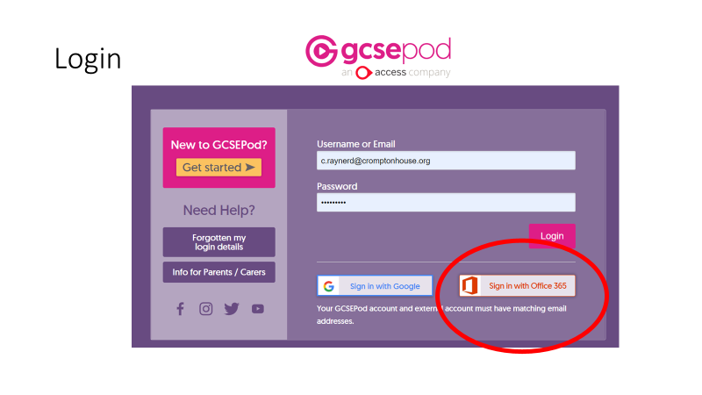
GCSEPod

Slide 12
Resources

Slide 13
Online Revision Websites
Wordwall (MFL)
www.photopea.com (Art)
Corbett maths, Dr Frost maths and Maths Genie (Maths)
Carousel Learning (science)
Tutor2u (Business, Sociology, Geography, History)
Focus on Sound and Teaching Gadget (music)

Slide 14
The use of homework and PLCs to help you learn and achieve
@CHS

Slide 15
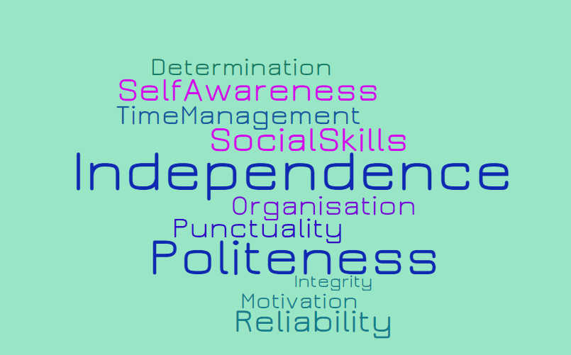
The transition from KS3 to KS4 – GCSEs:

Slide 16
Homework
Why is it important?
Are you organised? Do you go on the Doddle App every day?
Do you have a routine?
Location?
Time?
How can I be proactive, independent?

Slide 17
...help you learn how to work at your own pace, meet deadlines and organise your time effectively
… help you identify
areas of strength and weakness
...improve your academic performance
Why is independent learning so important?
...increase your confidence and motivation
… develop a sense of self-responsibility and self-discipline
...revise for your
exams!

Slide 18
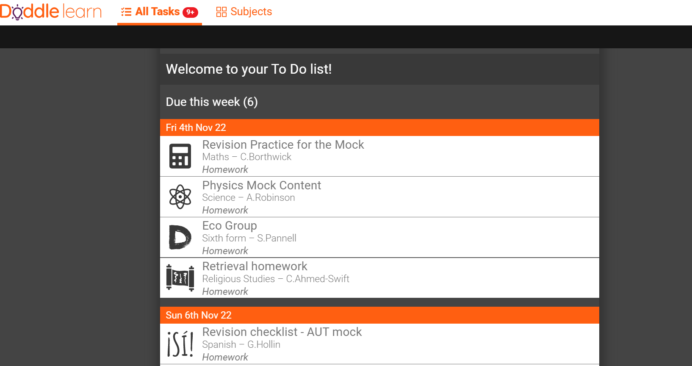
Doddle progress/PLC area - students

Slide 19
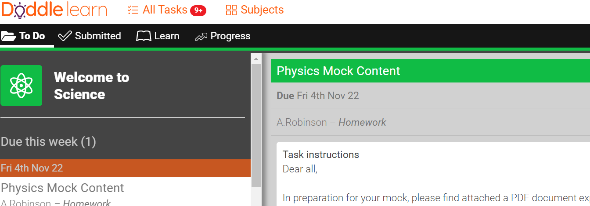

Slide 21
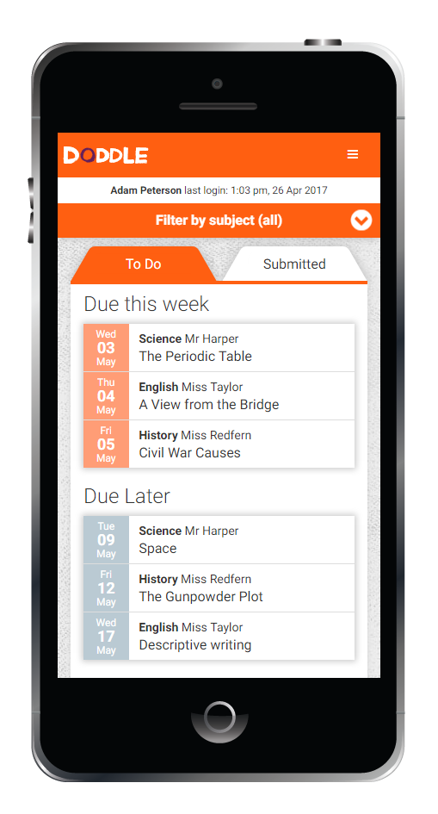
What is Doddle Parent?
1. Accessible from any computer,
laptop, smartphone or tablet
2. Keep up to date with your child’s assessment and homework information
3. Help focus revision
4. Encourage independent learning
If you are not already set up on this please go into your Parent Portal – e-mails an search for Doddle and you will find your personalised Parent Key and instructions how to set it up.
Notes:
Moving homework online means students no longer have the same excuses for not doing their homework. Moreover, parents no longer have to try and squeeze the information about what homework their child has been set out of them. It’s all there, including the resources. Because of this, parents can devote their time more efficiently to helping their child(ren) with their homework.

Slide 22
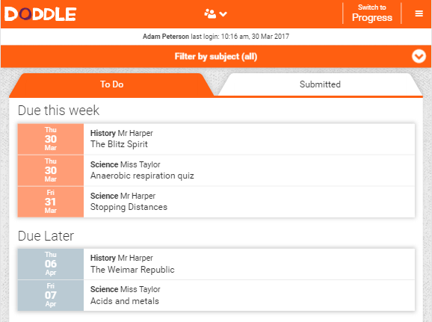
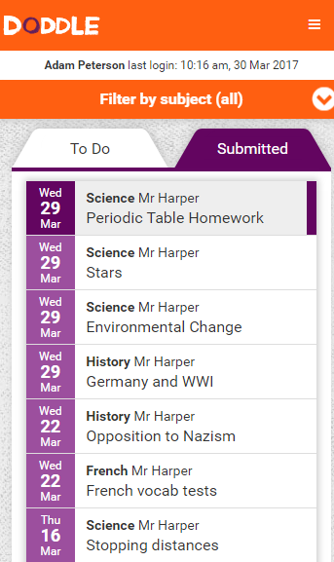
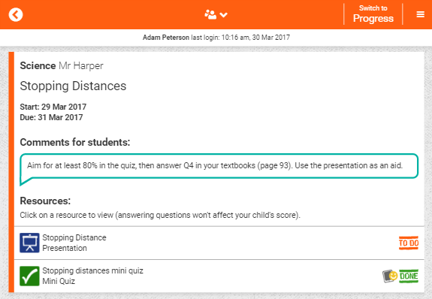
Homework: What will you see?
You can see all details of the homework your child has been set
You can view resources and even take quizzes yourself (don’t worry – answering questions won’t affect your child’s score!)
You can see all homework they have submitted, including their quiz scores
Notes:
When it comes to homework, parents now have complete visibility. They can see what homework has been set, and when it’s due. Furthermore, they can view the resources their child has to work with, even taking the quizzes themselves.

Slide 23
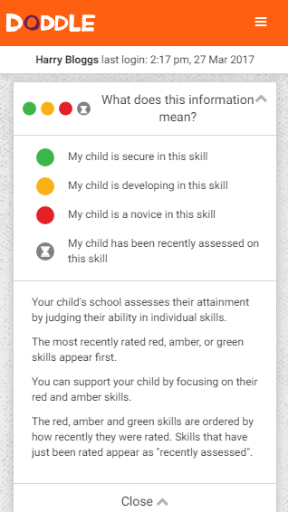
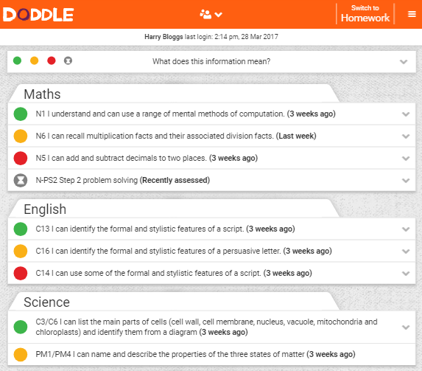
Progress: What will you see?
Track your child’s progress in every subject over time
Help them turn their red and amber scores to green
Identify strong and weak points
Know how your child is doing at all times

Slide 24
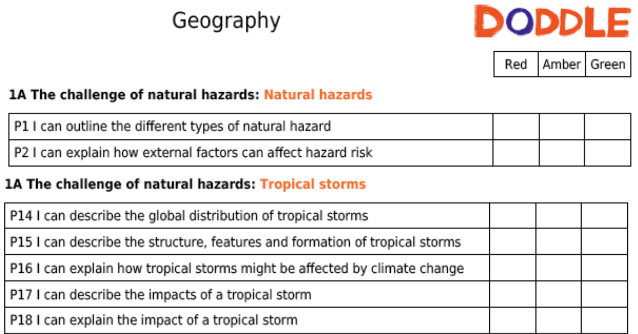
PLCs MUST be in books / folders
03/09
02/11
03/09
02/11
03/09
07/09
02/11
02/11
02/11
02/11

Slide 25
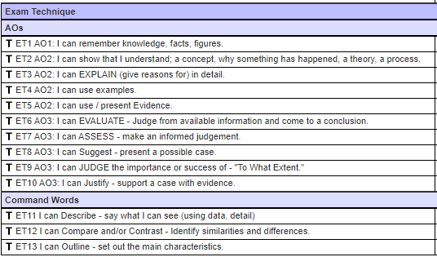
Doddle – exam skills too. [Not just content (knowledge and understanding) but the application of it too.]

Slide 26
RED Doddle statements the basis for Now tasks / Homework = addressing learning gaps:

Slide 27
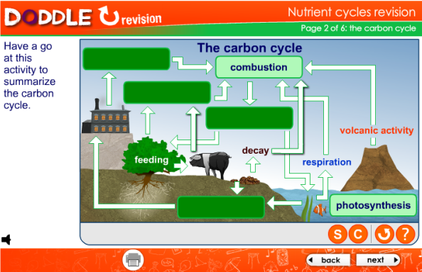
Independent Learners
In Browse, you’ll find:
Presentations – in-depth introductions to whatever you’re studying.
Worksheets – use these during exam preparation to vary your revision.
Revision – quickly recap a topic when you’re revising for exams.
Interactives – animations and activities that let you see ideas in action.

Slide 28
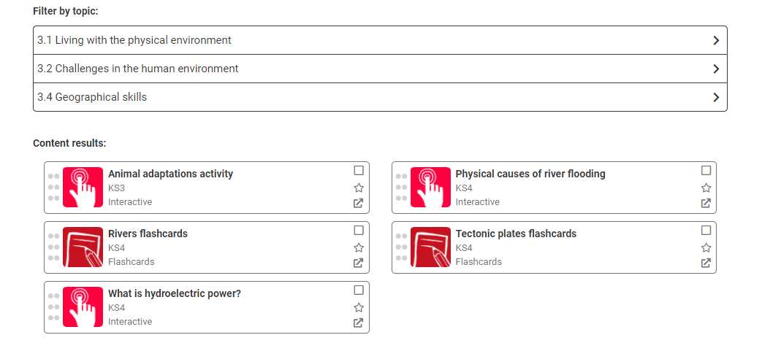
Doddle resources:

Slide 29
Other resources/how to revise/prepare:
Exam board website – past questions
Revision guides
Teams
Seneca Learning
GCSE POD
Textbooks
The internet – BBC Bitesize etc
Folder notes / course booklets
Subject specific resources / websites e.g. Kerboodle, My Maths

Slide 30
Hard work and high standards =

Slide 31
Why Retrieval practice?
Retrieval practice is a learning strategy where students focus on getting information out.
Through the act of retrieval, or calling information to mind, memory for that information is strengthened and forgetting is less likely to occur.
The aim of independent study and revision is to be able to retrieve previously learnt knowledge so that it is secure in your long term memory.
This ensures that you have a good level of working subject knowledge and enables you to access the conceptual understanding which is taught in class by reducing your cognitive load.

Slide 32
Look Say Cover Write Check
LOOK SAY COVER WRITE CHECK x3
LOOK - Read the specific knowledge you need to learn.
SAY – Read out loud the specific knowledge you need to learn.
COVER – Cover the knowledge.
WRITE – Write out everything you can remember from knowledge organiser
CHECK – Check that you have all the knowledge needed and it is correct. Any content that is missing or incorrect use a red pen to illustrate the gaps in your knowledge that you have corrected.
x3 – Repeat 3 times.
Round | Knowledge
1
2
3

Slide 33
Around the clock
Chunk an hour into 4 x 15 minute slots over the month to practice retrieving a topic. By the end of the month complete a blank clock without looking at your Knowledge Organiser.

Slide 34
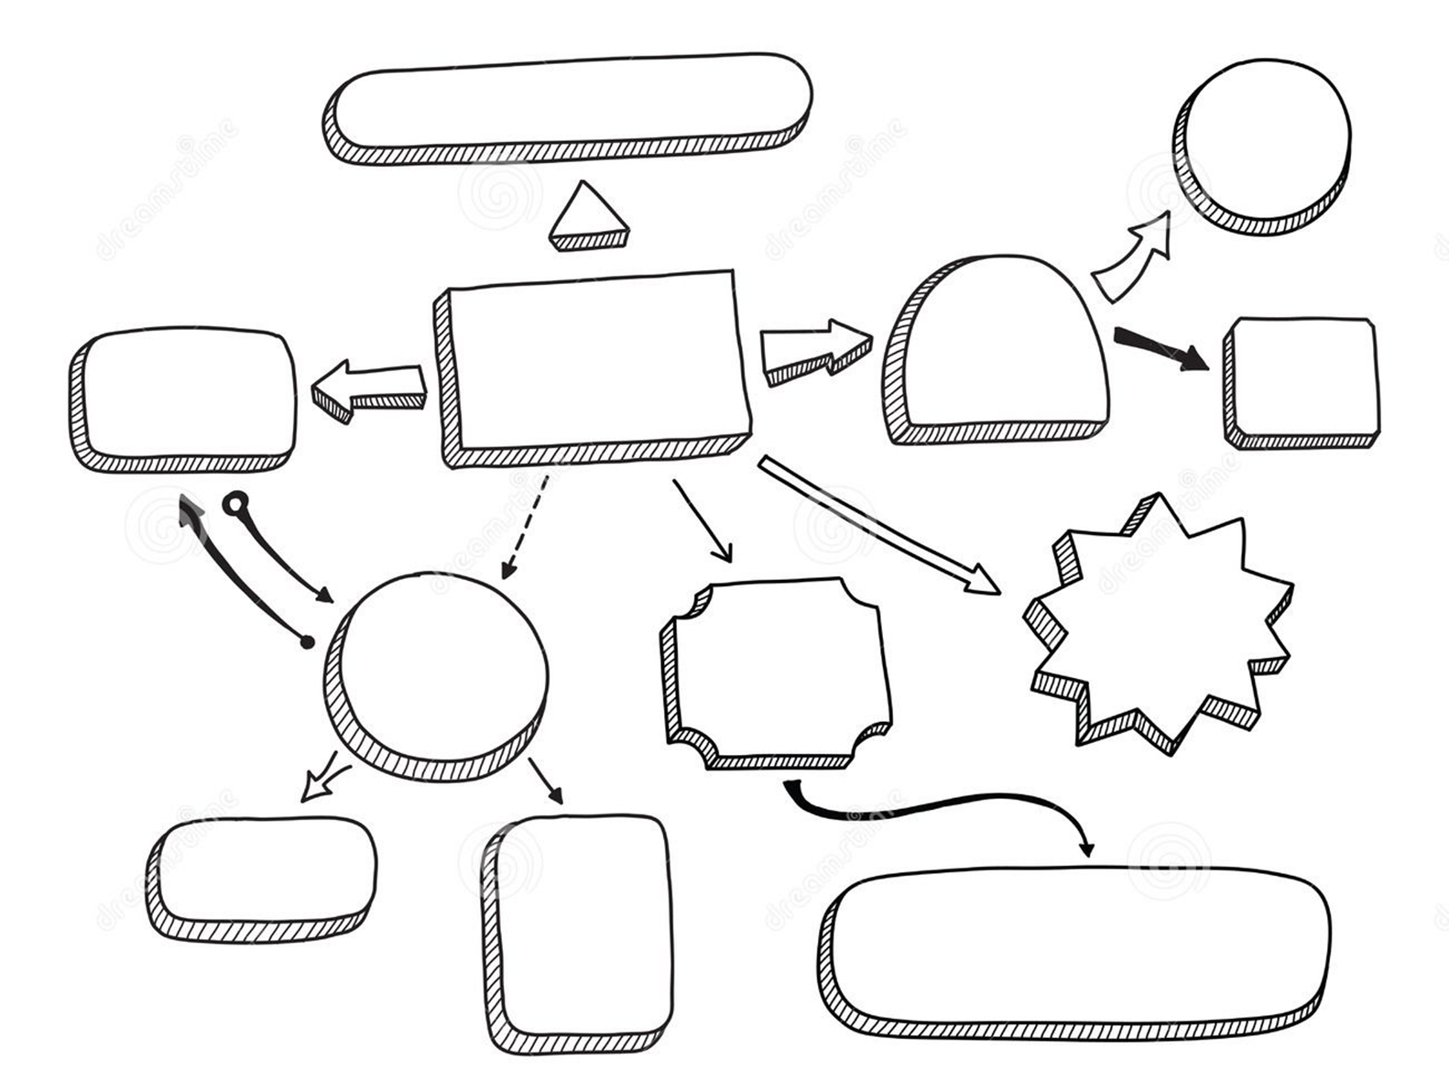
Concept Mind Map
Create a mind map using the knowledge from your Knowledge Organiser. Break up the topics into key concepts and different categorise to practice retrieval.

Slide 35
Shrink it
KNOWLEDGE HERE
2. Summarise Here
4.Summarise a final time
3.Summarise Again

Slide 36
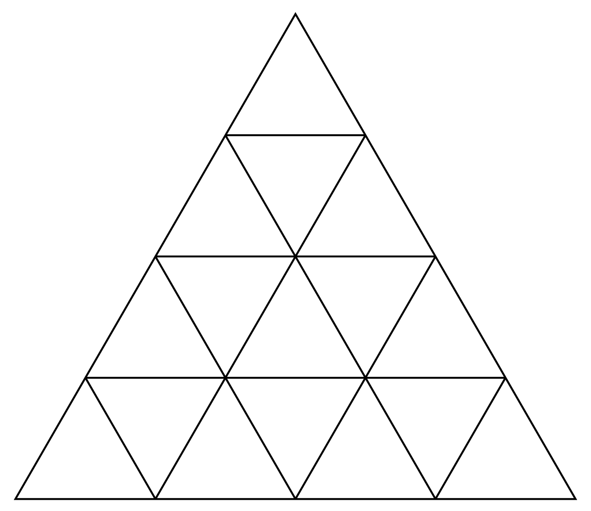
Knowledge Triangle
Create links around the edge of each Triangle to link up concepts/knowledge from your knowledge organiser. You teacher may direct you to a certain number of triangles at a time over the month.
Reasoning

Slide 37
Chunking
Write a topic out in your own words in the boxes provided

Slide 38
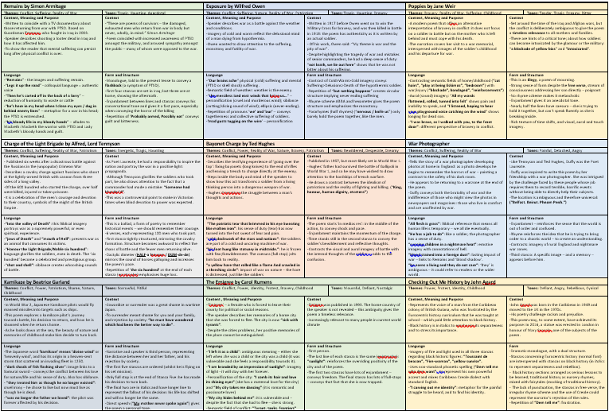
This is and example of a knowledge organiser for the Anthology Poetry.
It has all the essential knowledge for each poem including context, meaning, language and structure.

Slide 39
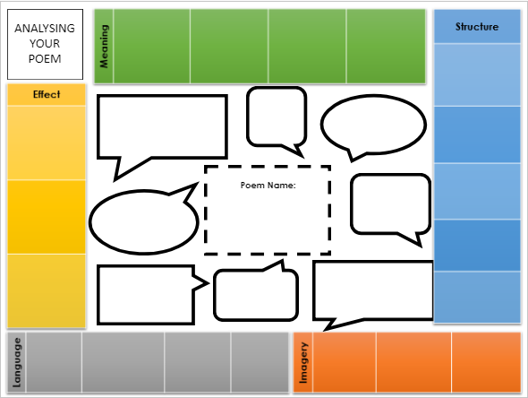
This is an example of the blank Retrieval Practice sheet.

Slide 40
What students should do…
Spend 15 minutes studying the knowledge organiser/researching the poem/revising notes from class.
WITHOUT looking at the knowledge organiser/notes spend 30 minutes trying to fill in the sheet. It is up to the student how they fill in each box but they must have at least one quotation under each heading e.g structure/language. The most effective way to fill each section would be to develop initial idea in each box that follows under a particular heading.
Spend 15 minutes cross referencing the sheet to the notes/knowledge organiser. USING A DIFFERENT COLOURED PEN, add anything forgotten.

Slide 41
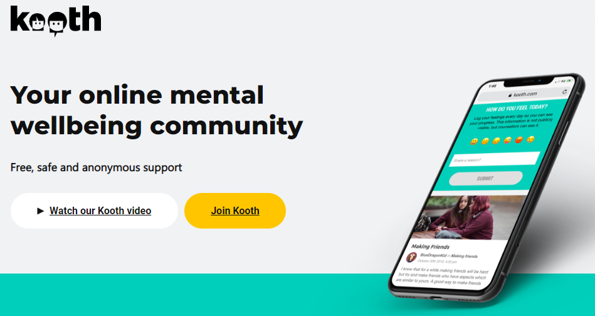
Looking after Mental Health
1. Plan
2. Make time for real breaks
3. Study with friends
4. Plan rewards for yourself
5. Listen to your body
6. Eat Well and keep hydrated
7. Don’t stop hobbies – exercise and social time are really important!

