Slide 1
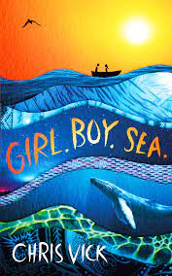
Crompton House School
English Department
Year 7 Summer Reading Challenge
Complete the activities while you read the book.
You can use the space provided to complete your answers, or you can print out the booklet and handwrite them in.
Prizes will be awarded for the best completed workbooks.
Name:

Slide 2
Reading Strategies
When we are reading, we will refer to the following strategies to help us to understand what we are reading in a deep and meaningful way.
Predictions
As you are reading, make predictions about what is going to happen next to the characters and how the plot might evolve.
Connections
As you are reading, make connections to the word ‘scavenger’.
Clarify
As you are reading, make a note of vocabulary you might not understand so you can look them up or discuss them with someone.
Questions
As you are reading, make a note of any questions you might have. Consider, what is the writer trying to show us?

Slide 3
Download the app or Click on https://soraapp.com/welcome
Click on My School is Secondary eBooks Now
Select Crompton House Church of England School from the scroll down menu or type in Crompton House School. Then click on our school.
User name – johnsmith23 (firstnamesurname + year started at CHS)
Password – ddmmyy students DOB in 6 digit format.
If you have trouble logging on email learning-zone@cromptonhouse.org
For an overview on how to use Sora click here!

Slide 4
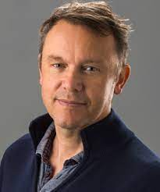
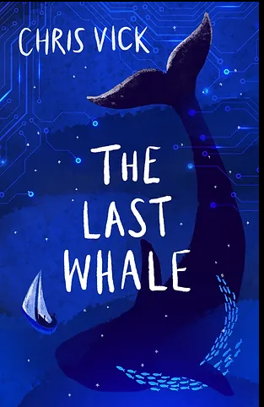
Reading the book
You can read this book as an audio book on SORA.
About the Author:
Chris Vick lives in Bath with his family and is a full time writer. Before becoming a writer, Chris worked for a whale and dolphin conservation charity (www.whales.org) and his love of these incredible animals inspires his work.
Chris went on to study an MA in creative writing at Bath University saying it changed his life:
“People say writing can’t be taught. Sure, you need a cracking story and you need to have a basic drive and set of skills, but good writer/tutors will really help you find your voice and your story, and will help you bring it from the dark of your imagination and into the light of day”
Chris continues to support marine conservation and is a member of the Authors4oceans initiative. https://www.authors4oceans.org/
His latest book is called:
Challenge Task:
Curious? Find out more about Chris Vick by watching the link to this video:
https://vimeo.com/413963630

Slide 5
Task 1 - Research
Research the two conservation charities that Chris has been involved with:
www.whales.org
https://www.authors4oceans.org/
What are the aims of these charities?
What do they do?
My notes:
Based on your research, how do you think this might link to Girl. Boy. Sea.?

Slide 6
Pre-Reading
Predictions
What are your impressions from the book cover?
Label what you can see.
Storm, shipwreck, survival. Chris Vick's novel delves deep into the mighty and majesty of the unpredictable ocean, the strength of an unlikely friendship between a British boy and a Berber girl and their will to survive against all the odds.
A British boy narrowly survives the sinking of his yacht in a huge storm off the coast of Morocco. After days alone at sea in a tiny rowing boat, Bill rescues a girl clinging for her life to a barrel. Aya, from the nomadic Berber tribe, was escaping to Europe when her migrant ship was destroyed in the same storm. Through endless days and star-spangled nights, they drift - mere specks on the vast, empty ocean - weakened by fear, hunger, and burned by the unforgiving sun. Aya tells Bill about The Arabian Nights, and Shahrazad, who told 1001 stories to save her life. As hope of rescue begins to fade, they find strength in these tales of magic, brave heroes, wily thieves, greedy sultans, and courageous girls.
When they land on a desert island, they're surprised to be confronted by a stranger who is not what he seems. Back out on the waves once more in the dark deep, a shadow follows...
What do you predict might happen in the story?

Slide 7
Pre-Reading
Vocabulary
Definition:
A genre is a particular type of literature, painting, music, film, or other art form which people consider as a class because it has special characteristics..
Synonyms: type, group, school, form
genre
[noun]
Examples:
His favourite books were from the horror genre.
Link:
What genre do you expect Girl. Boy. Sea. to be and why?
.
What do you think of the title? What meanings can you think of for each word separately and then for the whole title?
Challenge:
Why do you think each word has been separated by full stops rather than commas?

Slide 8
The structure of the novel.
Girl. Boy. Sea. is structured into six main sections.
The titles of each six sections are listed below in order. In brackets are additional titles within some of these sections.
Pandora
The Sea (The Tale of Shahrazad, The Thief of the Light)
Land (The Shadow Warrior)
The Sea (The Final Tale of Shahrazad)
Nowhere
The Road of Bones
What clues do these titles give us?
What do you think might happen in this story?

Slide 9
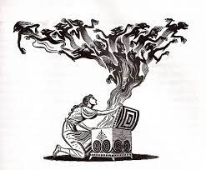
Pre-Reading
Chapter one is called Pandora. This is the name of the boat that the main character, Bill, is shipwrecked from. To understand the significance of this, we need to consider where the name Pandora originates from.
Greek Mythology: Pandora’s Box
This ancient Greek myth starts with Prometheus’ gift to mankind, which was the gift of fire. When Zeus, ruler of Olympus, found out, he was filled with rage! Fuelled by his anger, he punished Prometheus by shackling him in chains and each day he’d send an eagle to peck out his immortal liver, which grew back overnight!
Zeus also decided that mankind needed punishment too, so he commissioned Hephaestus and Athena to create the very first human, flesh and blood woman. Aphrodite gave her the ability to charm all men, and Hermes the gift of trickery and deceit. They breathed life into her and named her Pandora. Even though she was mortal, Zeus decided to marry Pandora to Epimetheus, Prometheus’ brother
She was given as a gift to Epimetheus, and he was overjoyed at the idea!
Prometheus tried to warn his brother that this was also a form of punishment, but Epimetheus laughed at him and joked saying ‘If this is what Zeus’ punishment is like, he can punish me more often, for Pandora is the most beautiful thing I have ever seen!’
Pandora came with a dowry which included many beautiful things, the most odd was a box made out of clay, with clear instructions that it never ever be opened. Pandora was as curious as she was beautiful and longed to open the box, but she brimmed with excitement at life on Earth, so this stilled her longing for what was in the box for some time. But because of her thirst for knowledge, often her mind would drift back to thoughts about the box.
Over time, the box became an obsession to Pandora, it was as if forces beyond her control were pulling her towards the box, saying her name over and over. One day she could resist the temptation no longer. She stole away from Epimetheus, ‘just one peek inside, and then I can rid my mind of this forever’ Pandora thought.
But at the first crack of the lid, the box flew open, monsters, spectres and awful sounds rushed out surrounding Pandora, screeching and cackling. She desperately tried to trap the creatures back into their box, but to no avail, they billowed away and were now free in the world of mortals!
As Pandora wept and shuddered, she heard a soft whisper coming from the box. This voice wasn’t the cruel howl of demons, it was a light twinkling sound that eased her anguish. Pandora once again opened the box, and a warm beam of light floated out, as the light fluttered around the evil Pandora had released, her fears melted away. She knew that opening the box was irreversible, but she had also set free hope to temper the effects of the evil.

Slide 10
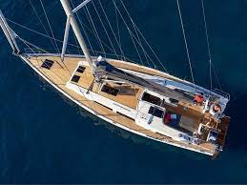
Pre-Reading
Making Connections
How does the story of Pandora’s box link to the theme of hope?
Making Connections
Why might Bill’s boat be called Pandora?

Slide 11
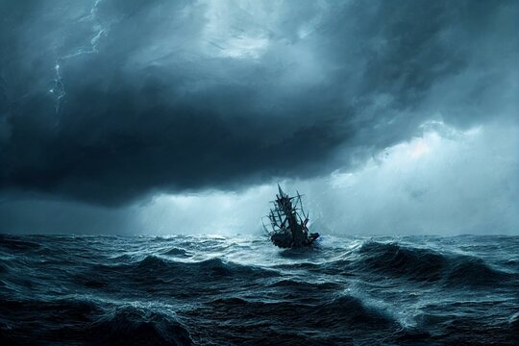
Read or listen to chapters 1- 5
The storm is the focus of these chapters.
Write down a list of interesting words or phrases used to describe the storm. For example,
“The violent rollercoaster of the waves.”

Slide 12
Now continue to read through the novel.
Make notes as you are reading about the main characters, Bill and Aya.
Consider the following:
What are your first impressions of these characters?
Do these impressions change as you are reading?
How does the relationship between them develop?
What struggles do they face?
My Notes

Slide 13
Character Study
Bill
Label your character with your impressions of them. Place thoughts and feelings on the inside and physical descriptions on the outside.
Summarise the character of Bill in one sentence.
Challenge: Would you like to be friends with Bill? Justify your answer.

Slide 14
Character Study
Aya
Label your character with your impressions of them. Place thoughts and feelings on the inside and physical descriptions on the outside.
Summarise the character of Aya in one sentence.
Challenge: Would you like to be friends with Aya? Justify your answer.

Slide 15
Pre-Reading
Vocabulary
Definition:
If you describe memories and descriptions as vivid, you mean that they are very clear and detailed..
Synonyms: clear, detailed, realistic, telling
Adverb = vividly
vivid
(adjective)
Examples:
People of my generation who lived through World War II have vivid memories
of confusion and incompetence.
On Wednesday night, I had a very vivid dream which really upset me.
Non- Examples
It was very vivid; I can hardly remember it.
Explain in your own words why the non-example is the incorrect use of the word vivid.

Slide 16
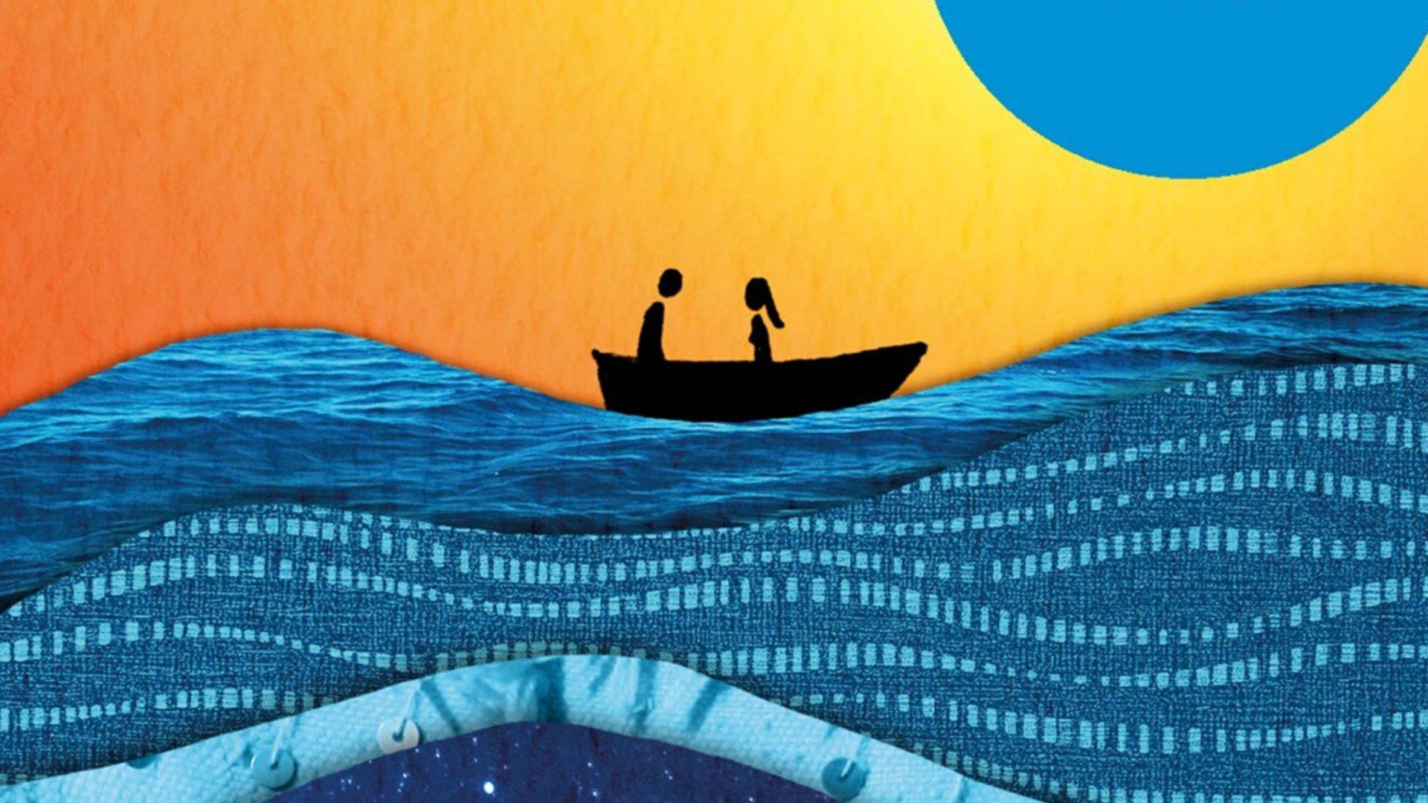
Character Study
Challenge:
One reader said, “For me, the sea is overwhelmingly the main character in this novel. Chris Vick brings it to life so vividly that it takes on a personality.
Write down three descriptions of the sea within the book:
1.
2.
3.
Do you agree or disagree with the reader’s statement? Why? Why not?

Slide 17
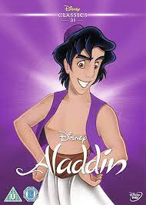
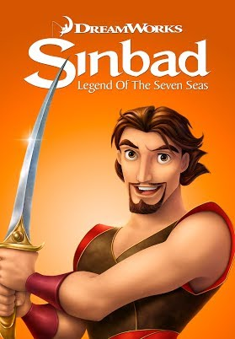
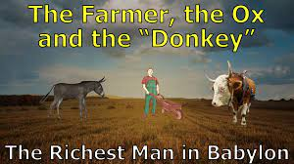
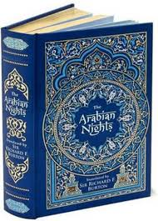
Storytelling
What do these images have in common?.
These are all stories which originate from a short story collection called The Thousand and One Nights. Read below a summary of the tales.
The One Thousand and One Nights, perhaps better known in the Western world as The Arabian Nights, is a remarkable collection of folk tales and legends from what is commonly known as the Middle East. As with the classical Greek and Roman myths and the Norse legends, these stories are anonymous and have their roots in oral culture, passed down from one generation to the next.
“The tales themselves are masterpieces of the art of story-telling. In inventiveness and sheer entertainment value they stand supreme among the short stories of all time.”

Slide 18
Pre-Reading
Vocabulary
Definition:
A narrative is a story.
A frame narrative is a story in which another story is enclosed or embedded as a ‘tale within a tale’.
Synonyms: ‘A story within a story.’
Frame Narrative
The writer employs a narrative structure in which the main action is relayed at second hand through an enclosing frame story.
.
Examples:
Famous frame narratives include:
Frankenstein
Wuthering Heights
The Canterbury Tales
How does Girl. Boy. Sea. use a frame narrative?

Slide 19
Storytelling
In Girl.Boy. Sea. Aya begins telling Bill stories. Firstly, she does this to help pass the time but as these stories develop, she reveals more of herself and they help contribute to their survival.
Aya begins by telling Bill the story of Shahrazad (Scheherazade) the narrator of the One thousand and One Nights. Read more about this story below:
The tales from One Thousand and One Nights are set within a frame story. Its scene is Central Asia or “the islands or peninsulae of India and China,” where King Shahryar, after discovering that during his absences his wife has been regularly unfaithful, kills her and those with whom she has betrayed him.
Then, loathing all womankind, he marries and kills a new wife each day until no more candidates can be found. His vizier, however, has two daughters, Shahrazad (Scheherazade) and Dunyazad; and the elder, Shahrazad, having devised a scheme to save herself and others, insists that her father give her in marriage to the king.
Each evening she tells a story, leaving it incomplete and promising to finish it the following night. The stories are so entertaining, and the king so eager to hear the end, that he puts off her execution from day to day and finally abandons his cruel plan.
Connections
How does storytelling help Aya and Bill with the difficult decisions they need to make and ultimately help them to survive?
Challenge: Most of Aya’s stories feature strong female characters. What does this tell us about her?

Slide 20
Timeline
Create a timeline going down the page with the key events from the story.

Slide 21
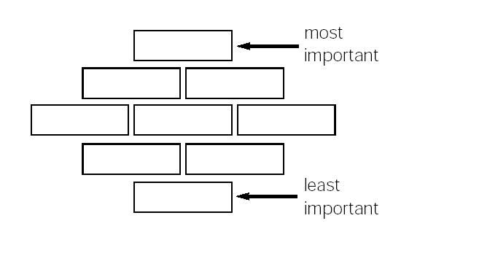
After Reading: What is the novel about?
Below are nine suggestions for what Girl. Boy. Sea. is about.
Rearrange them into a ‘Diamond 9’ formation as shown below.
Girl. Boy. Sea. is about……
The friendship between a young girl and a young boy. | The importance of hope and resilience. | How the world can be dark and dangerous.
Migrant struggles and war-torn communities | The power of nature. | The importance and relevance of stories.
Overcoming human differences | How life-changing experiences make you a better person. | The struggle between humans and the environment.
Explain why you have placed your top one as the most important theme.

Slide 22
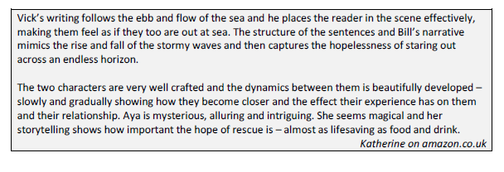
Reviews
The following extracts are all from reviews of the book.
Which review comes closets to your own view of the book and why?

Slide 23
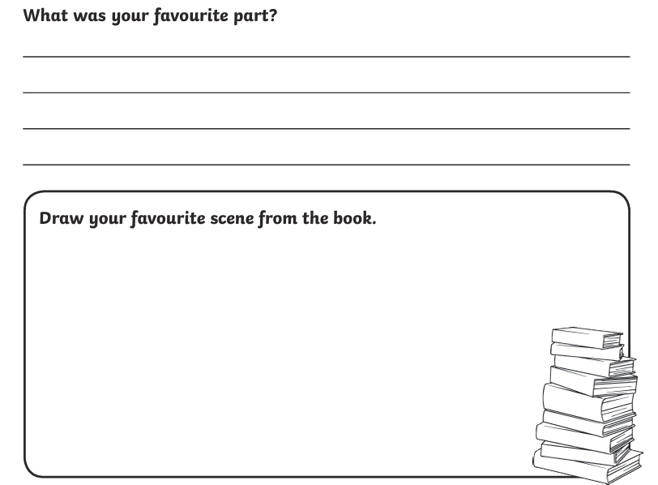
Reviews
Create your own book review.

Slide 24
Creativity
Complete any three tasks of your choice.
Draw a key scene from the novel.
Draw a poster promoting one of the charities that the author, Chris Vick, supports.
Draw your own book cover for the novel.
Write an alternate ending to the novel.
Write a short story titled, The Shipwreck.
Write a description of one of the animals in the story.
Create a VLOG book review of the novel.
Discuss your favourite character with someone who hasn’t read the story.
Talk to someone about this book and give a verbal book review.
Read another Chris Vick novel and write a book review.
Read an extract from The Arabian Nights and write a summary of the plot.
Research and read two non-fiction articles about the refugee crisis.

Slide 25
Additional Pages for Notes (if needed)

Slide 27
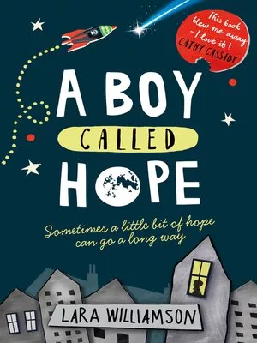
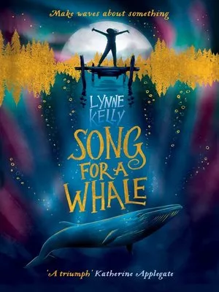
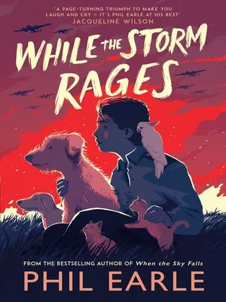
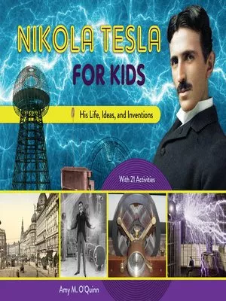
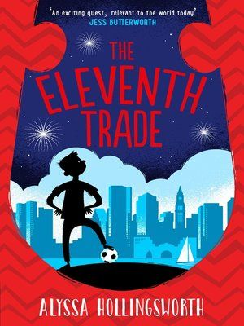
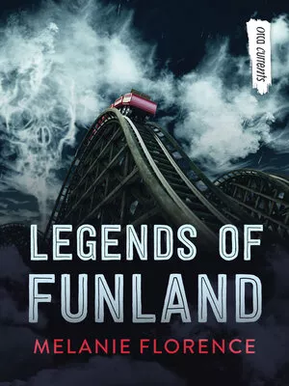
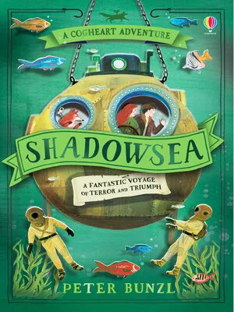
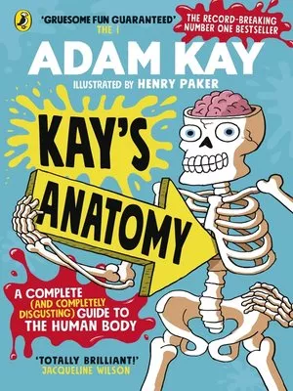
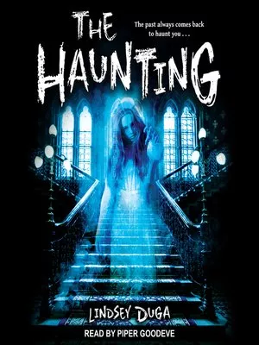
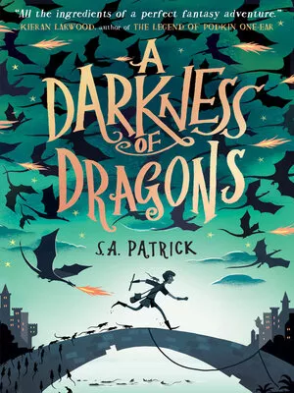
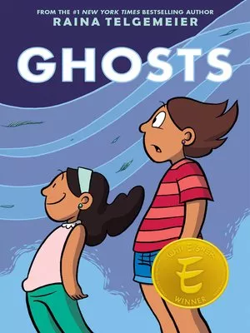
More recommendations to enjoy on Sora

