Slide 1
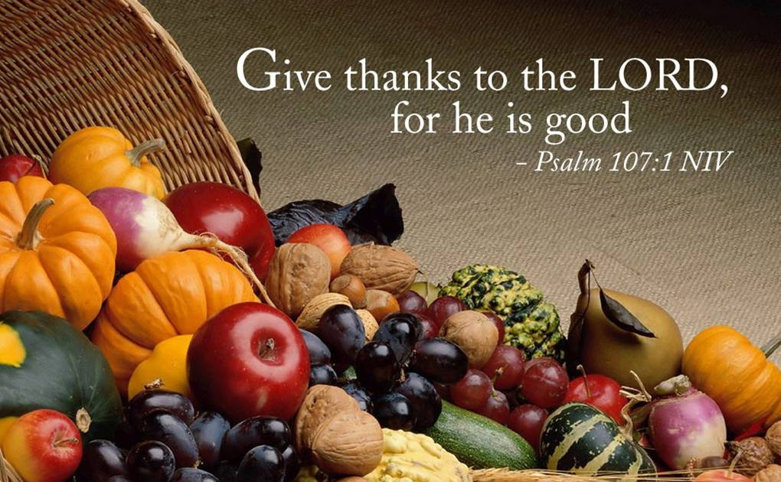
Harvest Thanksgiving

Slide 2
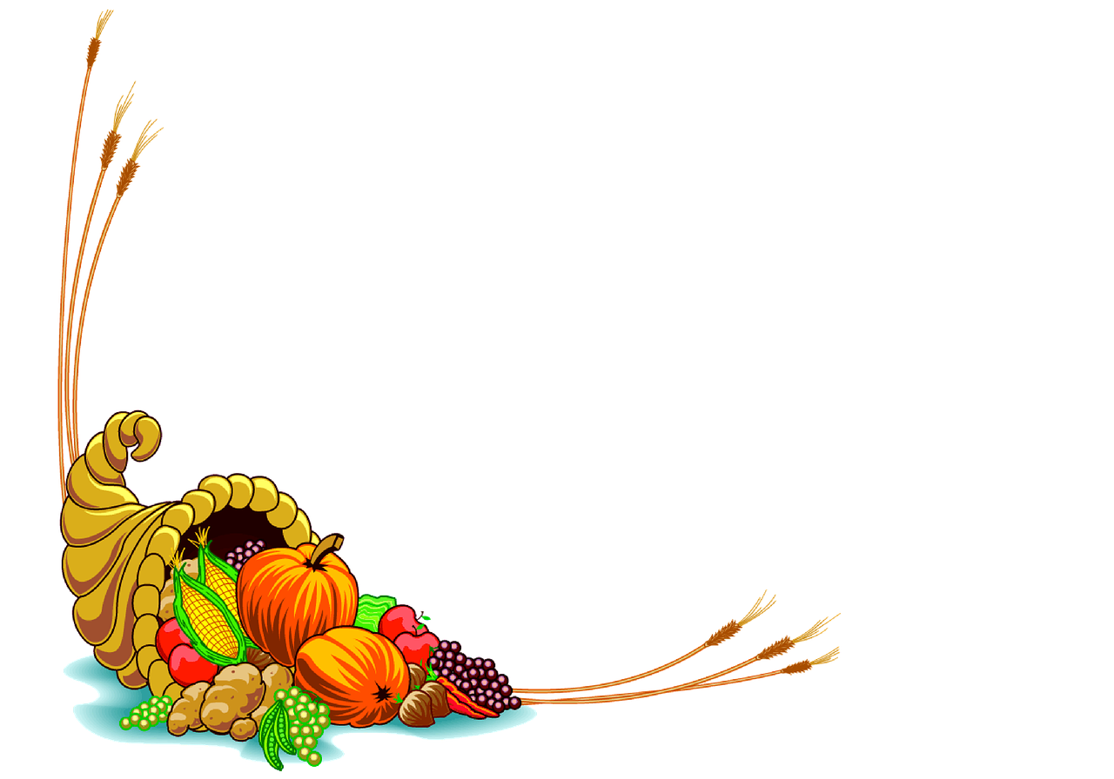


Crompton House supporting Oldham Foodbank
Harvest Thanksgiving 2023

Slide 3


‘Then they will say to the King, “Master, when did we ever see you hungry and feed you, thirsty and give you a drink? And when did we ever see you sick or in prison and come to you?’
Then the King will say, ‘I’m telling the solemn truth: Whenever you did one of these things to someone overlooked or ignored, that was me—you did it to me.”’
Matthew 25:37-40

