Slide 1
Y10 Working Together Evening
Welcome to KS4

Slide 2
Notes:
Your child has now started the final two years of their GCSE journey. Our current Y11 have about 22 schools weeks until their exams start and it soon comes around. So what can we do to ensure students are prepared and avoid cramming information in y11, to ensure students are fully prepared well in advance.

Slide 3
The Importance of you….
Notes:
And the most important thing is often you, parents and careers. Whilst we are constantly trying push the important of independent learning, and this most certainly is the key to success, it sometimes takes a little bit of support and a helping hand to steer them in the right direction. And that it was we hope to do in this short meeting. I want to share with you some strategies you can use to support your child and give them a helping hand in starting their GCSE Preparations.

Slide 4
Aims
Mrs Hegarty
Welcome and introductions
Mr Raynerd
ClassCharts
GCSEPod & Online Resources
The GCSE Journey
Exam board specifications
Assessments
Mrs Gadsby
Revision Strategies
Good Mental Health

Slide 5
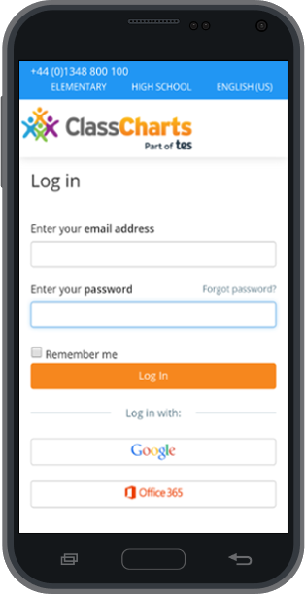
Class Charts
Notes:
Class charts is our primary form of communication

Slide 6
Download the app from the App Store
ENTER YOUR CODE AND FOLLOW THE INSTRUCTIONS. YOUR CHILDE WILL HAVE A DIFFERENT CODE!

Slide 7
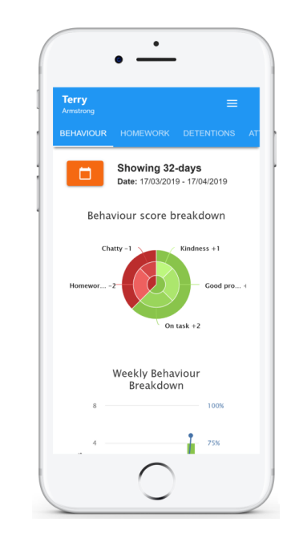
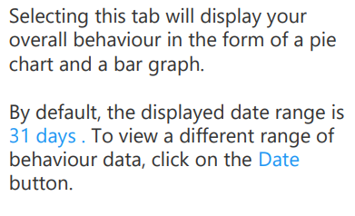
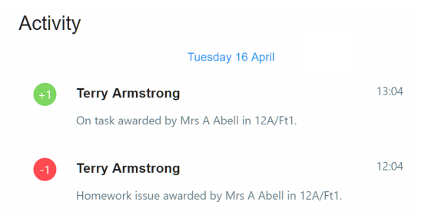
Behaviour Data

Slide 8
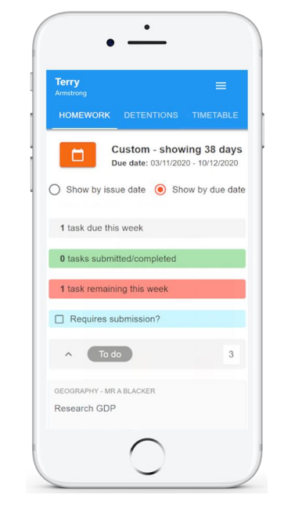
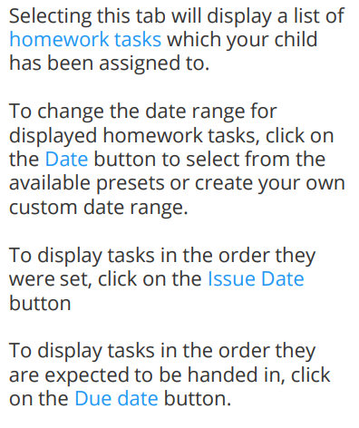
Homework

Slide 9
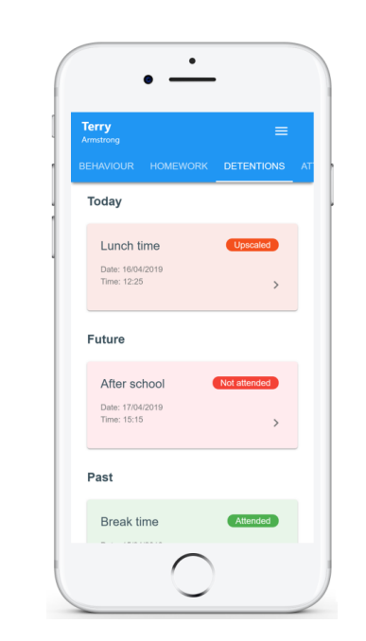
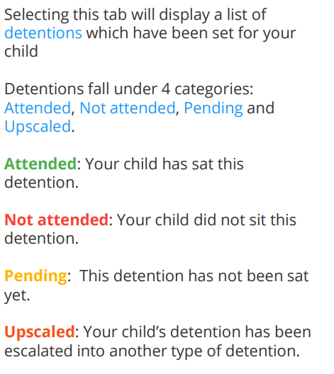
Detentions

Slide 10
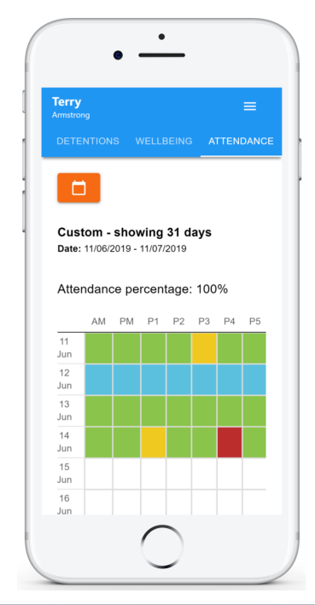
Attendance
Lesson by lesson attendance.
1 Day delayed.

Slide 11
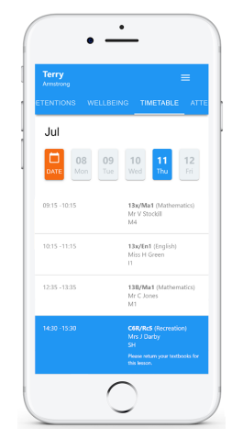
Timetable

Slide 12
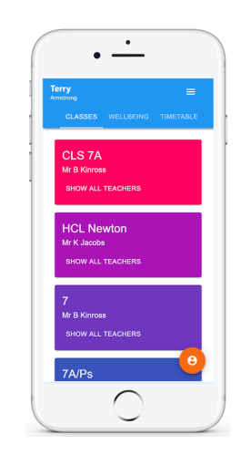
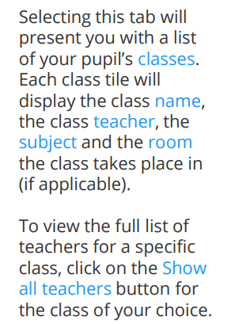
Classes

Slide 13
Generic Resources for Revision

Slide 14
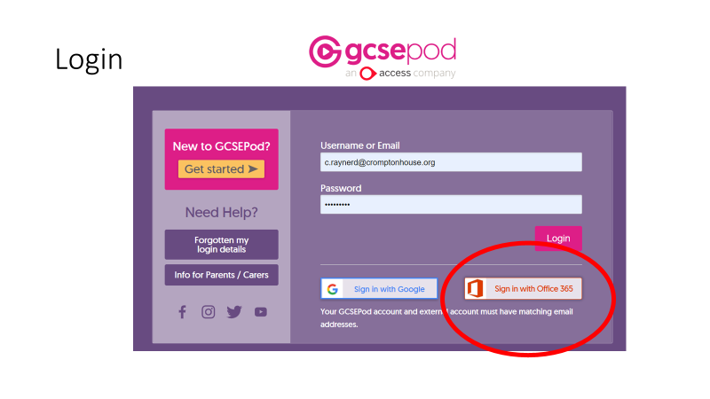
GCSEPod

Slide 19
Resources

Slide 23
Online Revision Websites

Slide 24
The GCSE Journey
What does it look like?
The GCSE Journey – What does it look like?
Notes:
For my next few slides I`d like to talk to you about subject content. How do you know what your child is learning and at what point are they going to be taught it. And this can all be found on our website.

Slide 25
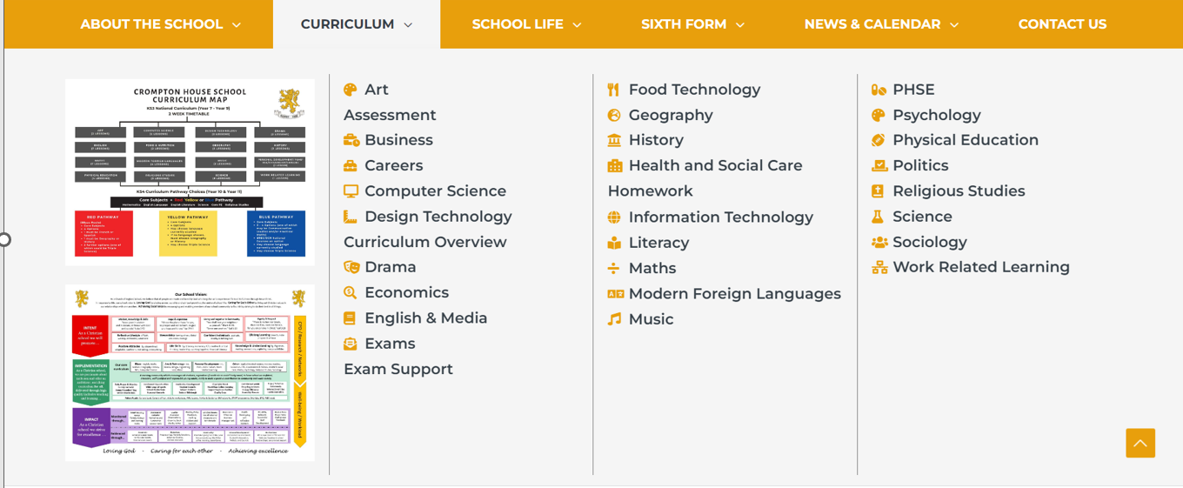
Notes:
If you navigate to our website and head to curriculum, you can see a super detailed overview – you can find our implementation and impact statement but importantly a clear curriculum map and overview statement, identifying what topics are being taught in which term

Slide 26
Notes:
In this example, we have the intent/implementation and impact statement which will open once selected, and in the orange box at the bottom, links to download the schemes of work and learning journey.

Slide 28
Subject Specifications / Exam Boards
This slide will be updated and sent as a separate parent email.
AQA | GCSE | Biology
Pearson | GCSE | Business
AQA | GCSE | Chemistry
AQA | GCSE | Combined Science: Trilogy
OCR | CAMBRIDGE NATIONAL | Creative iMedia
AQA | GCSE | Design and Technology
OCR | CAMBRIDGE NATIONAL | Design Engineering
AQA | GCSE | Drama
OCR | CAMBRIDGE NATIONAL | Engineering Manufacture
AQA | GCSE | English Language
AQA | GCSE | English Literature
AQA | GCSE | Food preparation and nutrition
AQA | GCSE | French
AQA | GCSE | Geography
AQA | GCSE | History
EDUQAS | LEVEL 1/2 AWARD | Hospitality & Catering
Pearson | GCSE | Mathematics
Pearson | BTEC | Level 1/2 Technical Award in Music Practice
AQA | GCSE | Physical Education
AQA | GCSE | Physics
AQA | GCSE | Religious Studies
AQA | GCSE | Sociology
AQA | GCSE | Spanish
OCR | CAMBRIDGE NATIONAL | Sport Studies
Subject Specifications and Subjects with NEA
Notes:
Along with this information it is vital to know the exam board that your child is studying. Whether you are choosing to purchase some additional revision resources, or just download some past paper questions, it is vital that you chose the exact exam board. In the next few days this powerpoint will be released on our website and you can use this slide to check the exam board for each subject.

Slide 29
Subjects – Theory & NEA (Non Examined Assessment)
Non-Examination Assessments (NEA) is defined as work assigned to and completed by a student during a course of study and contributes to the student’s final exam grade; it is marked internally by the teacher before being submitted for review and external moderation by the exam board.
Subject Specifications and Subjects with NEA

Slide 30
Approved Revision Guides
Revision Guides – Years 10/11
Notes:
There are many revision guides which are available and many that are approved by the exam boards and also the school. Departments will be in touch to offer these revision guides and resources, often at a reduced price. Whilst they are not essential, they are most definitely recommended to support independent study.

Slide 31
Assessment Plans – Year 10
Summative Assessment 1 Deadline: 20th November
Short Report Information to parents: W/C 11th December
Summative Assessment 2 Deadline: 12th February
Short Report Information to parents: W/C 4th March
End of Year Assessments: W/C 10th and 17th June
Short Report Information to parents: W/C 8th July
Assessment Plans – Year 11
Mock Examination 1 – Autumn Term 1
Mock Examination 2 – Spring Term 1
Assessment Plans – Years 10/11

Slide 32
Parents’ Evenings
Wednesday 13th March CO/CR
Thursday 21st March OR/RI
Assessment Plans – Years 10/11

Slide 33
Homework
Why is it important?
Are you organised? Do you go on the Class Charts App every day?
Do you have a routine?
Location?
Time?
Notes:
Homework is set to allow students to work independently, either researching concepts and ideas or more frequently, practicing questions.

Slide 34
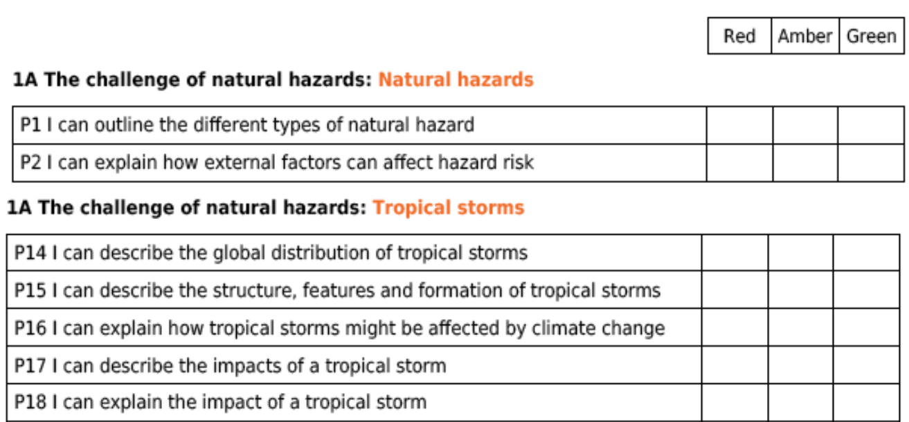
PLCs in Books
03/09
02/11
03/09
02/11
03/09
07/09
02/11
02/11
02/11
02/11

Slide 35
Other resources/how to revise/prepare:
Exam board website – past questions
Revision guides
Teams
Seneca Learning
GCSE POD
Textbooks
The internet – BBC Bitesize etc
Folder notes / course booklets
Subject specific resources / websites e.g. Kerboodle, My Maths

Slide 36
Hard work and high standards =
Mrs Gadsby

Slide 37
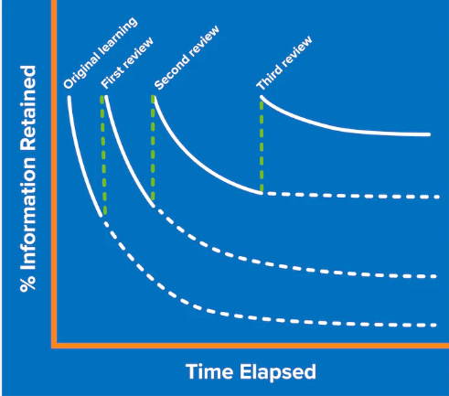
Why Retrieval practice?
Retrieval practice is a learning strategy where students focus on getting information out.
Through the act of retrieval, or calling information to mind, memory for that information is strengthened and forgetting is less likely to occur.
The aim of independent study and revision is to be able to retrieve previously learnt knowledge so that it is secure in your long term memory.

Slide 38
This is an example of a blank Retrieval Practice sheet.
 | Niveau 1 – Listez… | Niveau 2 – Complétez… | Niveau 3 – Traduisez…
Year 9 | 3 adjectifs por donner une opinion | Récemment… et c’était… | I am going to eat at Nando’s, it will be great.
Year 10 | 3 lieux dans une ville (places in town) | Dans ma ville on peut….dans… | In my town there is a lot to do.
Year 11 | 3 problèmes environnementaux | Si on…. on peut… | We should reduce waste

Slide 39
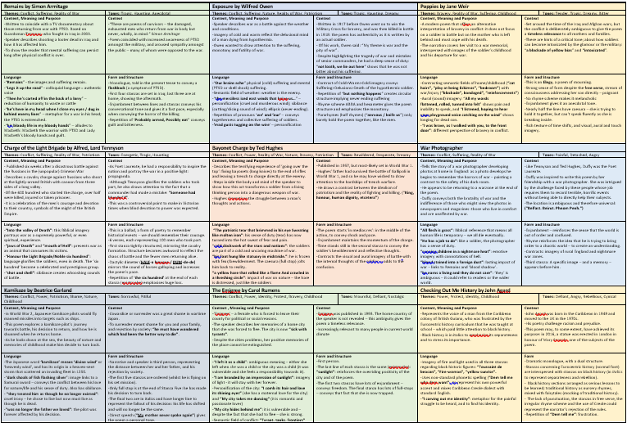
Knowledge Organisers
ENGLISH
This is an example of a knowledge organiser for the Anthology Poetry.
It has all the essential knowledge for each poem including context, meaning, language and structure.

Slide 40
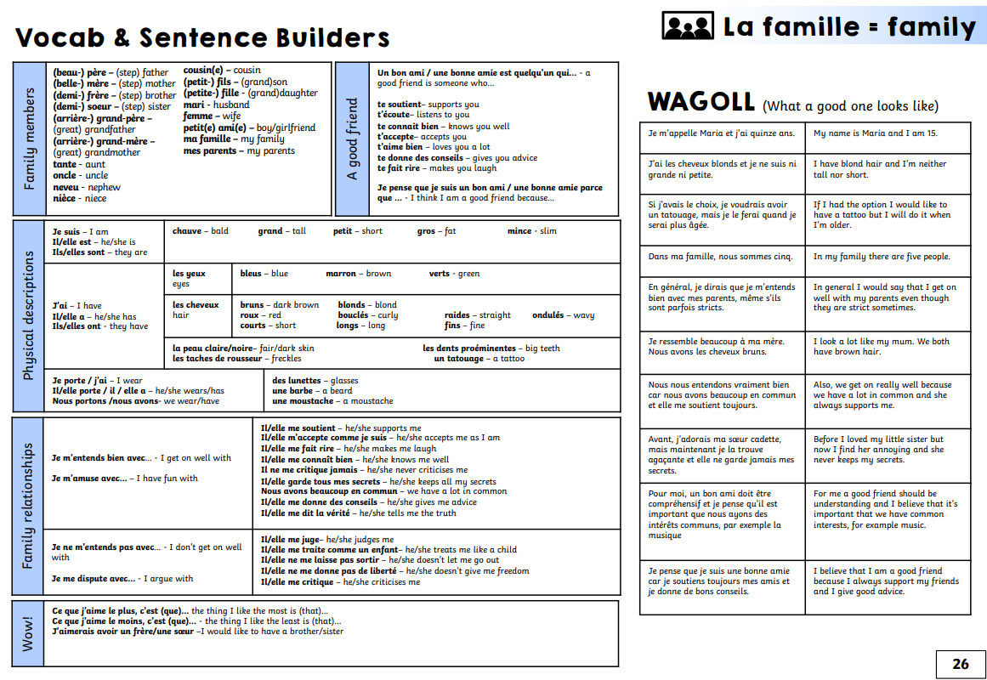
Knowledge Organisers
MFL
This is an example of a knowledge organiser on the topic of Family.
It has all the essential vocab and structures needed to write/speak about family

Slide 41
Look Say Cover Write Check
LOOK SAY COVER WRITE CHECK x3
LOOK - Read the specific knowledge you need to learn.
SAY – Read out loud the specific knowledge you need to learn.
COVER – Cover the knowledge.
WRITE – Write out everything you can remember from knowledge organiser
CHECK – Check that you have all the knowledge needed and it is correct. Any content that is missing or incorrect use a red pen to illustrate the gaps in your knowledge that you have corrected.
x3 – Repeat 3 times.
Round | Knowledge
1
2
3

Slide 42
Chunking
Write a topic out in your own words in the boxes provided

Slide 43
Concept Mind Map
Create a mind map using the knowledge from your Knowledge Organiser. Break up the topics into key concepts and different categories to practice retrieval.

Slide 44
Shrink it
KNOWLEDGE HERE
2. Summarise Here
4.Summarise a final time
3.Summarise Again

Slide 45
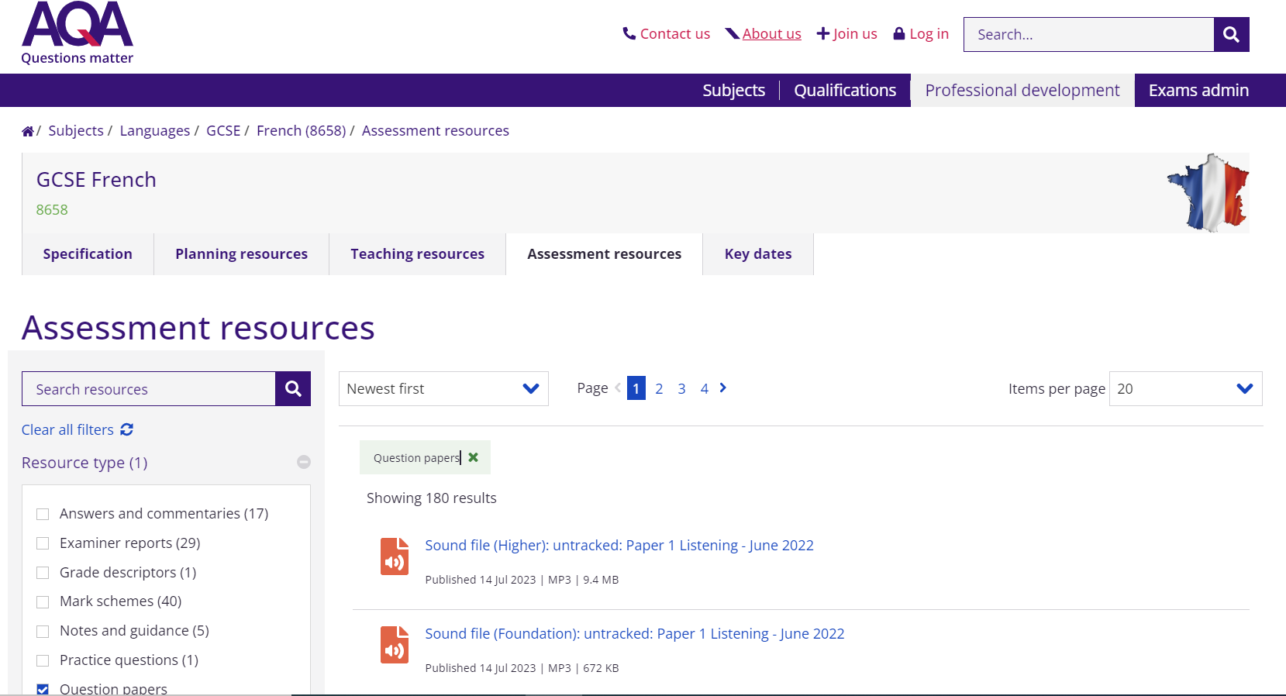
Test it
Exam Practice
Exam board Websites Published practice books

Slide 46
Looking after Mental Health
1. Plan
2. Make time for real breaks
3. Study with friends
4. Plan rewards for yourself
5. Listen to your body
6. Eat Well and keep hydrated
7. Don’t stop hobbies – exercise and social time are really important!

Slide 47
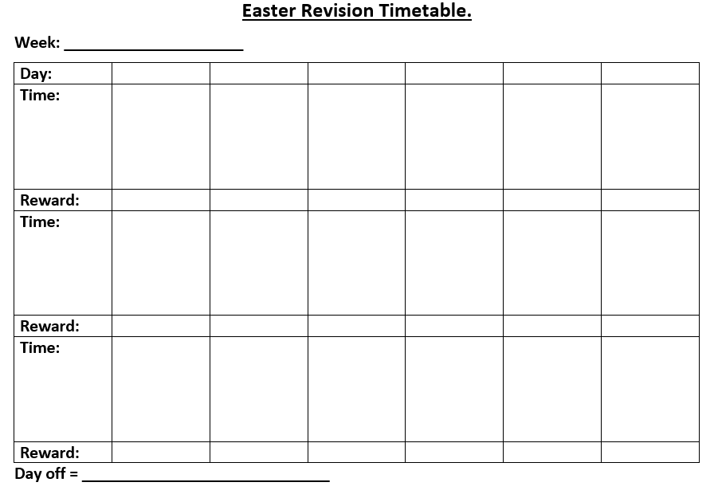

Slide 48
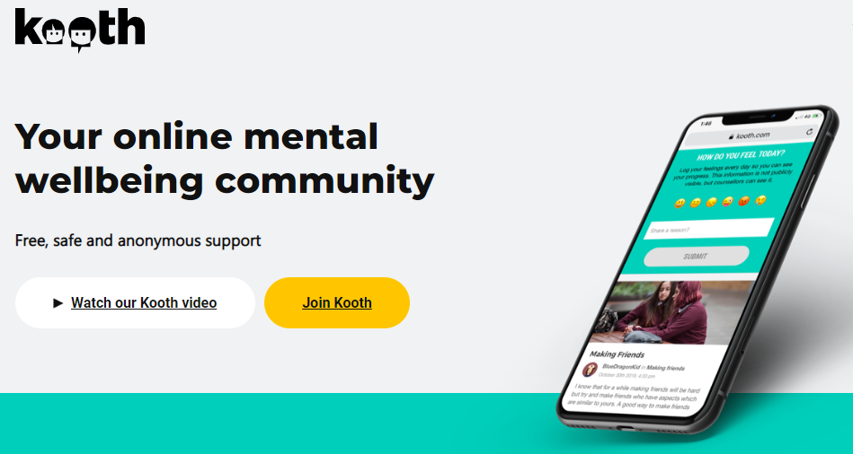
Looking after Mental Health
Ask for help if you need it.
Contact Mrs Gadsby / Miss Daniel in the Hub.
KOOTH

