Slide 1

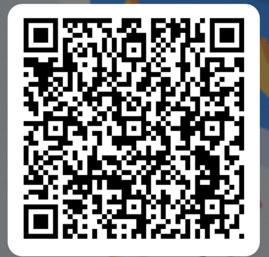
Welcome
Please take a seat
Scan the QR code to register your attendance

Slide 2
Welcome
Mr S. Deane
Assistant Headteacher – KS3
Notes:
Welcome to the PIE for Year 7. I am Mr Deane, assistant HT and responsible for KS3 behaviour and standards. I will also be talking to you tonight about Rewards and Extra curricular activities in Year 7. I would like to introduce you to the colleagues who will be speaking to you this evening. Ms Clough – assistant headteacher and head of year 7 who will be speaking to you about our pastoral offer and assessment. Mr Slack who is our Deputy Headteacher and will be speaking to you about the Curriculum. Mr Robinson who now has a whole school responsibility for homework will be discussing homework with you and finally Mrs Heywood who is our SENCO and will be talking about our offer. I will now pass over to Miss Clough who will talk to you about our pastoral provision

Slide 3
Pastoral Offer
Ms S. Clough
Assistant Headteacher and Head of Year 7

Slide 4
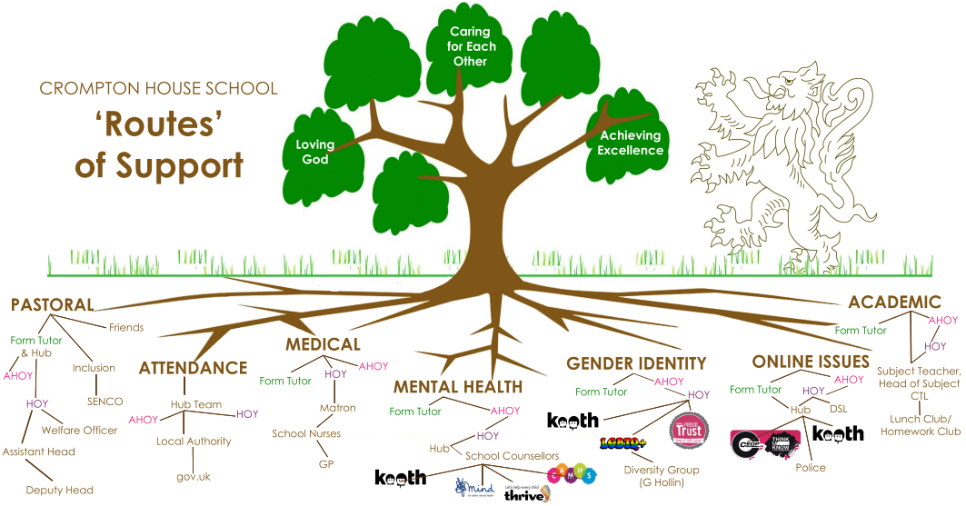
Pastoral Care at CHS

Slide 5
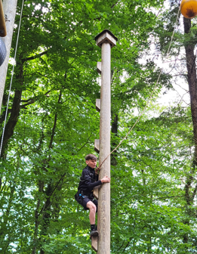
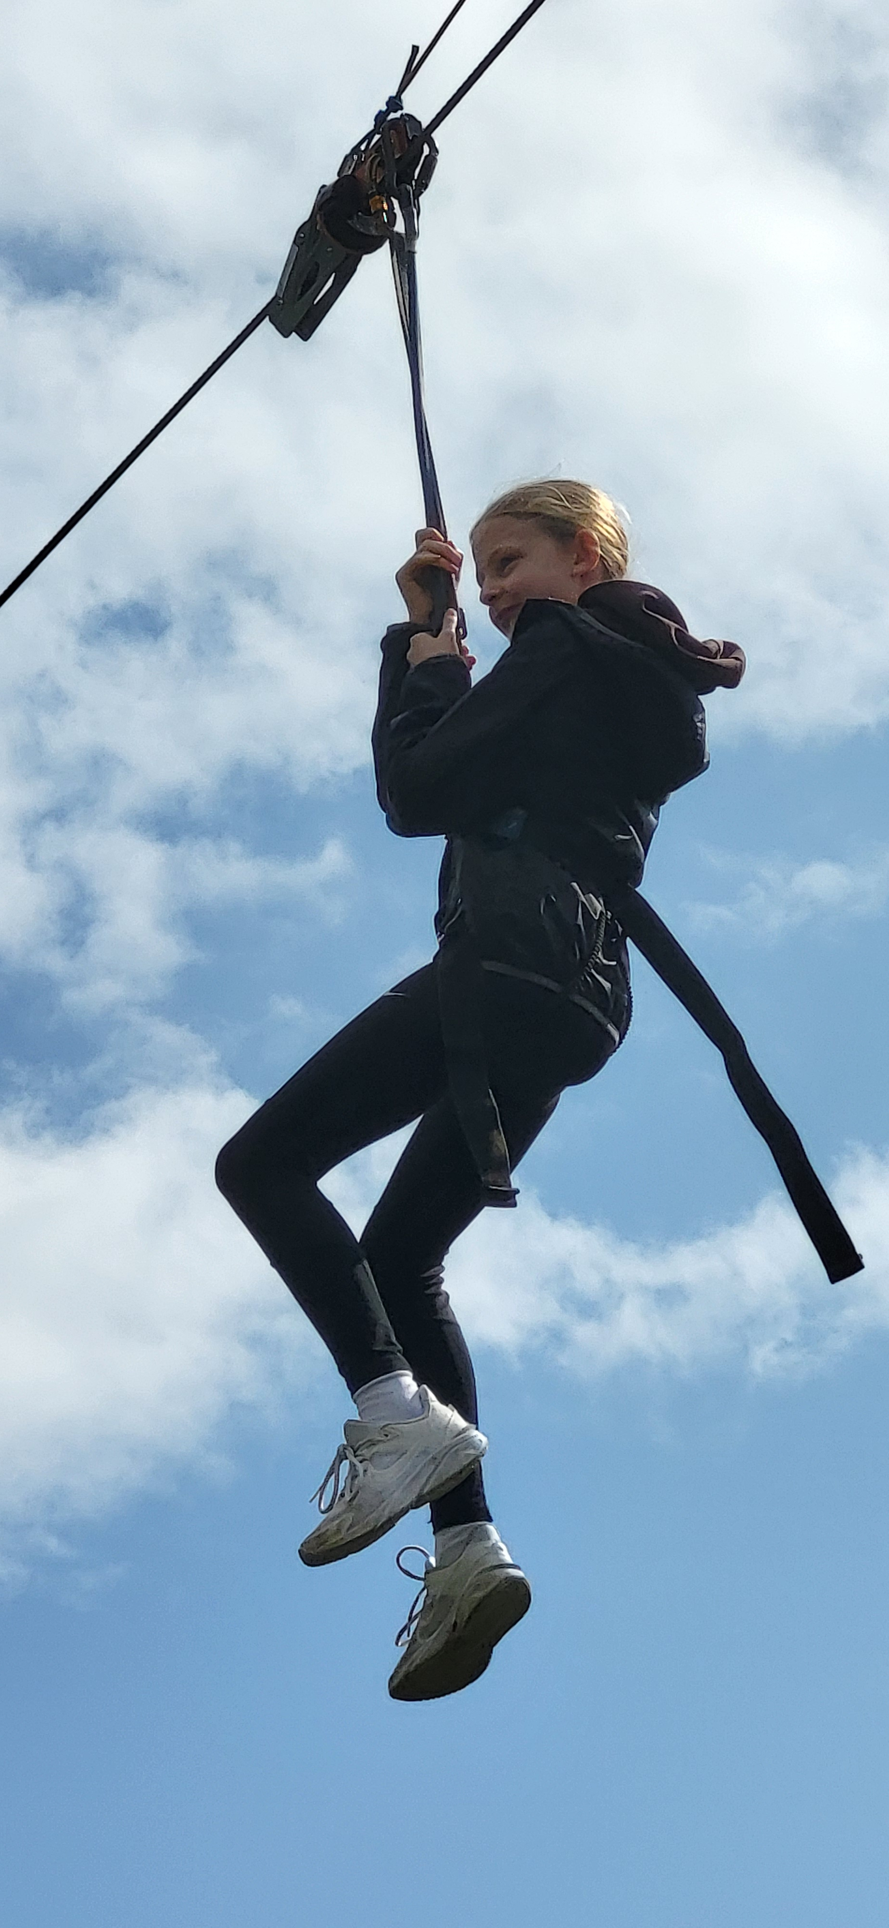
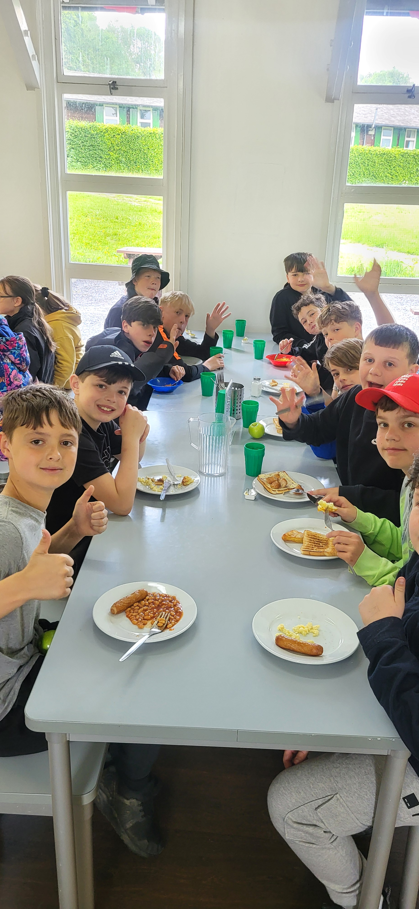
Colomendy 2025

Slide 6

Crompton House School PTFA
Please support your PTFA:
Join the 500 Club Lottery
Offer support at school events such as:
  Year 7 Disglo (Oct/Nov)
  Christmas Fair (Dec)
  Spring Ball (Mar)
  Summer Plant Sale (Apr-May)
Help provide refreshments at parent’s evenings, concerts and theatre productions
Join the Management Committee: We meet every 2nd Thursday monthly 7pm-8pm in the Sixth Form Centre
For more information or to join the PTFA WhatsApp group, please contact: info@cromptonhouse.org
Raising funds to support the education and enrichment opportunities of our children

Slide 7
Class Charts
Ms S. Clough
Assistant Headteacher and Head of Year 7

Slide 8
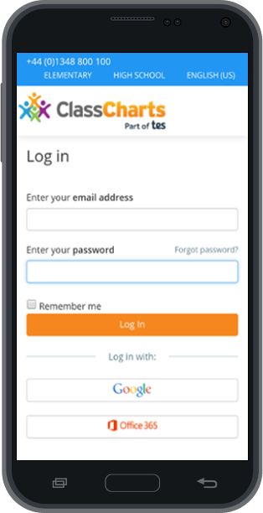

Class Charts

Slide 9

Download the app from the App Store
ENTER YOUR CODE AND FOLLOW THE INSTRUCTIONS.
YOUR CHILD WILL HAVE A DIFFERENT CODE!

Slide 10
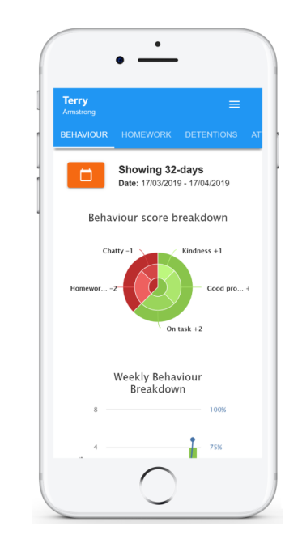
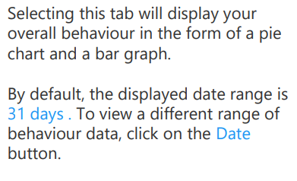
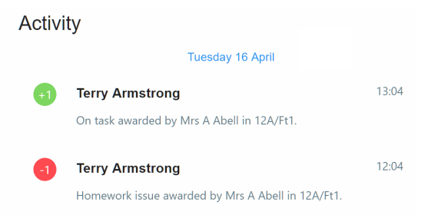
Behaviour Data

Slide 11
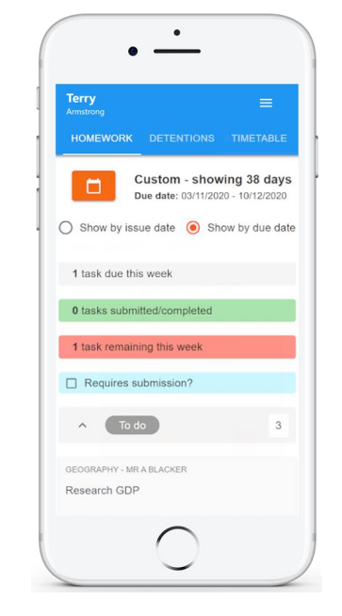
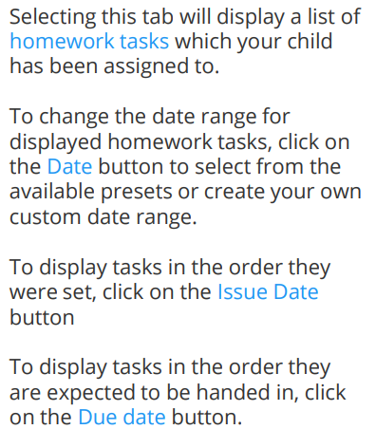
Homework

Slide 12
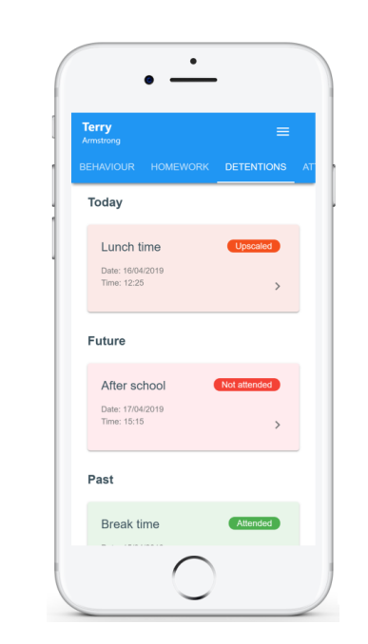
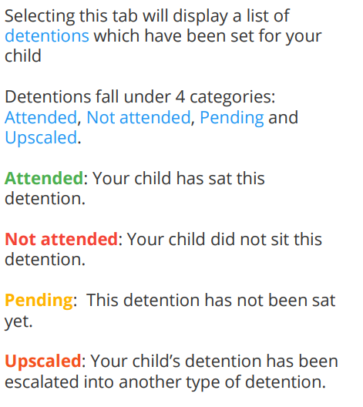
Detentions

Slide 13
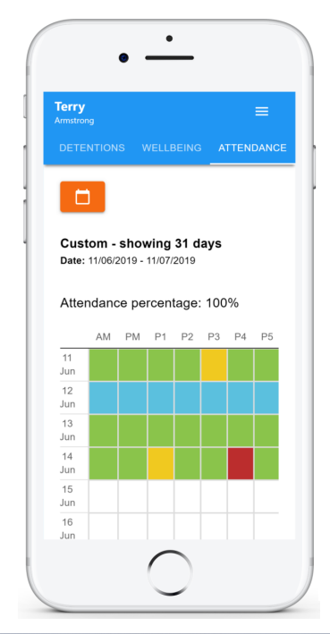
Attendance
Lesson by lesson attendance.
Green indicates a present mark
Yellow indicates a late to lesson mark
Red indicates an unauthorised absent mark
Blue indicated an authorised absent mark
1 Day delayed.

Slide 14
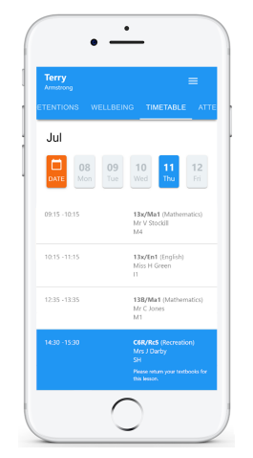
Timetable

Slide 15
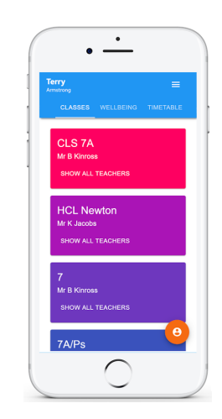
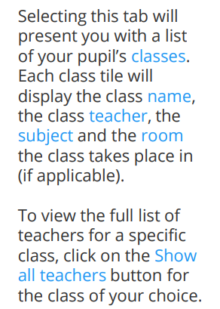
Classes

Slide 16
Office365
Ms S. Clough
Assistant Headteacher and Head of Year 7

Slide 17
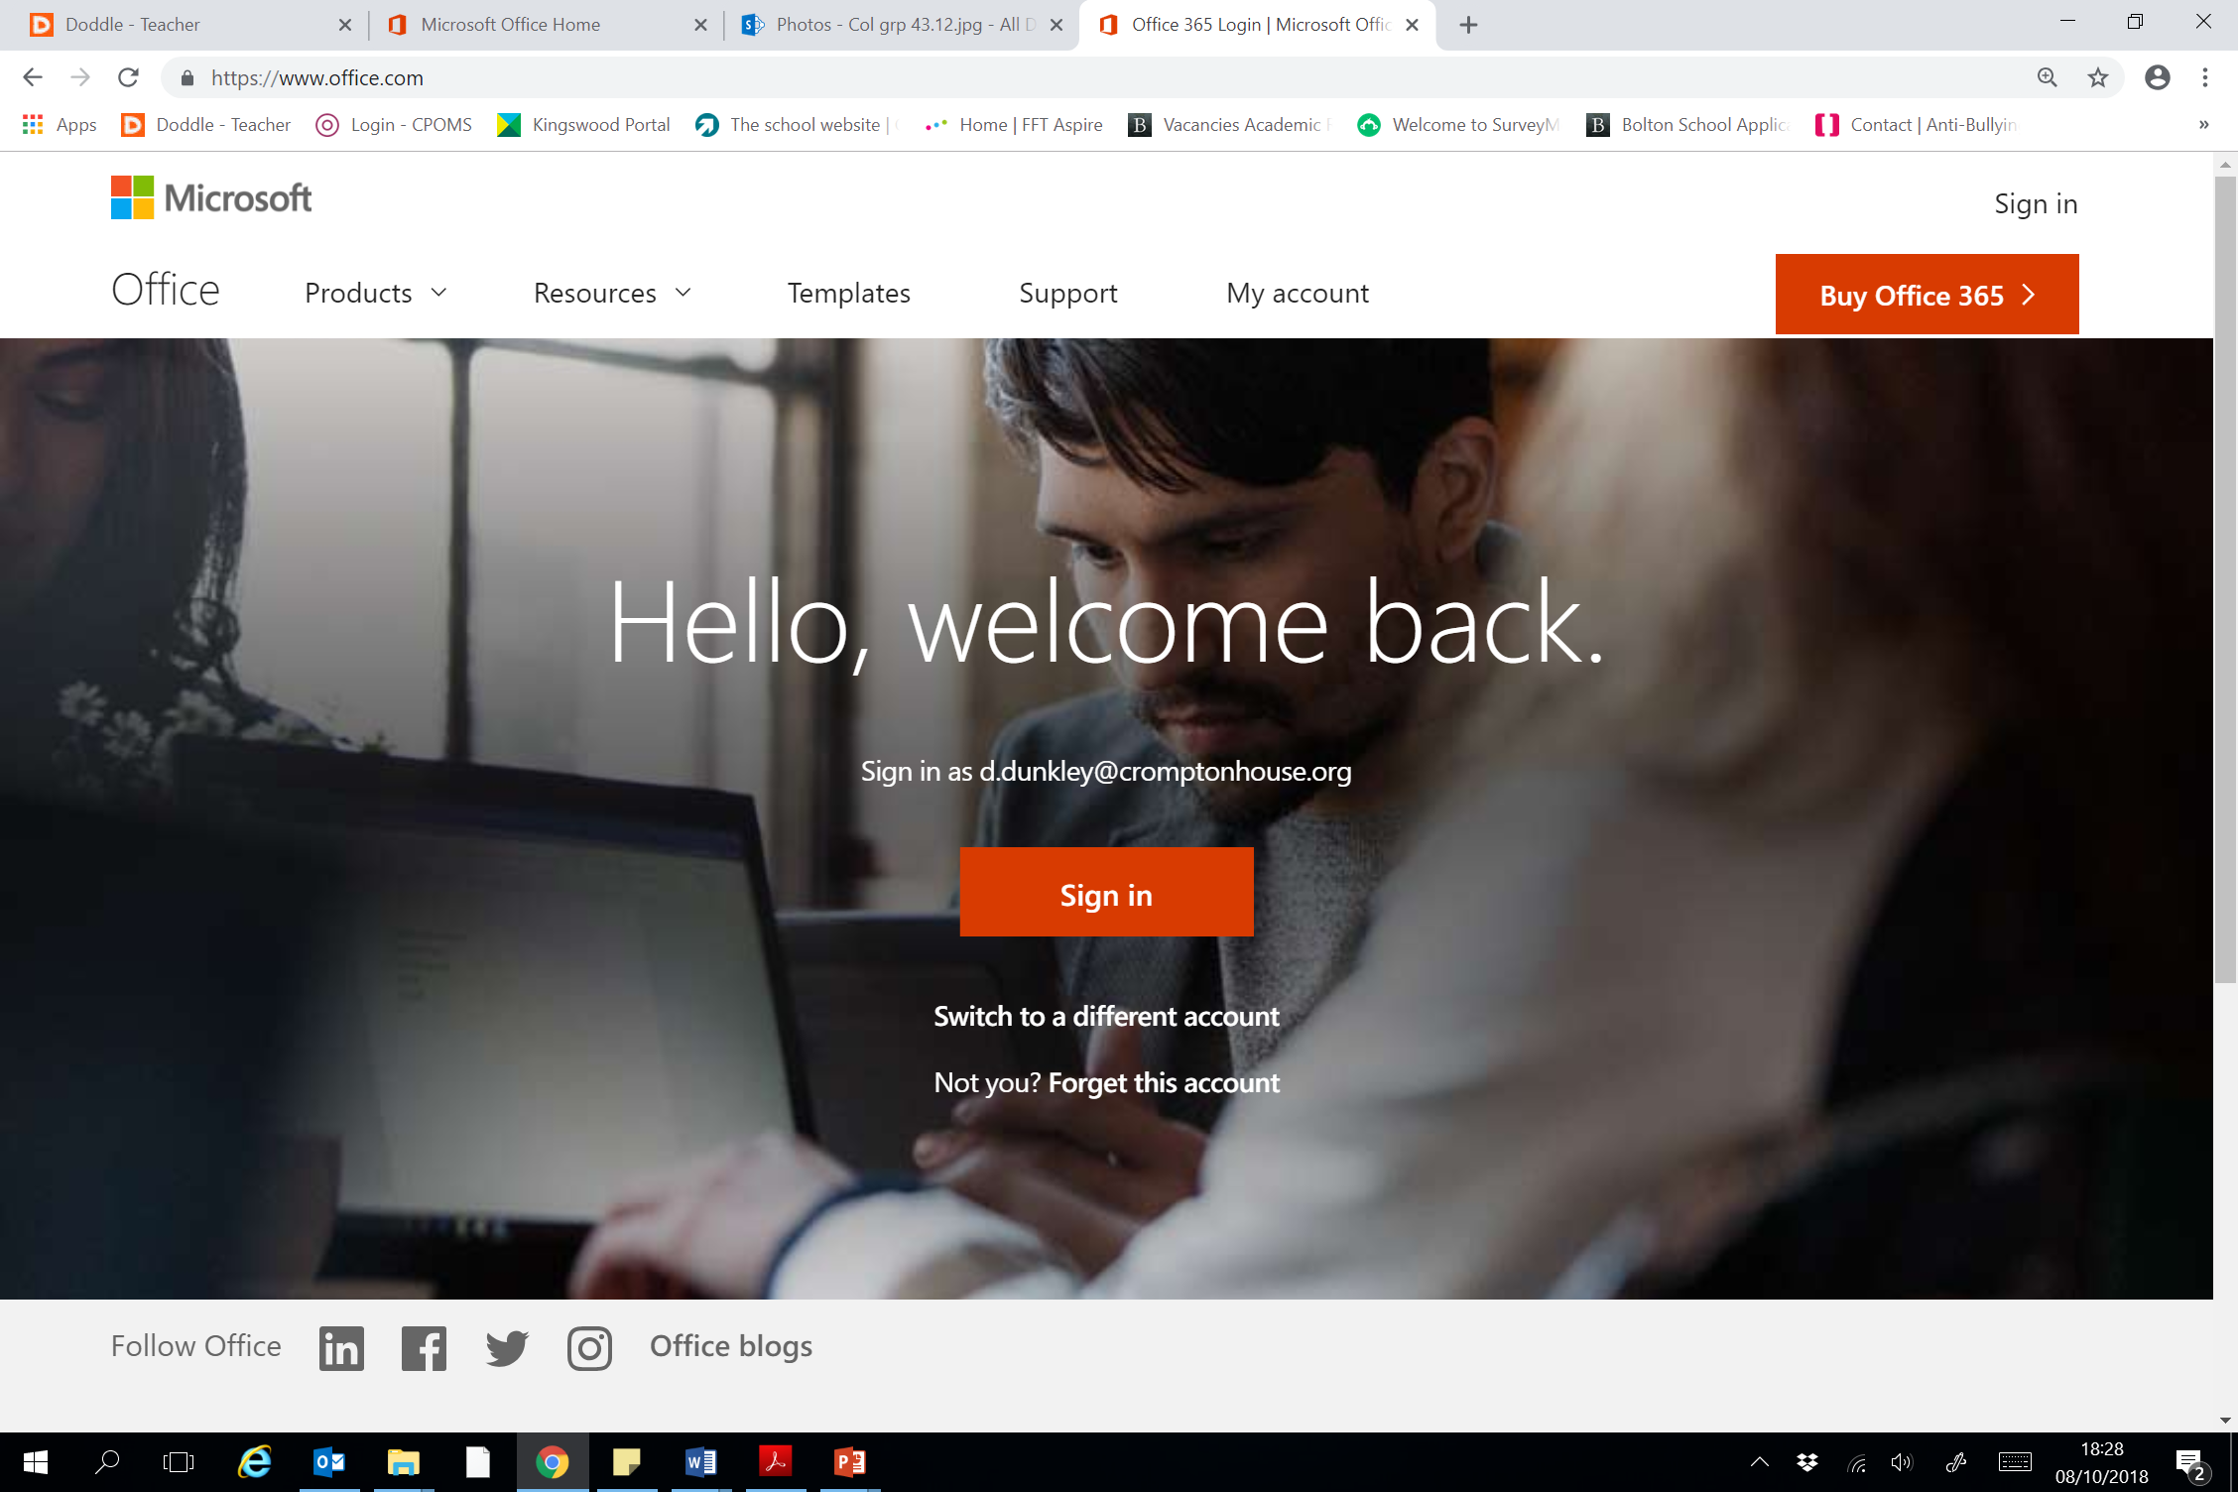
Office 365
All students have access to office 365
https://www.office.com
Password resets can be actioned with help from the school’s IT team.

Slide 18
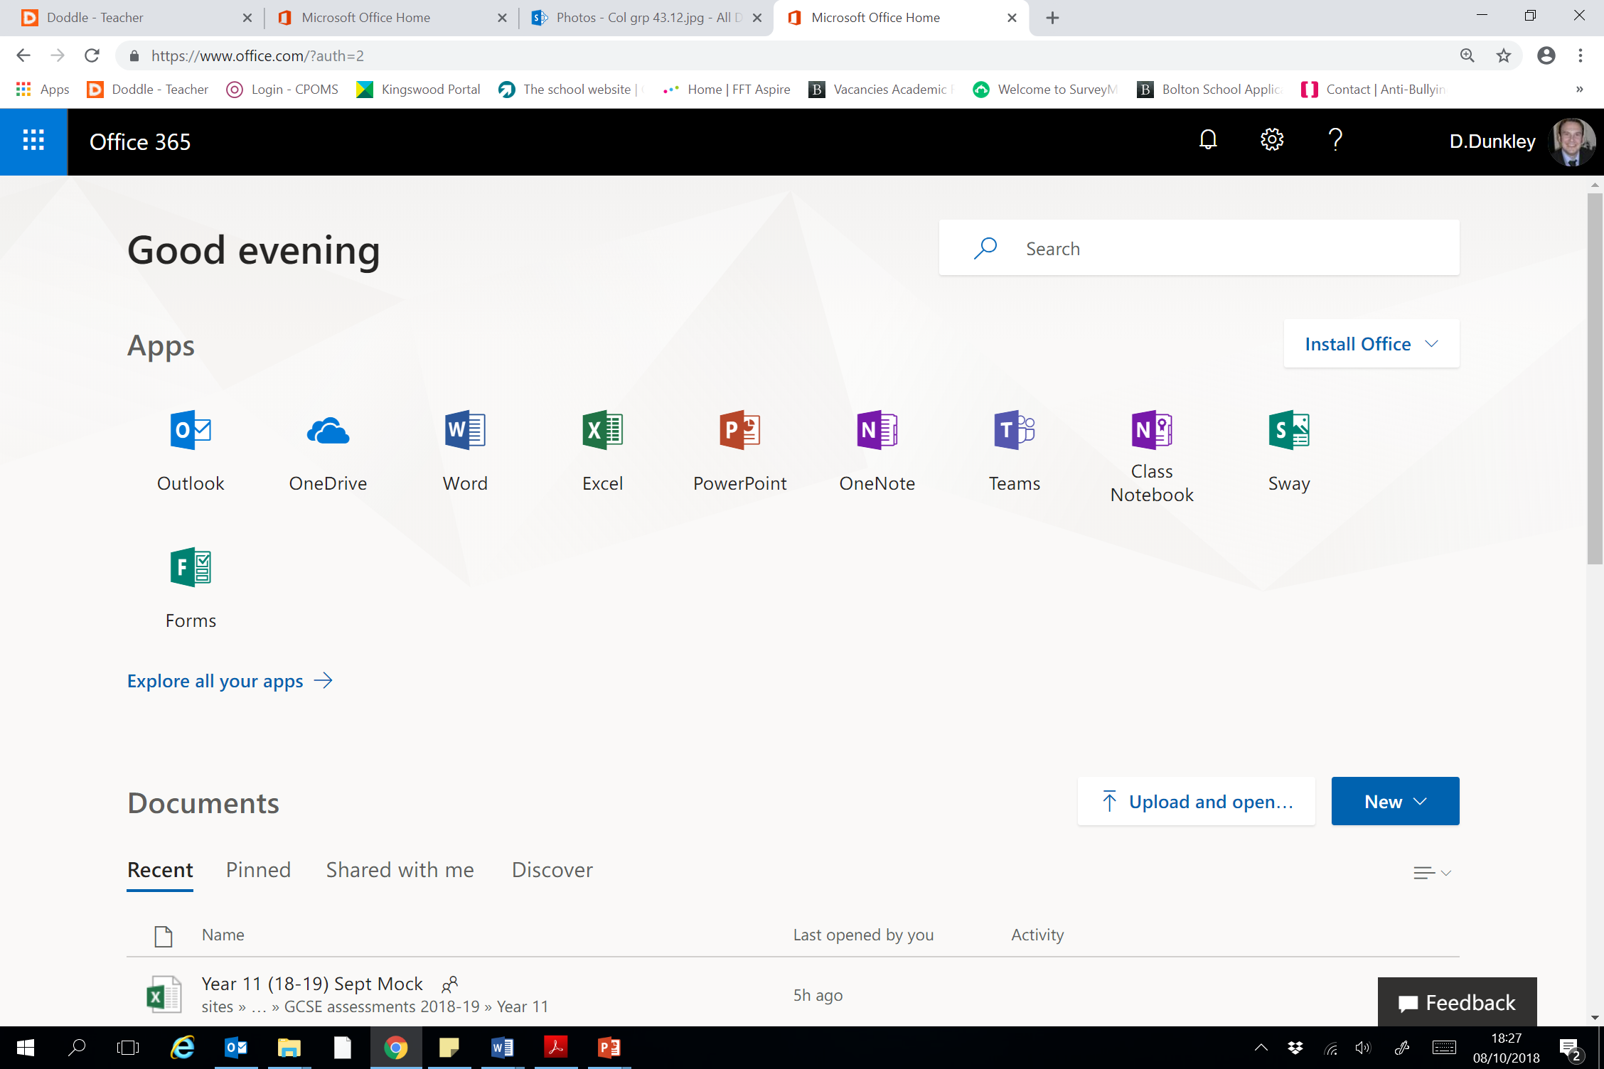
Log on

Slide 19
Install your own software to PC/Mac

Slide 20
Check emails ! Including the daily bulletin

Slide 21
Store work done at home and school
Notes:
No more memory sticks, lost work, files saved at home, not handed in, even email homework, collaborate of projects with file sharing.

Slide 22
Curriculum
Mr D. Slack
Associate Deputy Headteacher - Curriculum

Slide 23
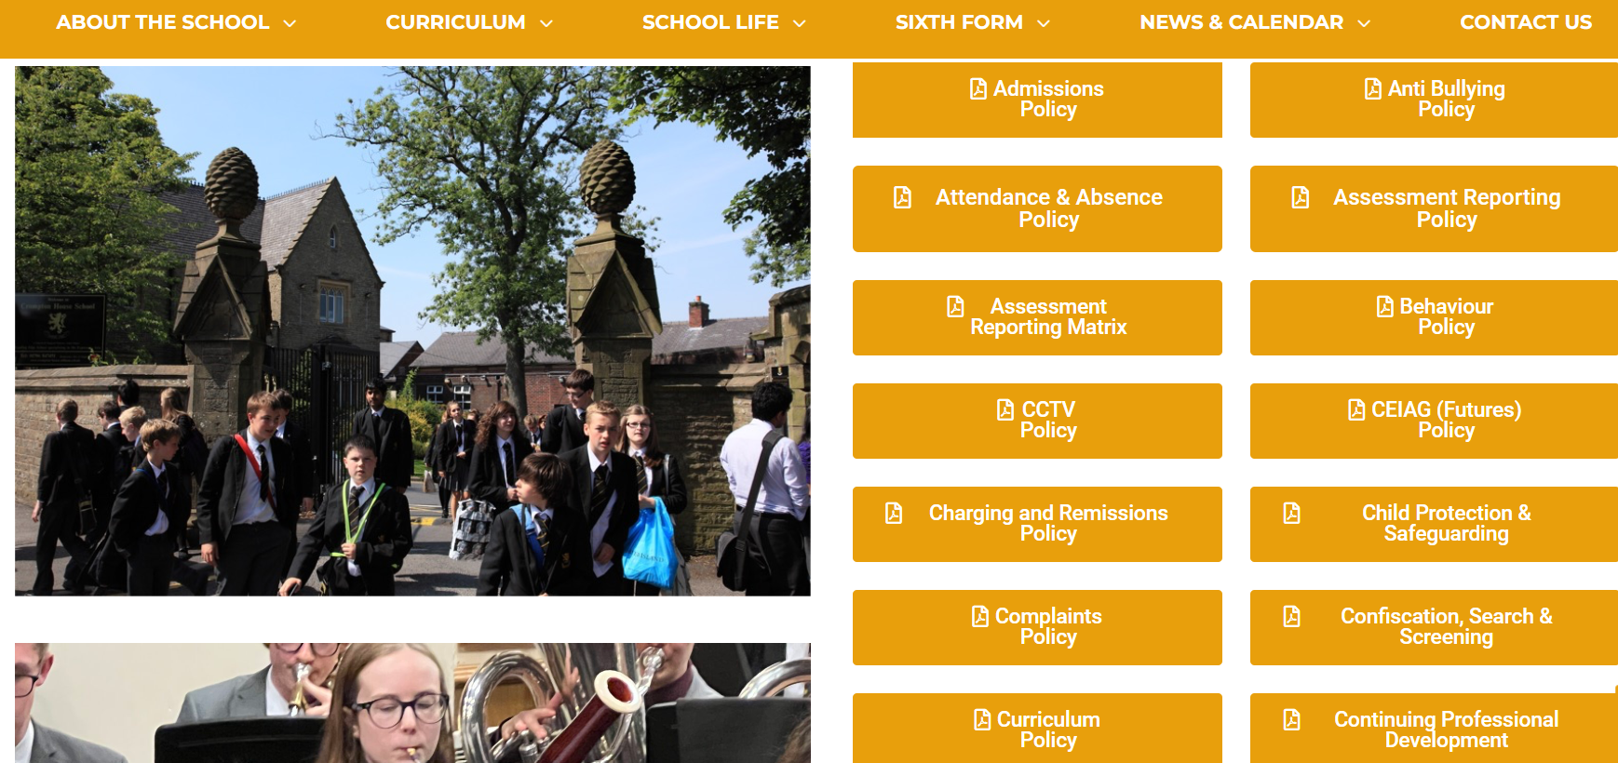
Crompton House Curriculum Policy

Slide 24
Structure of your child’s timetable
Students are banded initially based on their language of study:
  F Band = French
  S Band = Spanish
  X Band = French/Spanish
Students then grouped based on their ability and numbered 1-4/1-5
F Band F1 F2 F3 F4 F5 (in Technologies only) | S Band S1 S2 S3 S4 S5 (in Technologies only)
X Band X1 X2 X3 X4 (in English, Maths and Technologies only)

Slide 25
How has your child’s class been decided?
How have the classes been calculated?
2 key pieces of data:
  KS2 SATS data from primary schools
  CATS (Cognitive Ability Tests) data collected during transition days
Why these tests?
Both tests make use of different methods of analysing mathematical and literacy understanding
This gives us the best overview of a child’s ability

Slide 26
How has your child’s class been decided?
It is important to note that a review of your child’s classes will be undertaken after ‘Summative Assessment 1’ – around January.
Classes can then change based on the internal data we have gathered about performance in each subject.

Slide 27

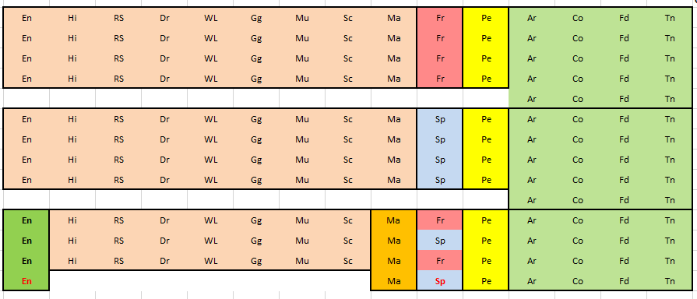
Year 7 Curriculum Structure 2024-25
Band F
Band S
Subjects in the same colour block are commonly set.
Therefore, the classes for all subjects in that colour are the same.
Band X

Slide 28



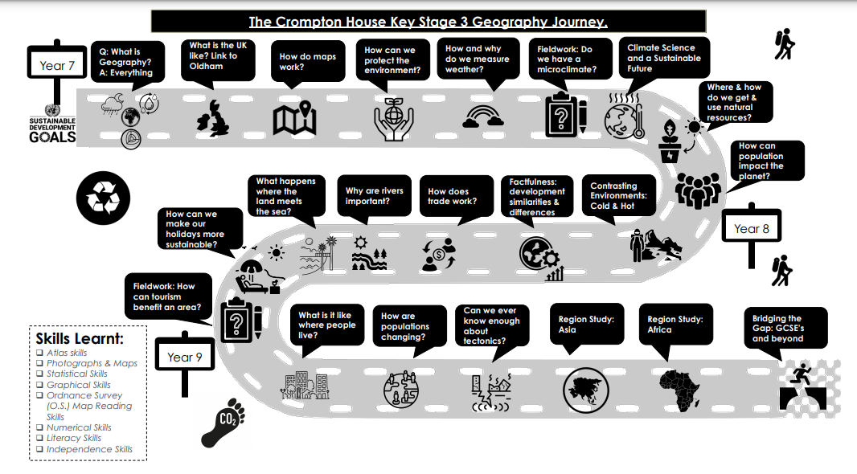
Where can I find what my child is learning?
Crompton House Website

Slide 29

Where can I find what my child is learning?
Curriculum Newsletters
Sent home termly Y7-11
Includes a summary of what is being studied in school for each subject in that year group
Also includes tips for supporting learning outside the classroom

Slide 30
Home Learning
Mr A. Robinson
Whole School Responsibility – Home Learning

Slide 31

What is Home Learning?
Learning does not stop at the end of the school day.
Learning at home is an essential component of the educational process.

Slide 32

What is Home Learning?
Home learning refers to the whole educational process where students engage in learning activities outside the traditional classroom setting.
This includes typical homework assignments but also fitness, wellbeing and social development.

Slide 33

What is home learning?
Independent learning skills are essential in our personal and professional lives.
Our home learning policy, aims to develop these skills for all students to be successful in both their education and later professional lives.

Slide 34

Homework assignments are carefully design by subject leaders to mirror and support the curriculum.
They serve as a bridge, linking directed learning from teachers, to independent student learning.

Slide 35
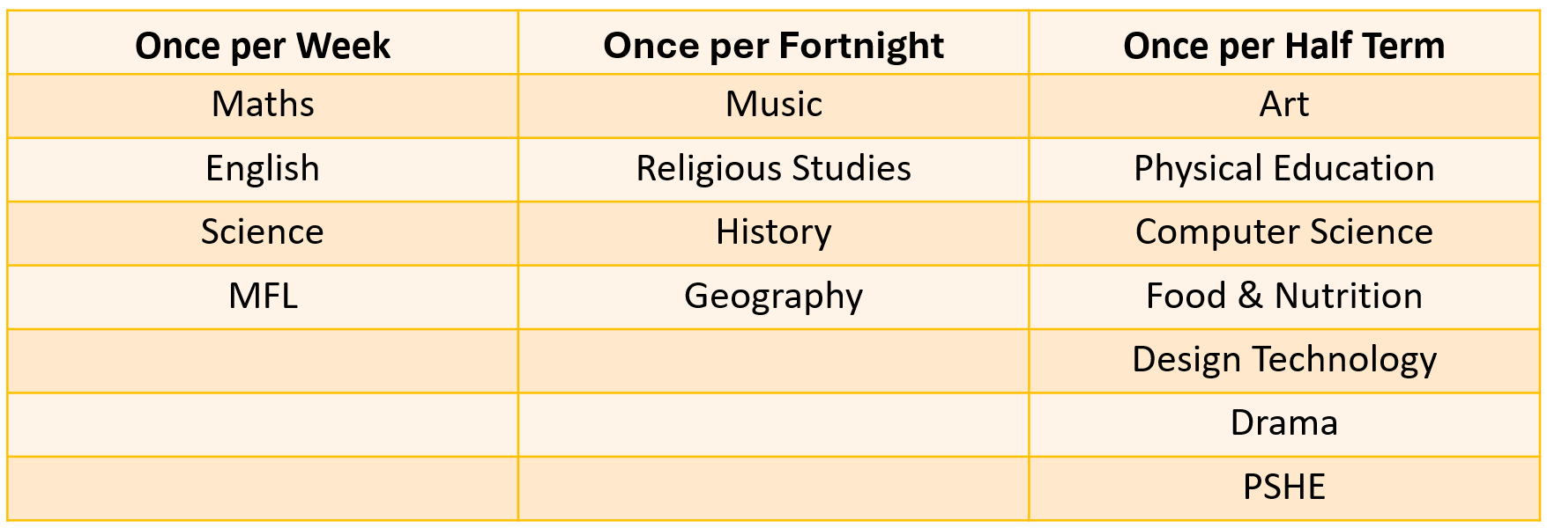
Frequency and duration
Subjects at KS3 will either set bi-weekly assignments with short durations, or a once-per-term more substantial assignment.
30 minutes a day.

Slide 36
Homework timetable
A homework timetable offers significant student benefits, including enhanced time management, improved organization, and a balanced workload, which help prevent students from feeling overwhelmed.
 | Red Week | Green Week
Monday | Science | Science
Tuesday | English | English
Wednesday | Maths | Maths
Thursday | MFL | MFL
Friday | History + Music | Geography + RS

Slide 37

Rewards
Students submitting homework on time and to a high standard will be awarded a homework positive, which contributes towards the wider school rewards process.
Notes:
On a half-termly basis, students who continually achieve excellence in homework by achieving no negatives will be rewarded an ‘Excellence in Homework’ certificate.

Slide 38
Support and sanctions
Students who miss deadlines will be supported to ensure they can access assignments and understand the school expectations for home learning.
Continued failure to meet homework requirements after initial support will result in escalating sanctions.
Homework Support
Class Teacher Detention
Head of Subject Detention
Headteacher Detention
Full details of sanctions can be found in our Home Learning Policy.

Slide 39

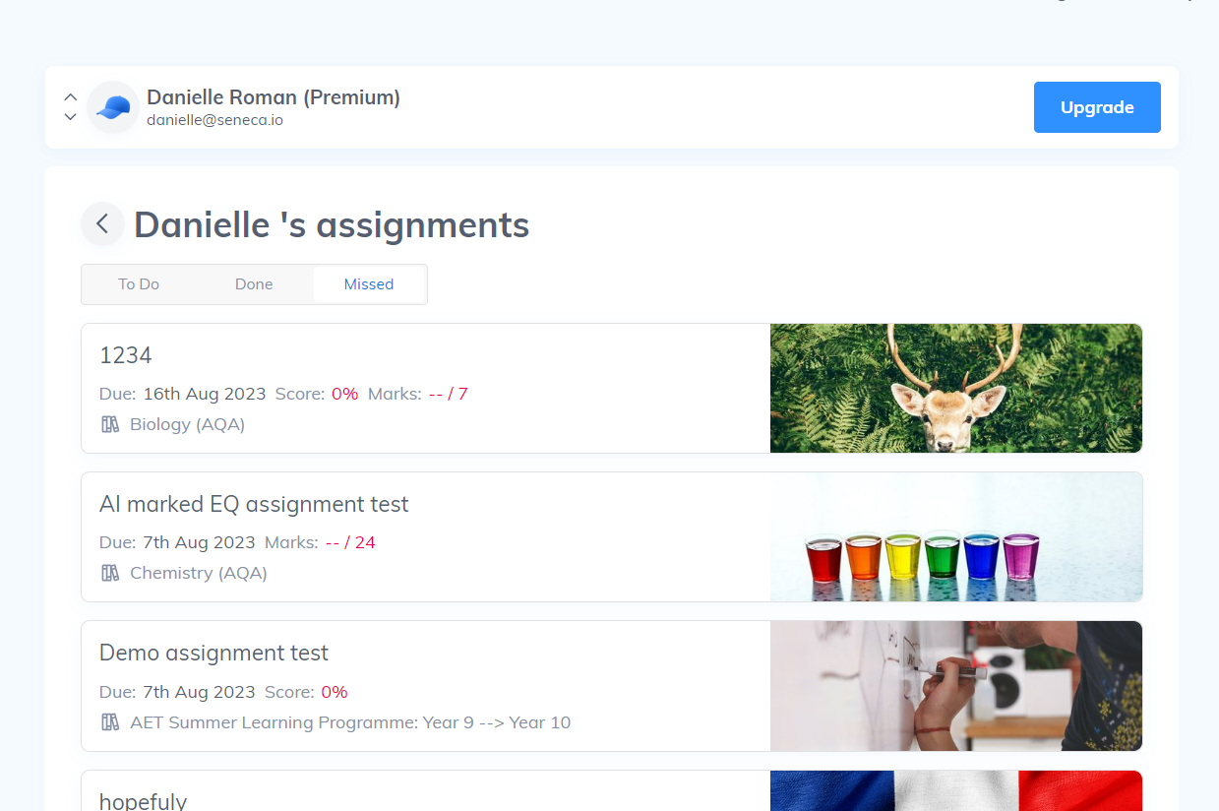
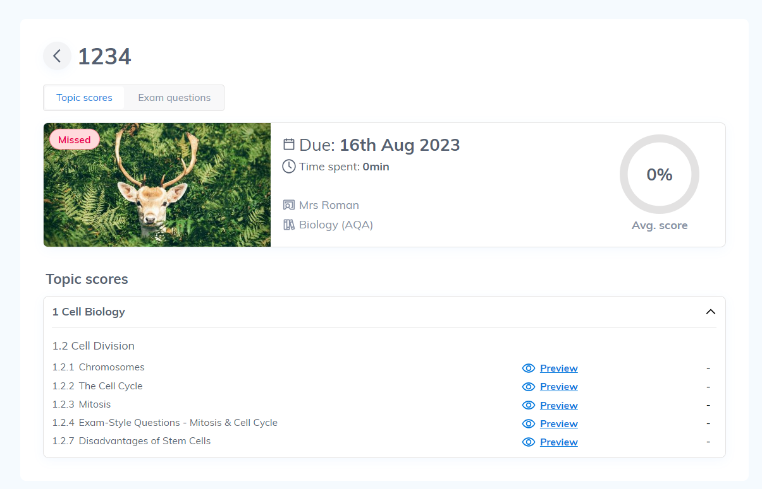
An online platform that can be thought of as an effective & engaging interactive learning and revision guide.
Crompton House subscribe to Seneca to support our students with Home Learning.
Notes:
Seneca is an online platform can be thought of as an effective & engaging interactive learning and revision guide that Crompton House subscribe to support our students with Home Learning.
Sparx supports students aged 11-16 with personalised, challenging and attainable homework.
Others will be used.

Slide 40


Parent guide to Home Learning
Click here
Detailed Home Learning Policy
Click here

Slide 41
Assessment and Reporting
Ms S. Clough
Assistant Headteacher and Head of Year 7

Slide 42
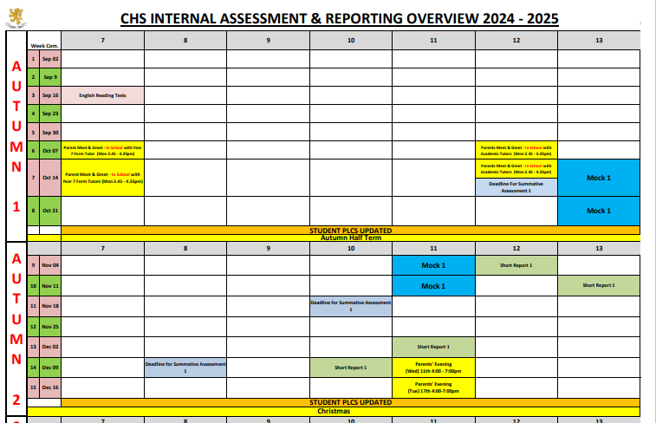
Year 7 Summative Assessment Deadline/Short Report:
W/C 6th January followed by a short report W/C 27th January
W/C 31st March followed by a short report W/C 5th May
Year 7 Form Tutor Report:
W/C 3rd March
English Reading Tests
Round One W/C 16th September
Round Two W/C 2nd June
Year 7 Parents’ Evenings
13th May F+X Band: 4-7.30pm
22nd May S Band: 4-6.30pm
https://www.cromptonhouse.org/assessment

Slide 43

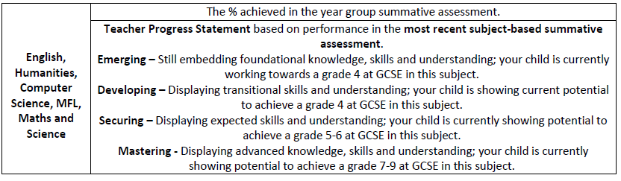
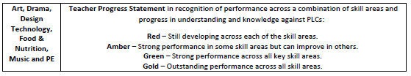
How will we report on your child’s achievement?

Slide 44
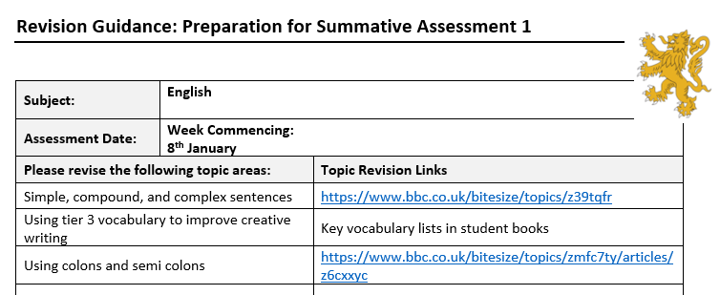
How can you help your child prepare for their summative assessments?
When?
What?
Talk
Time
Teacher

Slide 45
SEND
Mrs K. Heywood
Assistant Headteacher and SENCO

Slide 46
SEND Code of Practice 2014 (Special Educational Needs and Disabilities)
All children and young people are entitled to an education that enables them to make progress so that they:
  • achieve their best
  • become confident individuals living fulfilling lives,
  • make a successful transition into adulthood, whether into employment, further or higher education or training

Slide 47
Levels of need
EHCP
Record of Need
SEND SUPPORT
For those who require support that is additional or different
Quality First Teaching
For those who can make good progress with in class intervention and differentiation

Slide 48
SEND Code of Practice
Children or Young People who have been diagnosed with a condition (speech and language, dyslexia, autism etc.) may have a recognised Special Educational Need, but will not automatically be included on the SEND register unless they are in receipt of significant, additional and personalised support without which they could not access learning.
As part of the Transition Process at Crompton House School, each student is reviewed to determine whether they need to remain on SEND Support or whether they should be placed on the QFT List.
This is in order to reflect the increased level of independence that Secondary School life entails.

Slide 49

Year 7 SEND Transition
The period from September to October half term is a period of transition for our Year 7 students and therefore we do not currently have any Year 7’s at SEN Support Level.
This will be reviewed at October half term once staff can review and make an informed decision as to which students require this level of support.

Slide 50
Our Aim: To enable students to become confident individuals living fulfilling lives.
Each Intervention is designed to allow students to develop and establish their independence.
We want every student to have an Inclusive experience at Crompton House School

Slide 51
Every Teacher a Teacher of SEND

Slide 52
Code of Practice
Every teacher is responsible and accountable for all pupils in their class wherever or with whoever the pupils are working
High-quality teaching, differentiated for individual pupils, is the first step in responding to pupils who have or may have SEN. Additional intervention and support cannot compensate for a lack of good quality teaching.” (CoP 2015)

Slide 53
Do the best we can for as many as we can as part of the norm – What works for a child with SEND, works for everyone!
“Making higher quality teaching normally available to the whole class is likely to mean that fewer pupils will require such support (special educational provision).” (CoP, 6.15)

Slide 54
Levels of need
EHCP
Record of Need
SEND SUPPORT
For those who require support that is additional or different
Quality First Teaching
For those who can make good progress with in class intervention and differentiation

Slide 55
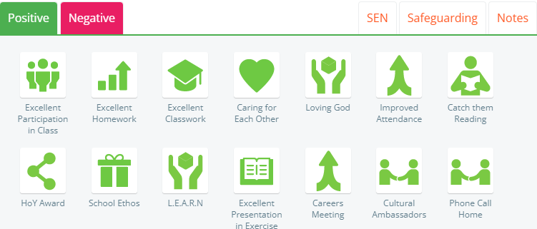
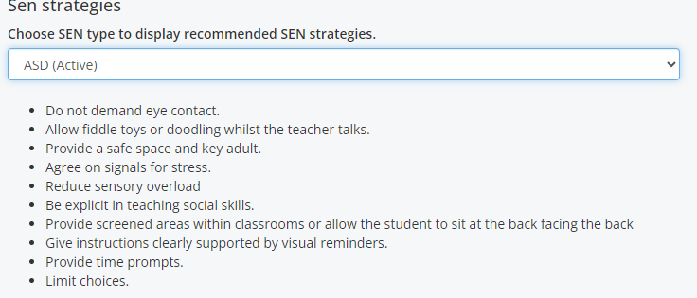

Slide 56
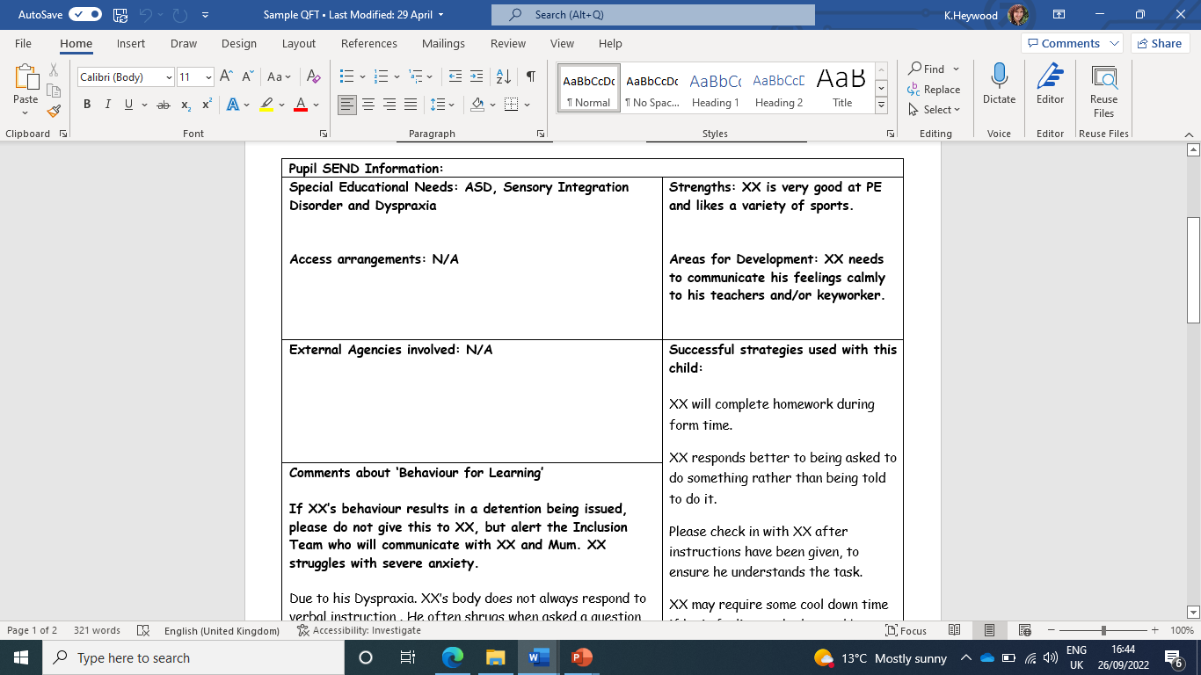

Slide 57
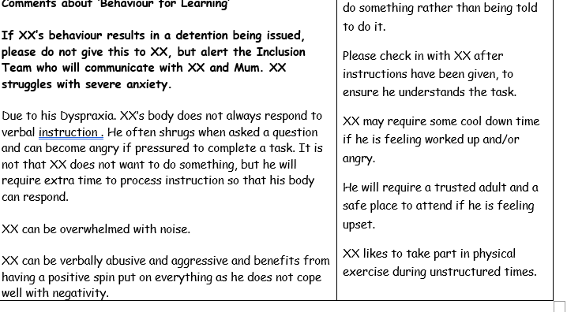

Slide 58
Extra-Curricular and Rewards
Mr S. Deane
Assistant Headteacher – KS3

Slide 59

How to receive Bronze, Silver, Gold and Platinum
Students can win Bronze, Silver, Gold and Platinum rewards by accumulating positives throughout the year
  Bronze – 300
  Silver – 400
  Gold – 500
  Platinum – finish in the top 15 of the year
All students must have a 95% ratio to qualify for this.

Slide 60
Bronze award for students – 300 positives
Bronze certificate from form tutor
Class Charts notification home
Awarded positives

Slide 61
Silver award for students – 400 positives
Silver certificate in Rewards Assembly
Class Charts notification home
Awarded positives
Ice Cream Truck

Slide 62
Gold award for students 500 positives
Chip shop reward
Class Charts notification
Gold certificate in rewards assembly
Gold rewards raffle day to win days out

Slide 63
Platinum award for students – Top 15 students in every year
Trip to Sandbrook park bowling
Platinum certificate
Class Charts notifcation

Slide 64
Student of the Week
Certificate off the HOY for top achievers
Points counted on Class Charts in positives
Entered into rewards assembly raffle for prizes
Phone call home from HOY/AHOY for Super Student of the Week

Slide 65

Subject prize winners
Rewards breakfast with a free breakfast and entered into a raffle prize as they attend the breakfast and can bring a friend

Slide 66
New rewards prizes
Extra curricular rewards for most positives – broken down to Music, Sport, Drama, D of E
Leadership rewards for most positives – prefects, student council prize, charity work
Excellent classwork
Learn
Excellent homework
School Ethos
Student of the Week points

Slide 67
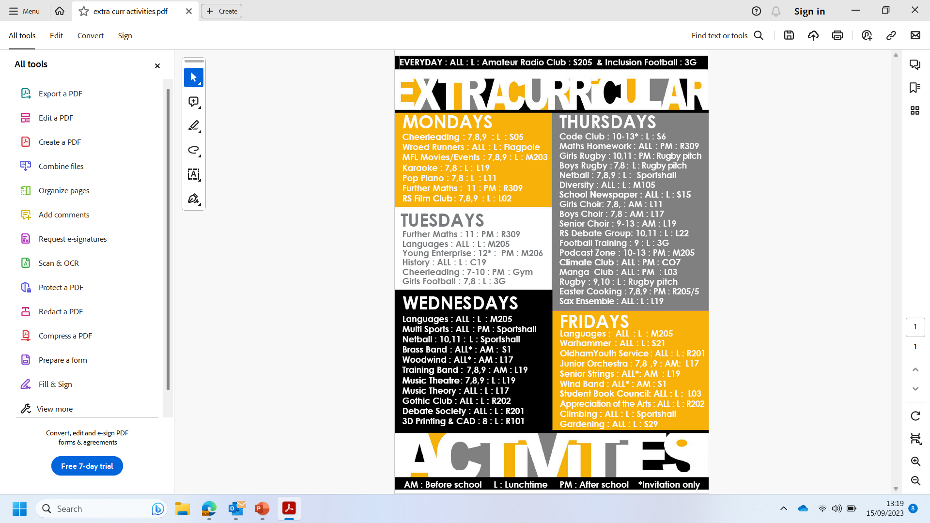

Slide 68
Thank you
Please see a member of staff if you have any questions.

