Slide 1

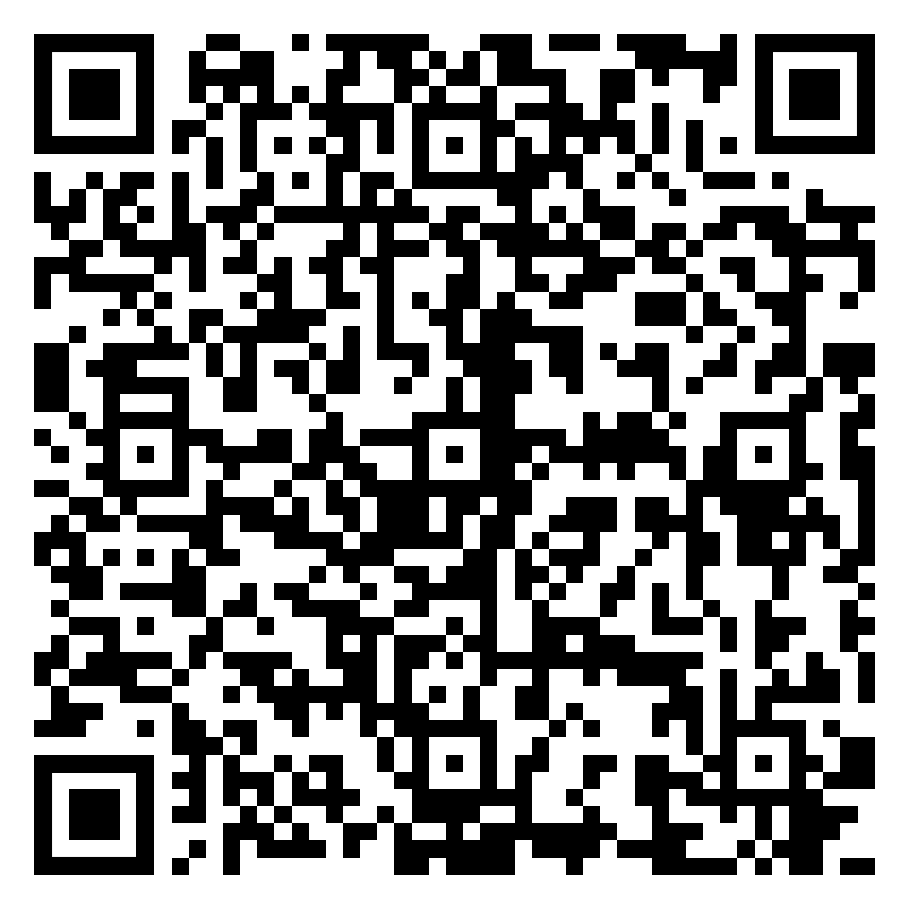
Welcome to KS4 Parent Information Evening Please scan the QR code and sign in

Slide 2
Introductions Mr D. Slack Deputy Headteacher

Slide 3
KS4 Overview Mr D. Slack Deputy Headteacher

Slide 4
KS4 Curriculum
Maths
English (Literature and Language)
Science
RS
Core PE
4 ‘Option’ Choices – Guided by the Pathways system

Slide 5

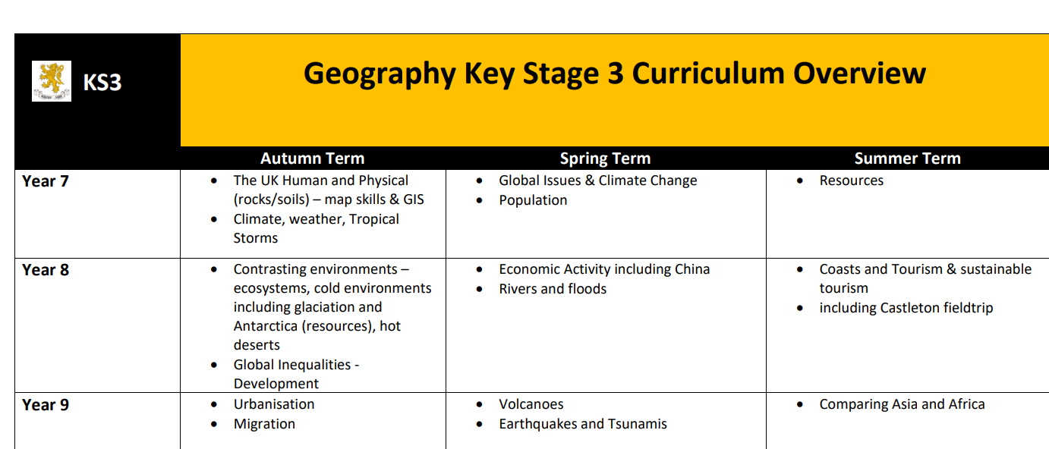

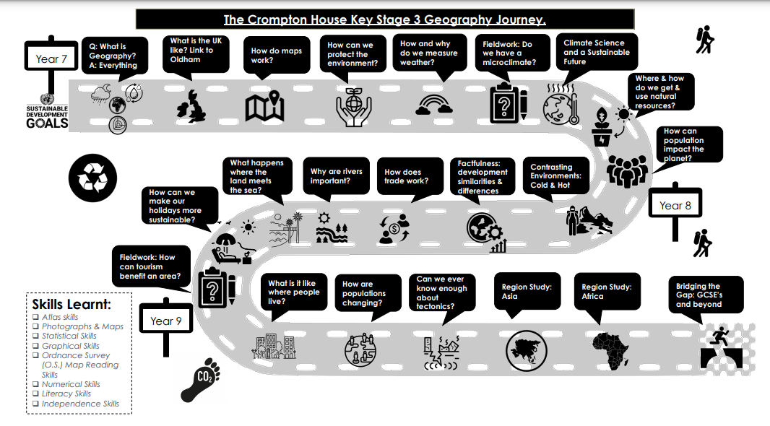
Where can I find what my child is learning? Crompton House Website

Slide 6
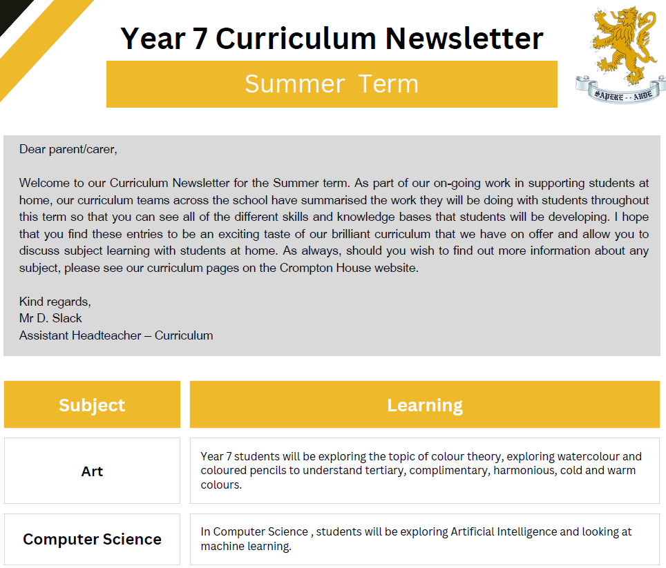
Where can I find what my child is learning? Curriculum Newsletters
Sent home termly Y7-11
Includes a summary of what is being studied in school for each subject in that year group
Also includes tips for supporting learning outside the classroom

Slide 7

What is Home Learning?
Learning does not stop at the end of the school day.
Learning at home is an essential component of the educational process.

Slide 8

Homework assignments are carefully design by subject leaders to mirror and support the curriculum.
They serve as a bridge, linking directed learning from teachers, to independent student learning.

Slide 9
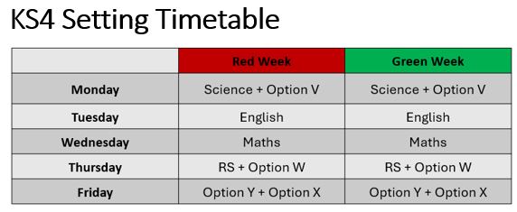
Home Learning: Frequency

Slide 10
GCSE Grades
Every student is given an individual MEG (‘Minimum Expected Grade’)
These grades are calculated based on:
CATs Data collected in Y7 (Cognitive Ability Tests)
Data collected on each student throughout Y7-9
Any additional information provided at transition
MEGs can and will change - they will move up with student performance

Slide 11
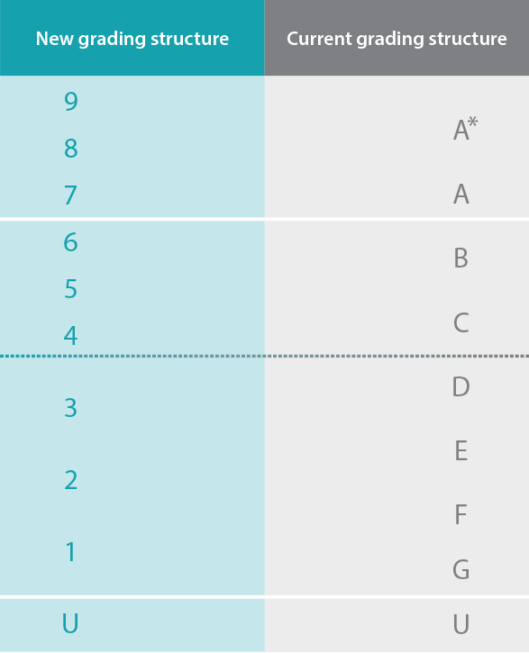
GCSE Grades
Grade 4 or Grade 5?
Always push for 5.

Slide 12
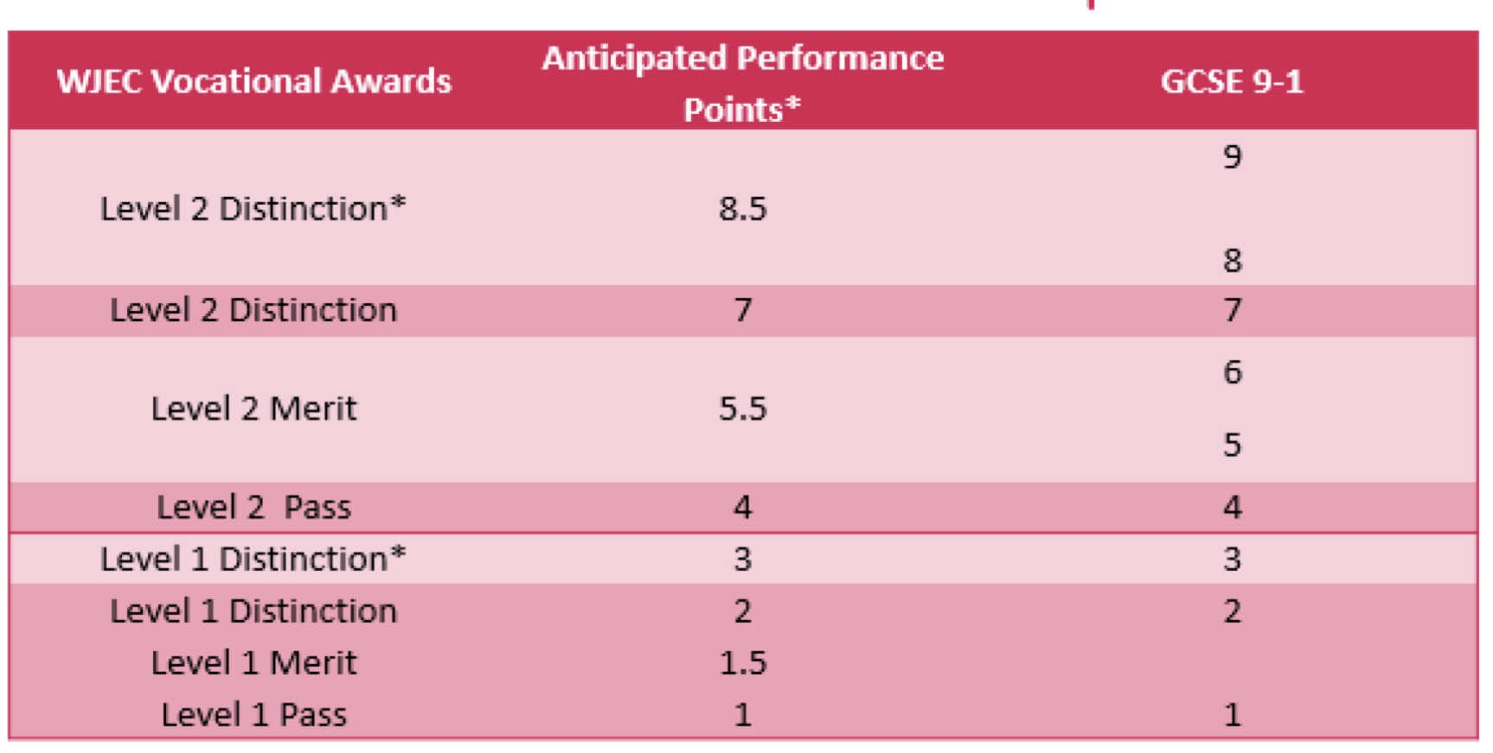
Vocational Grades
Level 2 = Grade 4+
Level 1 = Grade 1-3

Slide 13
Assessment in Y10
Summative Assessment 1 – November 2025
Short Report 1 - WC 8th December
Resetting – January 2026
Summative Assessment 2 – January/February 2026
Short Report 2 – WC 23rd March
13th April – Parent’s Evening
Year 10 Mocks – WC 15th June
Short Report 3 – WC 6th July

Slide 14
Grade 4+ in Maths and English
Average Point Score

Slide 15
Average Point Scores
Lots of Sixth Form and Colleges will ask for an ‘average point score’ or ‘APS’
This involves taking all the GCSE qualifications and adding them together
You then divide this number by the number of qualifications to get your ‘APS’
Maths – 5
Eng Lang – 6
Eng Lit – 6
Spanish – 5
Science – 4:4
RS – 7
History – 6
Art – 5
PE - 5
Total Points: 53
Number of GCSEs: 10
APS: 5.3

Slide 16
English Mr D. Pacey Assistant Headteacher

Slide 17
GCSE English Language Paper 1
Paper 1: Explorations in Creative Reading and Writing
Focus: 20th or 21st century prose fiction extract
Time: 1 hour 45 minutes
Marks: 80 marks total (50% of GCSE)

Slide 18
GCSE English Language Paper 1
Section A: Reading (40 marks, ~1 hour)
An unseen extract (from a novel or short story) and answer four questions:
Question 1 (4 marks) – Identify and retrieve
Question 2 (8 marks) – Language analysis
Question 3 (8 marks) – Structure analysis
Question 4 (20 marks) – Evaluation

Slide 19
GCSE English Language Paper 1
Section B: Writing (40 marks, 45 minutes)
One extended task:
Choice of two prompts (narrative or descriptive writing).
Examples: a picture stimulus, or a story title.

Slide 20
GCSE English Language Paper 2
Paper 2: Writers’ Viewpoints and Perspectives
Focus: Non-fiction and literary non-fiction (19th-century + 20th/21st-century extracts to compare)
Time: 1 hour 45 minutes
Marks: 80 marks total (50% of GCSE)

Slide 21
GCSE English Language Paper 2
Section A: Reading (40 marks, ~1 hour)
Students are given two unseen extracts on a linked theme (e.g. travel, crime, childhood). Then they answer four questions:
Question 1 (4 marks) – Retrieve
Question 2 (8 marks) – Summary and infer
Question 3 (12 marks) – Language analysis
Question 4 (16 marks) – Comparison and evaluation

Slide 22
GCSE English Language Paper 2
Section B: Writing (40 marks, 45 minutes)
One extended task:
Viewpoint/transactional writing
Example tasks:
Write a speech, article, or letter giving a view on a topical issue.
Write to a newspaper or online forum to express an opinion.

Slide 23


Paper 1: Shakespeare and the 19th-century novel
Time: 1 hour 45 minutes
Marks: 64 marks (40% of GCSE)
GCSE English Literature Paper 1

Slide 24
Section A: Shakespeare (34 marks, 50 minutes)
Students must answer one question on the Shakespeare play they’ve studied
Question format:
Extract provided (about 30–40 lines).
Task: Write in detail about the extract and then the play as a whole.
GCSE English Literature Paper 1

Slide 25
Section B: 19th-century novel (30 marks, ~50 minutes)
Students answer one question on the novel they've studied
Question format:
Extract provided.
Task: Write about the extract and then the novel as a whole.
GCSE English Literature Paper 1

Slide 26
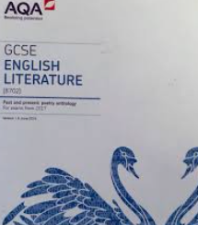

Paper 2: Modern texts and Poetry
Time: 2 hours 15 minutes
Marks: 96 marks (60% of GCSE)
GCSE English Literature Paper 2

Slide 27
Section A: Modern Texts (34 marks, ~45 minutes)
Students answer one essay question on the modern drama they’ve studied.
GCSE English Literature Paper 2

Slide 28
Section B: Poetry Anthology (30 marks, ~45 minutes)
Based on the cluster of 15 poems students have studied .
One named poem is printed in the paper.
Students compare it with another poem from the same cluster (of their own choice).
GCSE English Literature Paper 2

Slide 29
Section C: Unseen Poetry (32 marks, ~45 minutes)
Two parts:
Q1 (24 marks): Analyse one unseen poem in detail.
Q2 (8 marks): Compare the first unseen poem with a second unseen poem.
GCSE English Literature Paper 2

Slide 30
Homework
Homework will always be set weekly on Class Charts on a Tuesday and is due in on a Tuesday.
The average time to be spent on the homework is indicated on Class Charts.

Slide 31
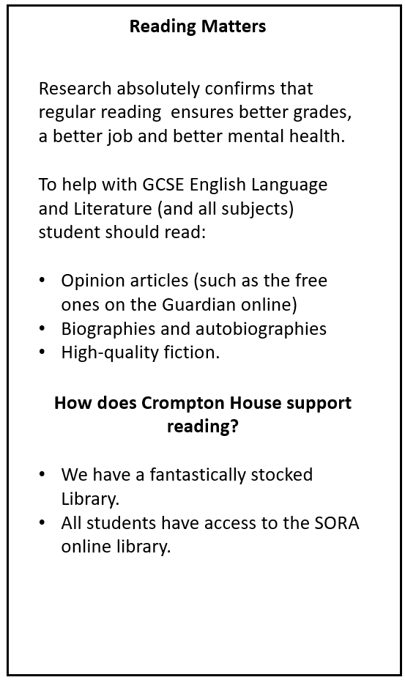
Reading Matters
Reading Matters

Slide 32
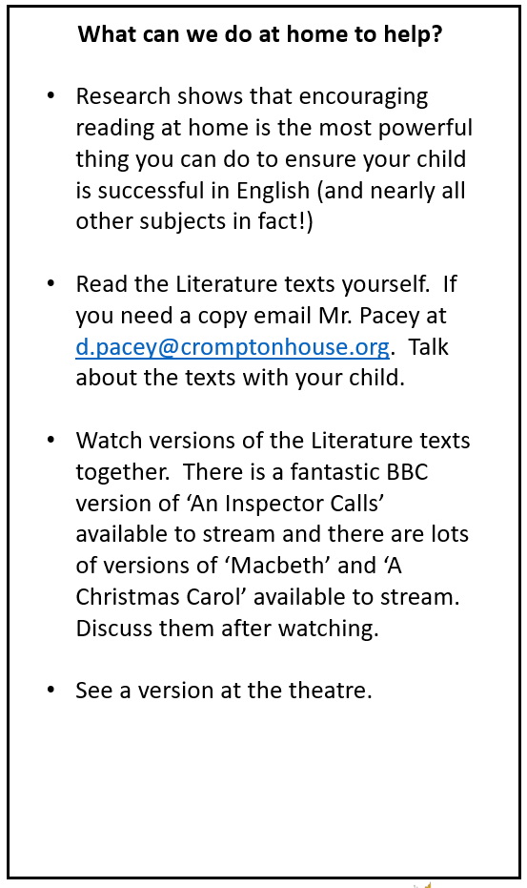
Learn together

Slide 33
Maths Curriculum Mr J. Duncan Curriculum Team Leader - Maths

Slide 34
Course Content
Number
Ratio and Proportion
Algebra
Geometry
Statistics and Probability

Slide 35
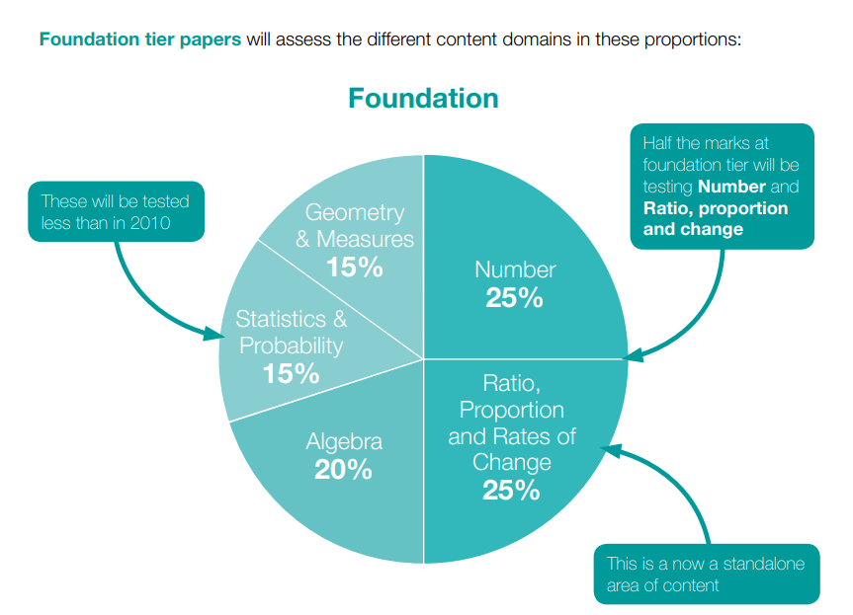
Foundation Tier: Grades 1-5
Exam Board - Edexcel
50% of the marks are for numerical skills.
Students need to aim for above 60% to achieve Grade 4.
Students need to aim for above 75% to achieve Grade 5.

Slide 36
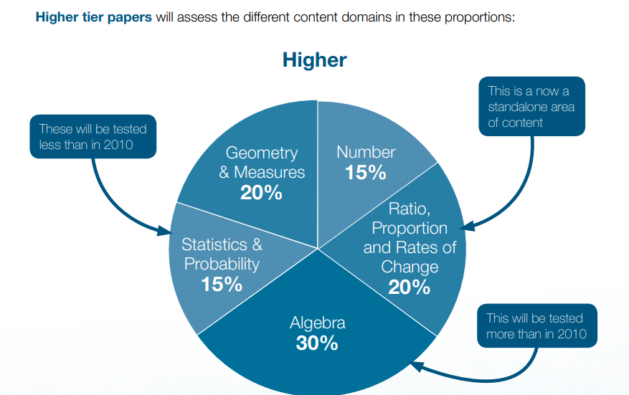
Higher Tier: Grades 4-9
Exam Board - Edexcel
By comparison, only 35% of the paper assesses numerical skills-more emphasis on algebra.
Students need to aim for:
45% +to secure a Grade 6
60%+ to secure a Grade 7
75%+ to secure Grade 8
85%+ to secure Grade 9

Slide 37


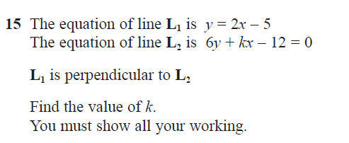
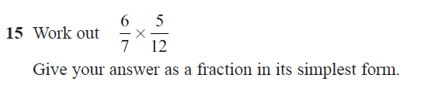
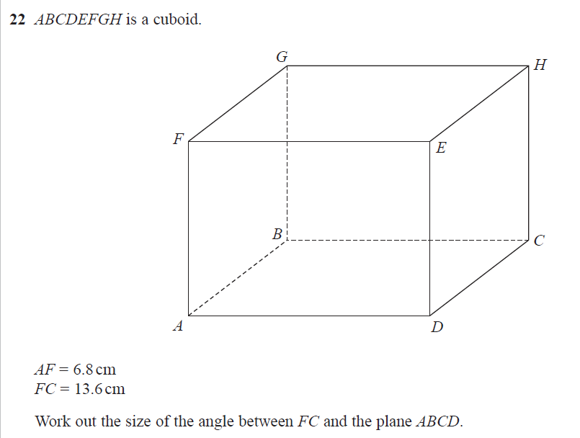
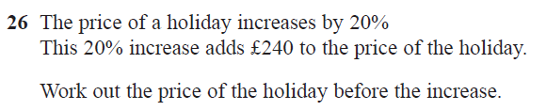
Key Differences
Skills questions (50%/40%)
Problem solving (50%/60%)

Slide 38
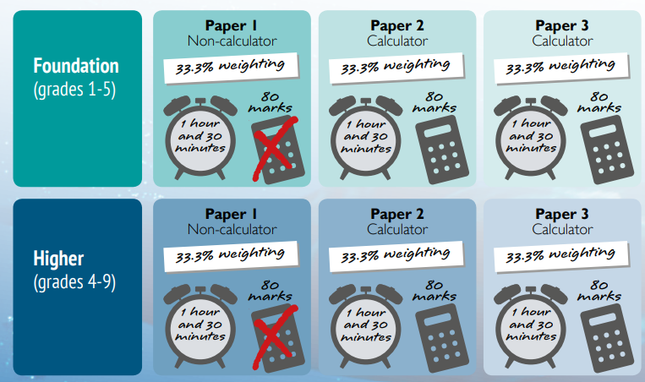
Equipment: scientific calculator essential

Slide 39
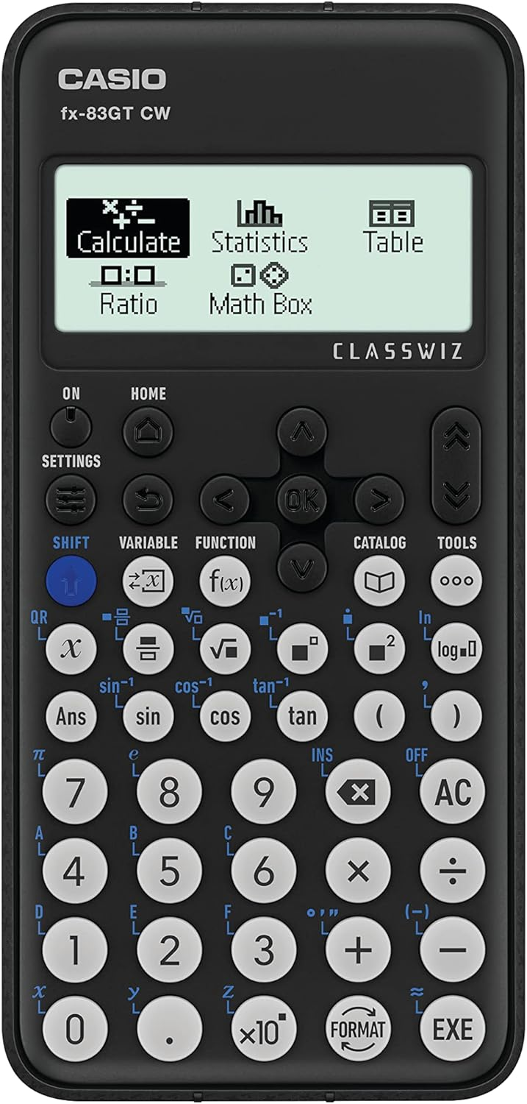
Which calculator?
Casio FX 83GT CW
These are available on ParentPay and calculators can be collected from finance.
They are also available from most supermarkets and Amazon.

Slide 40

Homework: SPARX
Set on WEDNESDAY
Due in on a Tuesday 7am. It will be checked on Tuesday morning
Parents/carers receive a reminder email over the weekend.
Other free resources
Maths Genie
Corbett maths
Physics and Maths Tutor (PMT)

Slide 41
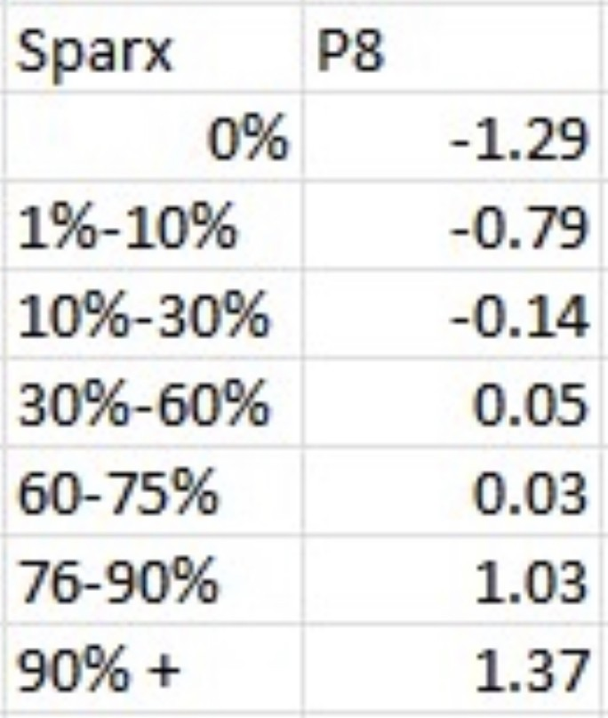
Sparx impact on grades
This shows that students who completed more than 75% of their Sparx homeworks regularly ended up gaining more than one grade better than their MEG.

Slide 42
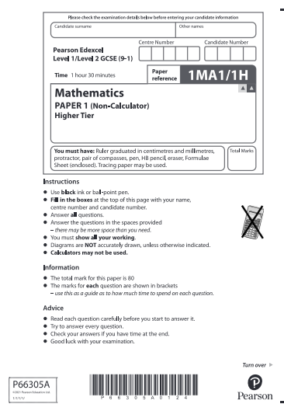
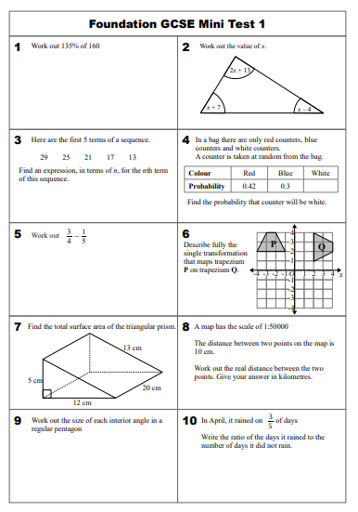
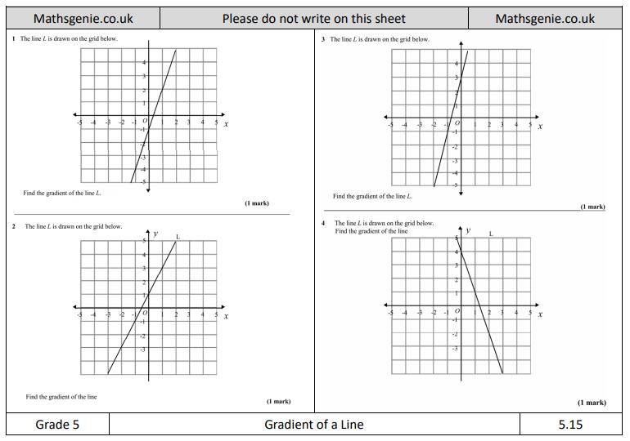
What more can be done?

Slide 43
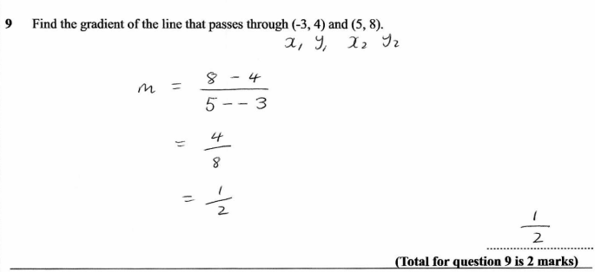
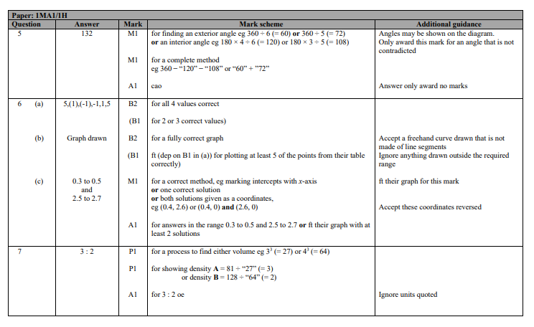
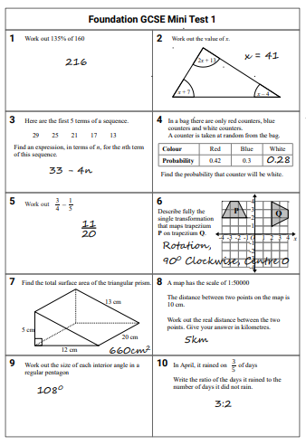
Students must be marking their work

Slide 44
Science Curriculum Dr E. O’Brien Assistant Headteacher

Slide 45
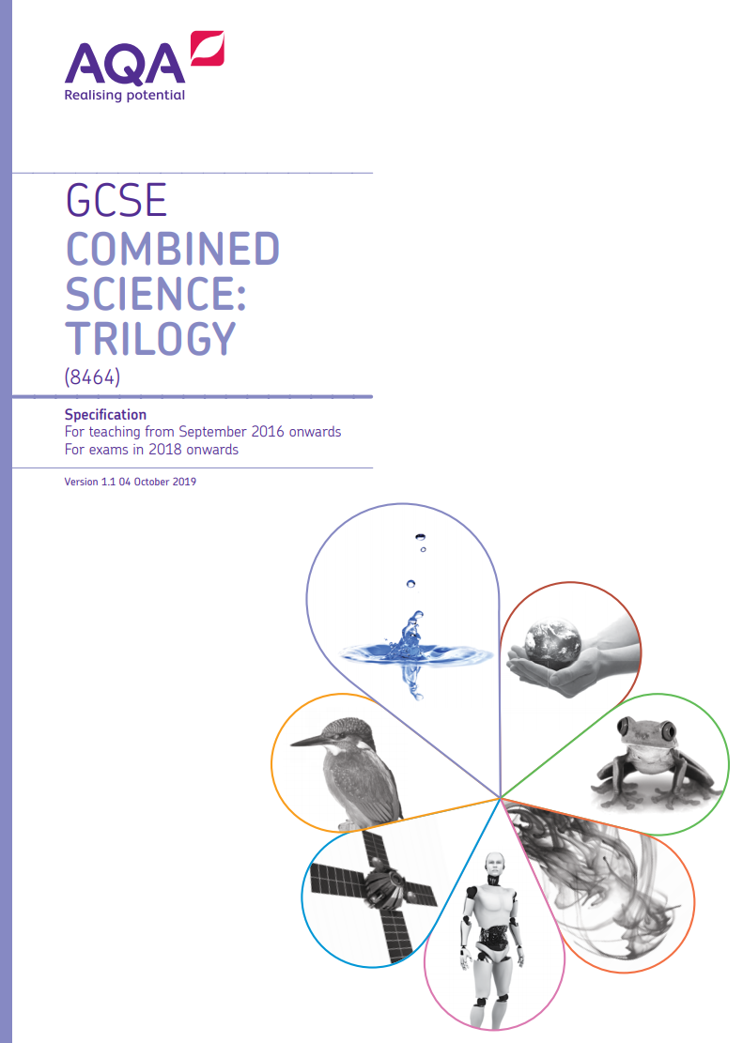
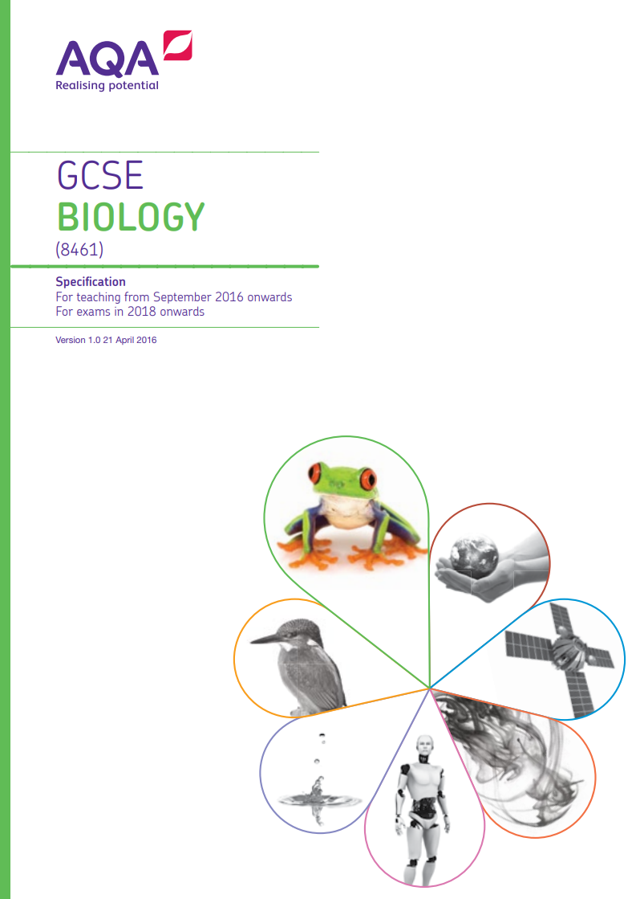
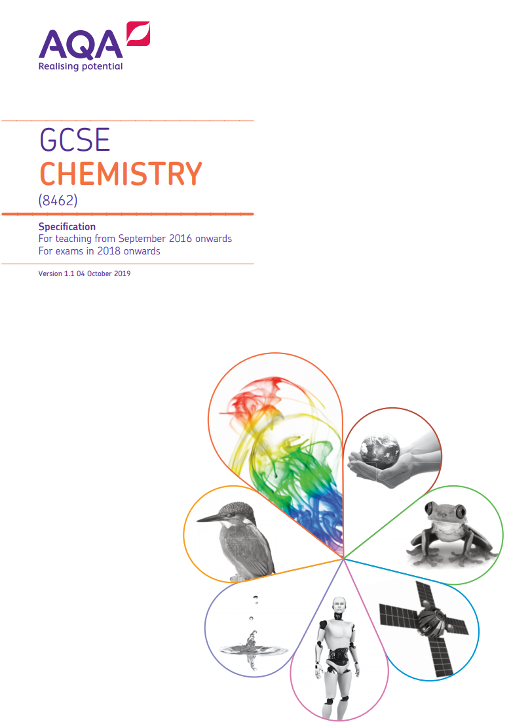

Combined Science or Separate Science

Slide 46
Two GCSEs
9 periods a fortnight
Specialist teachers
Biology teacher
Chemistry teacher
Physics teacher
6 exams at end of course (1 hour 15 minutes each)

Slide 47
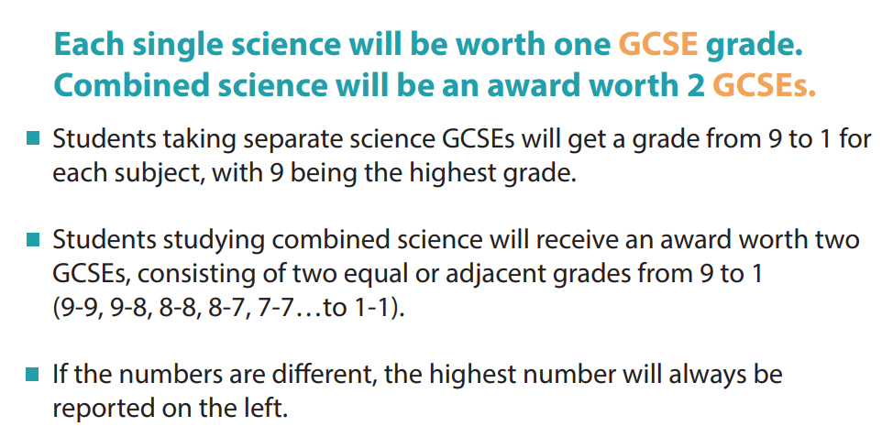

Slide 48
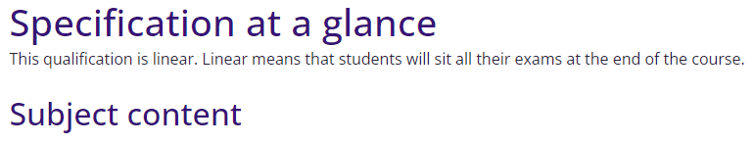
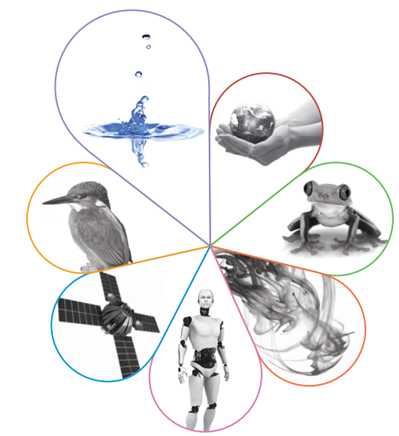
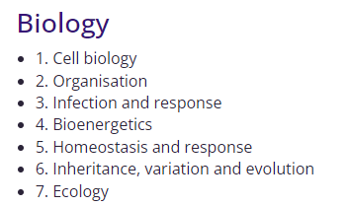

Slide 49
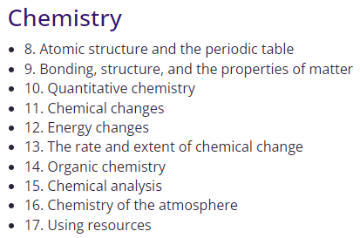

Slide 50
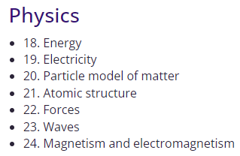

Slide 51
Separate Biology, Chemistry and Physics
GCSE in each subject.
2 exams of 1 hour 45 minutes in each subject.

Slide 52
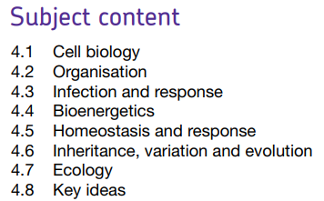

Slide 53
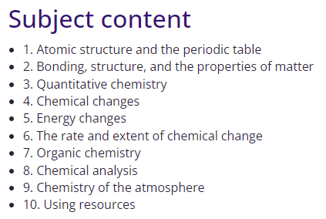

Slide 54
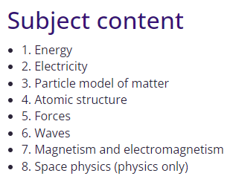

Slide 55
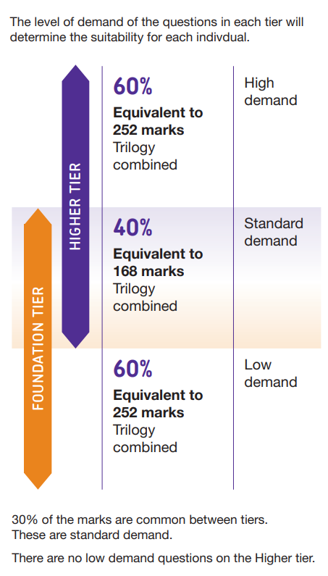


Slide 56
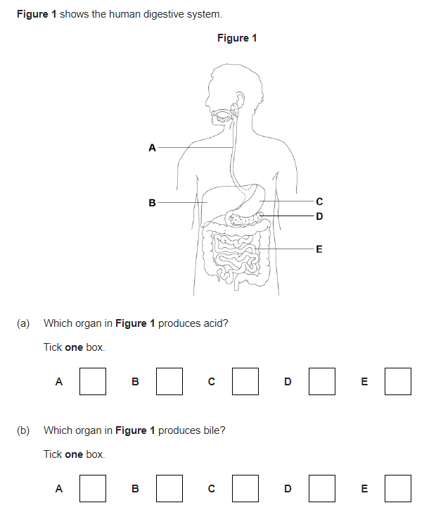
Foundation tier
Grade 5-1
Questions tend to be more scaffolded especially at the start of the exam paper.

Slide 57
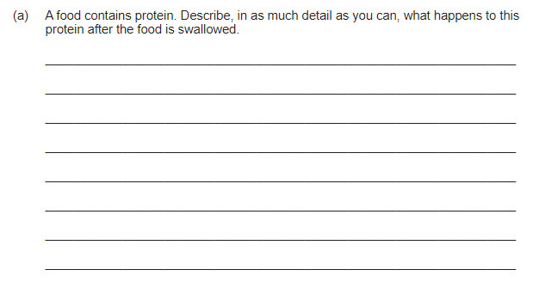
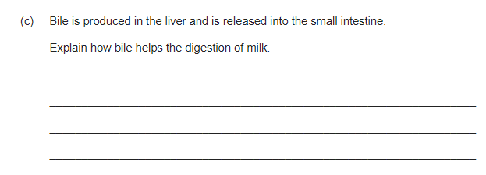
Higher tier
Grade 9-4
Questions require more free response.

Slide 58
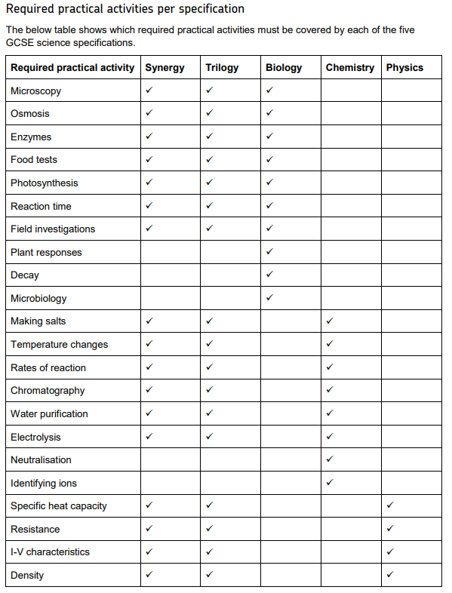
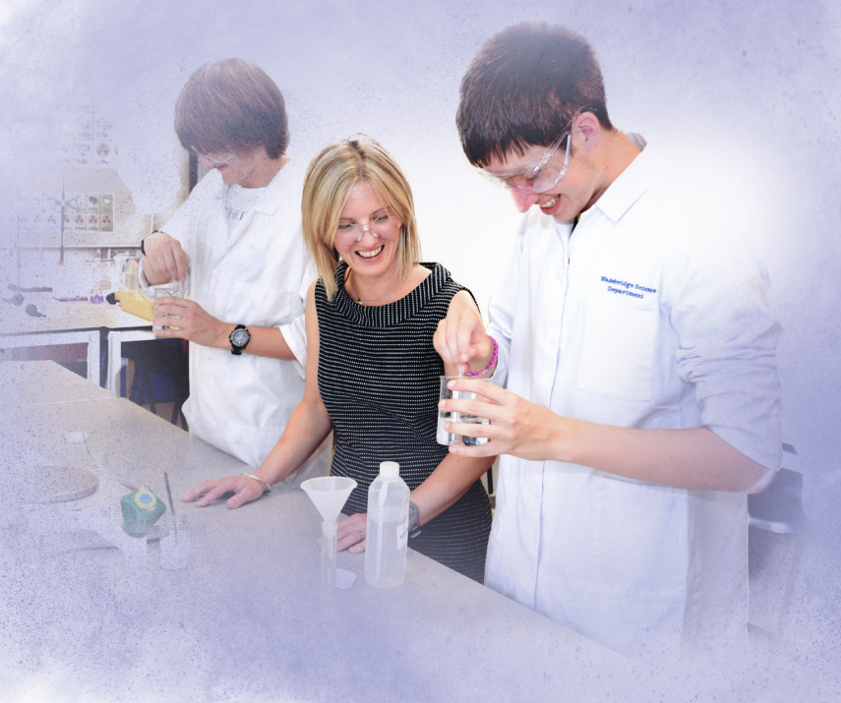
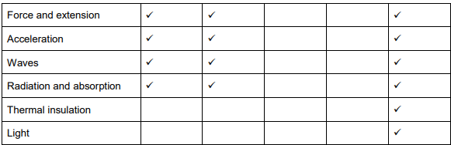

Slide 59
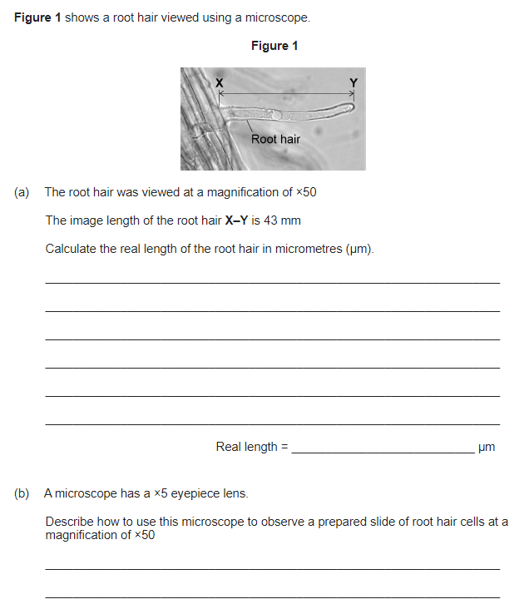
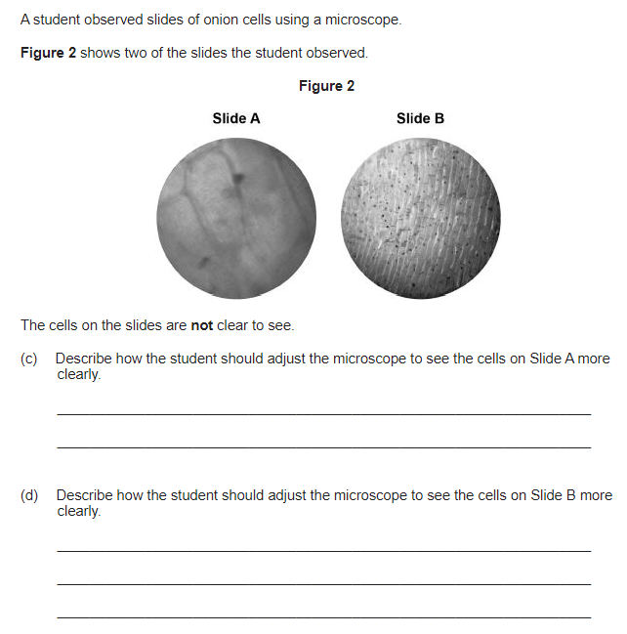

Slide 60
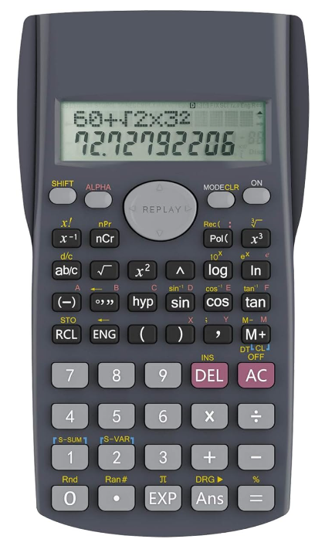
For each lesson of Science bring your calculator
Biology 10% of marks from mathematical content
Chemistry 20% of marks from mathematical content
Physics 30% of marks from mathematical content

Slide 61


Slide 62
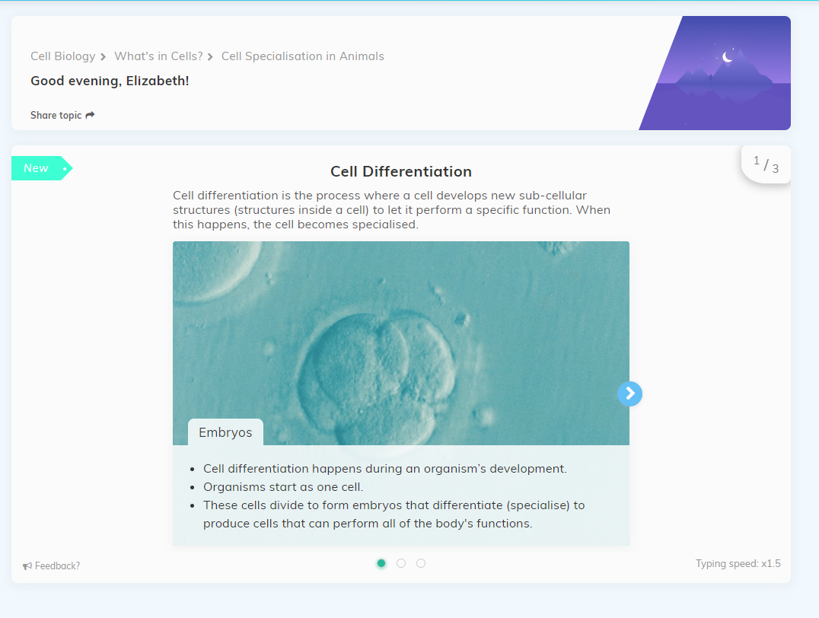

Slide 63
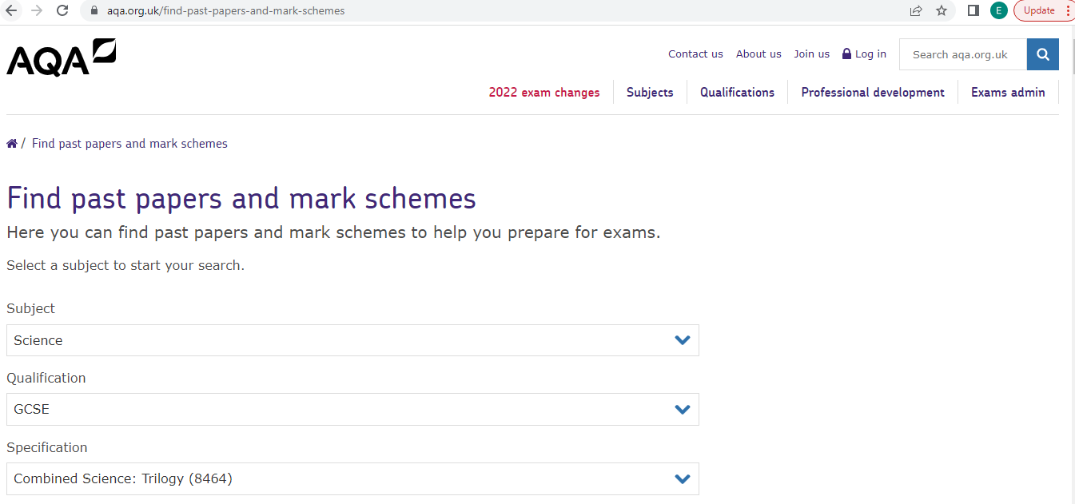

Slide 64
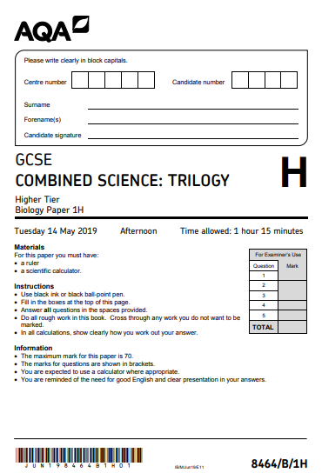


Slide 65
RS Curriculum Mrs C. Ahmed-Swift Head of Subject - RS

Slide 66
Full Course Short Course

Slide 67

FULL COURSE:
We study AQA A Specification (not AQA B)
The RS GCSE is made up of 2 components:
Component 1: The study of religions: beliefs, teachings and practices
Component 2: Thematic studies
Notes:
The full course students follow AQA Q Specification. The full course GCSE is made up of 2 components assessed in 2 exams at the end of the course. The components are: A study of religion and Thematic studies.

Slide 68

Component 1: The study of religions: beliefs, teachings and practices
FULL COURSE:
Paper 1 is the religion paper. We are required to study two religions
At Crompton House we study Christianity and Judaism.
Students will study:
Christian Beliefs
Christian Practices
Jewish Beliefs
Jewish Practices.
Notes:
Paper 1 – a study of religion requires students to have studied 2 religions. At Crompton House we study Christianity and Judaism. Within each religion students will explore the beliefs of Christians and Jews and the practices of that religion.

Slide 69

Component 2: Thematic studies
FULL COURSE:
Paper 2 is the Themes Paper. We are required to study four themes.
At Crompton House we study Theme A,B,D and E.
Students will study:
Family and Relationships
Religion and Life
Religion, Peace and Conflict
Crime and Punishment.
We do not study Theme C and F.
Notes:
Paper 2 is the thematic paper, it requires students to have studied 4 out of 6 possible themes. At Crompton House we study theme a,b,d and e. The 4 themes are…. We do not study theme c and f. It is important that students know this as all 6 themes appear on the final exam, students do not get extra marks from answering more themes. They only get marks for 4. Students who answer more than 4 themes risk lowering their grade as they will not be able to give the depth and detail to answers to get the higher grades.

Slide 70



Where are areas of surplus and deficit located globally?
Paper 1: Religion
resurrection
Creation beliefs
Nature of God.
crucifixion
The afterlife
Christian Beliefs
ascension
Incarnation
The trinity
Atonement and Salvation
Loving God, Caring for each other achieving excellence - Religious Studies – Crompton House.

Slide 71
Where are areas of surplus and deficit located globally?
Paper 1: Religion
Mission, Evangelism and church growth
Easter & Christmas
Holy Communion
Response to world poverty
prayer
Christian Practices
Worship
Pilgrimage
Reconciliation & persecution
Role of the church in the local Community
baptism
Loving God, Caring for each other achieving excellence - Religious Studies – Crompton House.

Slide 72

Where are areas of surplus and deficit located globally?
Paper 1: Religion
Messiah
Shekinah
Key moral principles
Covenant with Moses
God as 1
Jewish Beliefs
Covenant with Abraham
Life after death
Law giver & judge
Sanctity of life & Pikuach Nefesh
Mitzvot & free will
Loving God, Caring for each other achieving excellence - Religious Studies – Crompton House.

Slide 73



Where are areas of surplus and deficit located globally?
Paper 1: Judaism
Food laws
Birth ceremonies
Worship and prayer
Death ceremonies
Jewish Practices
The law
Shabbat
Festivals
The synagogue
Bar Mitvah’s & weddings
Loving God, Caring for each other achieving excellence - Religious Studies – Crompton House.

Slide 74

Where are areas of surplus and deficit located globally?
Paper 2: Theme A
Divorce and remarriage
Nature and purpose of marriage
Purpose of family
sexuality
Cohabitation
Family & Relationships
Nature of family
Sex outside of marriage
Contraception
Gender Equality
Same sex relationships
Loving God, Caring for each other achieving excellence - Religious Studies – Crompton House.

Slide 75
Where are areas of surplus and deficit located globally?
Paper 2: Theme B
Abortion
Use and abuse of animals
Origins of life on earth
Use and abuse of the environment
Life after death
Animals for food
Religion and Life
Pollution
Origins of the universe
Euthanasia
Value of human life
The value of the world and the duty of humans to protect it
Animals for experimentation
Loving God, Caring for each other achieving excellence - Religious Studies – Crompton House.

Slide 76


Where are areas of surplus and deficit located globally?
Paper 2: Theme D
Pacifism and working for peace
Reasons for war
Key words
Holy War
Peace and Conflict
Just war
Victims of war
Violence and terrorism
Weapons of mass destruction
Loving God, Caring for each other achieving excellence - Religious Studies – Crompton House.

Slide 77

Where are areas of surplus and deficit located globally?
Paper 2: Theme E
What do religious people think about crimes and law breakers?
Corporal Punishment
Suffering and forgiveness
Aims evaluated
What is a crime?
Crime & Punishment
Capital Punishment
Aims of punishment
Prisons
Why do people commit crimes?
Loving God, Caring for each other achieving excellence - Religious Studies – Crompton House.

Slide 78
Assessment:
FULL COURSE:
RS GCSE is 100% exam – there is no coursework (NEA)
Students will sit two exam papers.
Paper 1 – Religion
Paper 2 – Themes.
Each Exam is 1 hour 45 minutes. Each paper accounts for 50% of their final GCSE grade.

Slide 79

FULL COURSE:
Paper 1: Religion | Paper 2: Themes
1. Christian Beliefs | 1. Family and Relationships
2. Christian Practices | 2. Religion and Life
3. Jewish Beliefs | 3. Religion, Peace and Conflict
4. Jewish Practices | 4. Crime and Punishment
In each paper students will answer 4 questions which are out of 24 marks.
Each question follows a common structure of 1,2,4,6and 12 mark questions – totalling 24 marks.
There are 3 marks for SPaG.

Slide 80
FULL COURSE:
In 2026 there are changes to our exam structure.
We are moving from a 1,2,4,5 and 12 mark question structure to a 1,1,4,6 mark question structure.
All past papers are still good practice, but students must be aware of how to get the extra 6th mark in the 6 mark questions.

Slide 81
Homework:
FULL COURSE:
Homework has been mapped out across the whole course. Each unit of study has a homework booklet.
Students are expected to complete 1 task a week and hand the booklet in at the end of each unit.
The homework's alternate between tasks to further and deepen the current topic of study and retrieval of the previous units studied.
The booklets have revision for exams and mocks embedded in them.
Each task should take up to 1 hour and should be completed weekly.

Slide 82

SHORT COURSE:
This is half a GCSE. It is not a foundation paper.
Students can achieve grades 1-9 on this paper.
Each year we have had students achieve grade 7. This paper is aspirational.
The exam is the same. This paper is sat on the same day as the Full Course Paper 2 exam. The Themes questions are exactly the same questions for the full course and the short course. The exam structure is exactly the same.
The difference is this course studies 4 units, not 8 and is therefore worth half a GCSE, not a full GCSE.
Notes:
Many of the RS department have a short course GCSE. We went on to study A level RS and to degree. This course is a rigorous course, but allows students to study at a slower pace. Longer on each unit allows for more depth on that unit – students are therefore more likely to get their grade on this paper than if the worked at the much quicker pace of the full course. Students on the Short Course are selected by Crompton House – students do not get to choose their course of study. You will have been informed in the Summer of Year 9 if your child is following the short Course. Our Short Course classes are 10C4,10C5 and 10B5.

Slide 83
SHORT COURSE:
The Short Course is assessed in one exam at the end of Year 11. This exam is 1 hour and 45 minutes long.
The religions we study are Christianity and Judaism (the same as the full course). The Themes studied are chosen by the exam board.
Students will study:
Christian Beliefs
Jewish Beliefs
Family and Relationships
Religion, Peace and Conflict
Paper 1: Religion | Paper 2: Themes
1. Christian Beliefs | 1. Family and Relationships
2. Christian Practices | 2. Religion and Life
3. Jewish Beliefs | 3. Religion, Peace and Conflict
4. Jewish Practices | 4. Crime and Punishment
Notes:
Students on the short course answer the religion and themes question in the same exam.

Slide 84
SHORT COURSE:
In the final exam students will answer 4 questions which are out of 24 marks.
Each question follows a common structure of 1,1,4,6 and 12 mark questions – totalling 24 marks.
There are 3 marks for SPaG.

Slide 85
Homework:
SHORT COURSE:
At the end of each lesson students will be given key words / quotes to memorise these will be tested at the start of the next lesson.
This means that students will receive 3 revision tasks across the two-week timetable.

Slide 86
Year Group Updates Mr M.Ashworth Head of Year 10

Slide 87

Pastoral Care Matters

Slide 88

Pastoral Care Matters

Slide 89

Pastoral Care Matters

Slide 90

Pastoral Care Matters

Slide 91





Wellbeing and Mental Health – Crompton House School

Slide 92
Conclusions Mr D. Slack Deputy Headteacher

