Slide 1
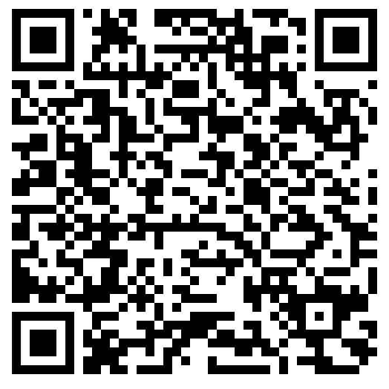
Year 9
Parent Information Evening
Please take a seat and then register attendance by scanning the QR code on the screen.

Slide 2
Welcome and introductions
Mr M Ashworth (Head of Year 9)
m.ashworth@cromptonhouse.org
Mr D Slack (Associate Deputy Headteacher - Curriculum)
d.slack@cromptonhouse.org

Slide 3
Year 9 Updates
Mr M. Ashworth
Head of Year 9

Slide 4
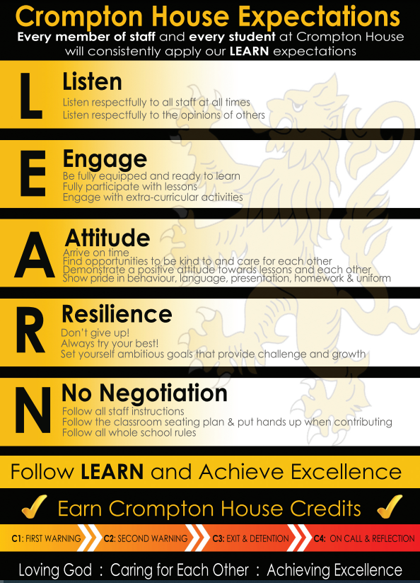
The year ahead
Every lesson prepares you for your GCSEs next year.

Slide 5
Standards
Red Card Detentions
Wearing coats inside the building
Skirt rolled up
Wearing trainers
Littering
Eating in a non-designated area
Chewing gum
Swearing around school
Unacceptable behaviour (e.g.silly on corridors, not following instructions, spraying water, out of bounds)
Mobile Phones
If a mobile is seen or heard, the phone is collected (with SIM) and taken to the Hub for 7 days.
Lates
60-minute detention for students late to class five times in a week.
For every subsequent late arrival, an extra 10 minutes will be added to the detention, capping at a maximum finish time of 5 pm.
Consistent failure to follow school rules leads to an escalation in consequences.

Slide 6
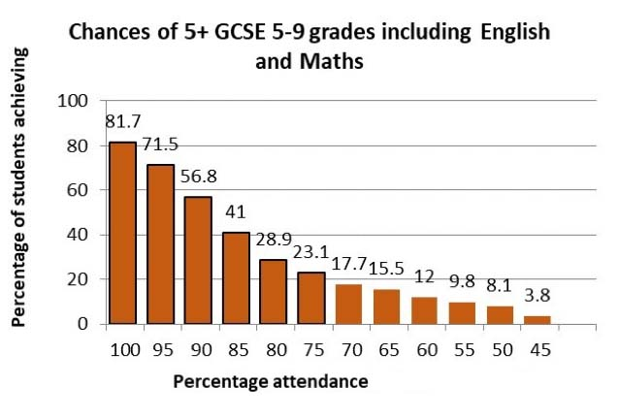
Lateness to lesson and missing days of school links to attainment

Slide 7

Reward system for students.

Slide 8
Bronze award for students 300 positives
Bronze certificate from form tutor
ParentMail home
Newsletter recognition
Entered end of term raffle

Slide 9
Silver award for students 400 points
Silver certificate in rewards assembly
Ice cream van
Newsletter recognition
ParentMail home
Entered end of term raffle

Slide 10
Gold award for students 500 positives
Chip shop reward
Phone call home
Gold certificate in rewards assembly
Entry into end of term raffle
Newsletter recognition

Slide 11
Platinum award for students – Top 15 students in every year
Trip to Sandbrook park bowling
Phone call from HOY/SLT
Diamond certificate off Headteacher
Entry into end of term raffle
News letter recognition

Slide 12
How to receive Bronze, Silver, Gold and Diamond
However one change this year is students must have the total points needed to reach Bronze, Silver and Gold but most also have more than 90% ratio of positives over negatives
E.g. 100 positives – 20 negatives would be 80% and would mean the student cant win the award as they have the incorrect ratio
100 positives and 9 negatives would be 91% and the student would have the correct ratio

Slide 13
Extra-Curricular
Our aim this year is to try and get EVERY pupil at CHS involved in some sort of extra-curricular club or activity.

Slide 14
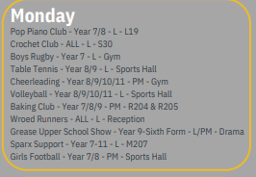
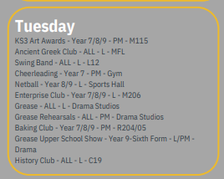
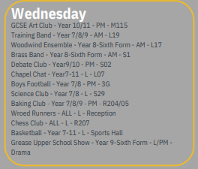
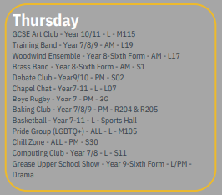
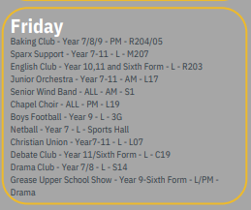

Slide 15
Christmas Fair
Saturday 7th December - 11am – 2pm
This is the most important fund-raising event in the school calendar, when staff, pupils and parents come together to raise vital funds for the school. The gifts should be brought into school and delivered to reception during the following weeks:

Slide 16

Year 9 Stall
Irish coffee & Mince pies:
We need…
  Coffee
  Brown sugar
  Cream
  Napkins
  Mince pies.

Slide 17
Year 9 Pathways
Mr D Slack
Associate Deputy Headteacher

Slide 18
Crompton House Curriculum
Our school aim and vision
As a Church of England school, we believe that all people are made and loved by God who longs for us to experience life in all its fullness through Jesus Christ.
Our School Mission
Loving God by placing prayer, worship and spiritual growth at the centre of school life
Caring for each other by living out Christian values in our relationships with one another
Achieving excellence by encouraging and enabling members of our school community to flourish by striving to do their best in all things

Slide 19
Pathways

Slide 20
Pathways
Year 9 is an important choice year the education of our students
These are decisions that are difficult to change, and are long-term commitments
Students need to ensure they have a clear understanding of how their choices can impact their career goals
Students need to make informed decisions about their future, that they are confident in.
Equally we want students to be supported towards the best outcomes at the end of Year 11

Slide 21
Pathways – A Timeline
December 2024 – Pathways Launch
December 2024 – Languages Assessments
January 2025 – Pathways Booklet Launched
January 2025 – Year 9 Short Report
January 2025 – Taster Sessions
January/February 2025 – Year 9 Parents Evening (30/01, 05/02)
February 2025 – Personalised Pathways Letter
March 2025 – Year 9 Pathways Evening (05/03)
March 2025 – Deadline for Choices (28th March)

Slide 22
Pathways
Students in KS4 (Y10/11) follow a core curriculum offer
Then…
Students then follow one of three pathways that help guide students towards their subject choices

Slide 23
Core Curriculum
English
  GCSE English Literature
  GCSE English Language
GCSE Maths
Science
  GCSE Combined Science
  Unless students have opted for Triple (Separate) Science as part of their Pathway choice
GCSE Religious Studies
  Course starts in Y9, so RS only has 3 lessons per fortnight (compared to other subjects which have 5)
Core PE
PSHE

Slide 24
Pathway subject choices
GCSE Subjects
Vocational Subjects
Art**
Business Studies
Computer Science**
Design Technology**
Drama
Food and Nutrition**
French
Geography
Graphic Communications**
History
Media Studies
Music**
PE**
Psychology
Separate Sciences (Triple)
Spanish
Sociology
OCR National Creative iMedia**
OCR National Design Engineering**
BTEC Hospitality and Catering**
L1/2 Certificate Music Technology**
OCR National Sports Studies**
BTEC Health and Social Care
** Students cannot do both of similar disciplined subjects

Slide 25
GCSE or Vocational?
At KS4 we offer a mixture of typical ‘GCSE’ subjects and Vocational subjects – these are awarded as BTEC or Cambridge National Qualifications
The grading works differently for both:
  GCSE 9-1
  BTEC/Cambridge National – Distinction*-Pass
BTEC/Cambridge National subjects are more practical and coursework based, and have less emphasis on examinations at the end of Year 11
In courses that offer a vocational route, e.g. PE, staff will work out which course is best for each student – things such as engagement with sport outside of school can be a determinate factor in GCSE PE vs Sports Studies

Slide 26
Ebacc
English Baccalaureate

Slide 27
Ebacc
English Baccalaureate
The EBacc at GCSE gives our students access to a full range of employment opportunities when they leave secondary school and the broad knowledge that employers are looking for
What subjects form the Ebacc?
English Language
English Literature
Maths
Science (Either Combined Award, or Separate/Triple Science)
Humanities (Either Geography or History)
Modern Foreign Languages

Slide 28
Ebacc
English Baccalaureate
The government recommends that all students study these subjects to keep a breadth of pathways open for young people after school.
Where does Crompton House stand on the Ebacc?
We recognise the value and merit in studying these subjects, and aim to be as aspirational as possible for each student in meeting the Ebacc criteria.
However we also recognise that this does not fit all students, and we therefore take a measured approach to the Ebacc.

Slide 29
Getting the right combination

Slide 30
Getting the right combination
Students should be encouraged to pick subjects that they enjoy, can be successful in, and also show a range of skills.
Research done by the Greater Manchester Combined Authority has highlighted growing employment opportunities for young people in the below areas:
  Construction/Green Economy
  Creatives and Culture
  Digital and Technology
  Education
  Engineering
  Finance
  Health and Social Care

Slide 31
The myths!
You do not need to do Triple/Separate Science to be a Doctor
Creative subjects such as Drama/Music are not just people wanting a career in these areas
Vocational qualifications like Health and Social Care are not easier – they are just assessed differently

Slide 32
Three Pathways

Slide 33
Three Pathways
School will determine which of the three pathways is most suitable for you.
Some of the core questions we ask as a school are:
  Is studying a language at KS4 the right decision for the child?
  Is studying a humanities subject the right decision for the child?

Slide 34
How is this determined?
In MFL, students work and aptitude will be looked at across KS3.
They will consider things such as:
  Assessments
  Aptitude in lessons
They will then determine whether or you have the aptitude to achieve a Grade 4 or above at GCSE in the language they have studied since Year 7.
This then helps to determine their initial pathway.

Slide 35
Three Pathways
Red Pathway
Yellow Pathway
Blue Pathway

Slide 36
Red Pathway
Core curriculum (English, Maths, Science, RS, PE)
4 additional subjects:
  Must follow a language
  Must follow History or Geography
  2 further choices (which could be the other of History/Geography not already picked, plus Triple Science)

Slide 37
Yellow Pathway
Core curriculum (English, Maths, Science, RS, PE)
4 additional subjects
  A language if desired
  History or Geography
    Optional if a language has been picked
    Compulsory if a language has not been picked
  2-3 other subjects (depending on MFL/Humanities Choices) – this can include Triple Science

Slide 38
Blue Pathway
Core curriculum
4 additional subjects
  Unlikely to follow a language – but this can be left to choice
  May follow additional courses to support Maths or English
  Choices of a range of other courses – including both GCSE and Vocational

Slide 39
How will this be communicated with you?
Students will have their Pathway confirmed by a letter home in February.
Students on the Blue Pathway will be invited in to meet with Mr Slack and Mrs Heywood (Assistant Headteacher – SENCO)

Slide 40
What guidance is available?

Slide 41
What guidance is available?
Assemblies
PSHE
Taster Lessons (e.g. Business Studies)
Future Pathways Booklet
Future Pathways evening, including a careers fair
Parents Evening
Optional meetings with HOY/CTL/SLT
Careers advice
School website

Slide 42
Final thoughts…

Slide 43
Final thoughts…
About 95% are on either the Red or Yellow Pathways – they offer the same choices, with the main difference being whether or not study of a language is compulsory
However in reality any student could pick any of the subjects that would ultimately match the criteria of the red pathway.
The vast majority of students are offered their first choice of subjects, however this cannot be guaranteed
Limited class numbers, and the construct of the timetable mean that submitted your different subject picks in order of priority is essential

Slide 44
Final thoughts…
Encourage your child to think about:
  What subjects do they enjoy?
  What subjects do they feel most successful in?
  A variety to show a range of skills
Also consider looking at different careers online – they help to give you an idea about subject options in school
But…
  Don’t pick based on friendships, or teachers!

Slide 45
Thank you

